Slide 1

GENETICS · MADE SIMPLE
Cracking the Code
of the Gene
Cistron, Recon & Muton — the Hidden Structure Inside Every Gene, Explained Simply
A Beginner-Friendly Guide

Slide 2






OVERVIEW
What We'll Learn
The Old Idea
Cracks in the Idea
Genes pictured as one solid, unbreakable brick
Clues that something didn't quite add up
Meet the Detective
The Big Reveal
Seymour Benzer's clever, simple experiment
A gene is a sentence, not a single word
Muton, Recon & Cistron
Old vs New
Three new building blocks, explained simply
How our picture of the gene changed forever
Cistron, Recon & Muton — The Molecular Gene, Made Simple
1

Slide 3
WHERE WE STARTED
The Old Idea: Gene = One Solid Brick
For decades, biologists pictured a chromosome as a string with genes strung along it like beads — each bead solid, whole, and separate from the next.
This “beads-on-a-string” idea said a gene was the smallest unit for everything: the smallest unit that mutates, the smallest unit that recombines, and the smallest unit that does a job.
GENE
GENE
GENE
GENE
GENE
GENE
GENE
Each bead = one whole, indivisible gene
This classical view came from Mendel and Morgan's work on inheritance — but it was about to be tested.
Cistron, Recon & Muton — The Molecular Gene, Made Simple
2
Notes:
Classical (Mendelian/Morgan) gene concept: the gene as the fundamental, indivisible unit of structure, function, mutation and recombination — 'beads on a string' on the chromosome. Sources: Morgan, T.H. (1910) 'Sex Limited Inheritance in Drosophila', Science; Mendel's laws of segregation and independent assortment as the conceptual foundation.

Slide 4


SOMETHING DIDN'T FIT
Cracks in the Model
Doctors and scientists kept noticing things the “solid brick” idea couldn't explain.
Garrod's Patients (1908)
Beadle & Tatum (1941)
A doctor named Archibald Garrod noticed that some inherited diseases were caused by a single missing chemical step in the body — as if one small part of a gene's job had failed.
Working with bread mold, they showed each gene seemed to control one specific enzyme — the famous “one gene, one enzyme” idea. But could a gene itself have smaller working parts?
Both pointed to the same question: does a gene have smaller working parts inside it?
Cistron, Recon & Muton — The Molecular Gene, Made Simple
3
Notes:
Garrod (1908) 'inborn errors of metabolism' (e.g., alkaptonuria) implied single-gene, single-biochemical-step defects. Beadle & Tatum (1941) Neurospora crassa experiments established the 'one gene-one enzyme' hypothesis (PNAS 27:499-506), raising the question of what internal structure a gene might have to specify a single enzymatic function.

Slide 5


THE BREAKTHROUGH BEGINS
Meet the Detective: Seymour Benzer
In the 1950s, geneticist Seymour Benzer chose a perfect tool for close-up detective work: a tiny virus called bacteriophage T4, which infects bacteria.
He studied a region of the virus's genes called rII — mutants here caused an easy-to-see difference in how the virus infected bacteria.
On E. coli strain B
On E. coli strain K12(λ)
Both normal and rII-mutant virus grow just fine
Normal virus grows — but rII mutants can't
A simple growth-or-no-growth test let Benzer detect thousands of tiny mutations, one by one.
Cistron, Recon & Muton — The Molecular Gene, Made Simple
4
Notes:
Benzer used the rII region of bacteriophage T4. rII+ (wild-type) phage grow on both E. coli B and E. coli K12(lambda); rII mutants grow on B but fail to grow on K12(lambda) (a host-range/plating-efficiency test). This simple, highly sensitive assay allowed detection of extremely rare recombination and mutation events, enabling fine-structure mapping at near-nucleotide resolution. Source: Benzer, S. (1955) 'Fine Structure of a Genetic Region in Bacteriophage', PNAS 41:344-354; Benzer (1961) 'On the Topography of the Genetic Fine Structure', PNAS 47:403-415.

Slide 6
THE BIG REVEAL
A Gene Is Like a Sentence, Not a Word
By finding and mapping thousands of separate mutations inside the rII region, Benzer showed a gene isn't one indivisible brick.
It's more like a sentence written in a 4-letter chemical alphabet — A, T, G and C — and almost any single letter inside it can change.
A
T
G
C
T
A
C
G
G
A
T
C
C
G
T
A
A
C
G
T
one short stretch of a gene — 20 “letters” of DNA
This meant a gene should have internal structure — smaller parts with their own identity. Benzer needed names for these parts.
Cistron, Recon & Muton — The Molecular Gene, Made Simple
5
Notes:
Benzer's fine-structure mapping of the rII locus (recombination + deletion mapping) revealed that mutations could be mapped to distinct, extremely small sites within the gene, down to the level of single base pairs — demonstrating that the gene has internal linear structure divisible by both mutation and recombination. Source: Benzer, S. (1957) 'The Elementary Units of Heredity', in The Chemical Basis of Heredity; Benzer (1959) 'On the Topology of the Genetic Fine Structure', PNAS 45:1607-1620.

Slide 7
BUILDING BLOCK 1
Meet Muton — the Smallest Possible Typo
The MUTON is the smallest unit that can change (mutate) — and it can be as small as a single DNA letter.
Change just one letter, and the “sentence” can carry a typo — sometimes enough to break the whole message.
A
T
G
C
T
A
C
G
G
A
T
C
C
G
T
A
A
C
G
T
MUTON —
1 changed letter
It's the genetic equivalent of a single mistyped letter changing the meaning of a whole word.
Cistron, Recon & Muton — The Molecular Gene, Made Simple
6
Notes:
Muton: the smallest genetic unit capable of independent mutation, operationally shown by Benzer to be as small as a single nucleotide pair — the smallest possible change in the DNA sequence. Source: Benzer, S. (1957) 'The Elementary Units of Heredity'.

Slide 8
BUILDING BLOCK 2
Meet Recon — the Smallest Swappable Piece
The RECON is the smallest chunk of DNA that can be swapped between two copies of a chromosome during recombination.
In principle, that chunk can be as small as a single letter too — but in practice it's usually a short stretch.
A
T
G
C
T
A
C
G
G
A
T
C
C
G
T
A
A
C
G
T
RECON —
smallest swappable chunk
Think of it like the smallest piece two puzzle-makers could trade and still get a piece that fits.
Cistron, Recon & Muton — The Molecular Gene, Made Simple
7
Notes:
Recon: the smallest unit of recombination — the smallest segment of DNA that can be exchanged (recombined) between homologous chromosomes without being subdivided further. Benzer's recombination frequency data suggested this too could approach single base-pair resolution, though limited by practical detection frequencies. Source: Benzer, S. (1957) 'The Elementary Units of Heredity'.

Slide 9

BUILDING BLOCK 3
Meet Cistron — a Stretch That Does One Job
The CISTRON is a longer stretch of DNA that acts as one functional unit — usually, what we'd now call a gene.
A
T
G
C
T
A
C
G
G
A
T
C
C
G
T
A
A
C
G
T
CISTRON A
CISTRON B
Two different cistrons = two separate jobs, sitting side by side
The “Two Broken Flashlights” Test
Dead battery + broken bulb → parts combine, light turns on
Two dead batteries → no working part to share, still dark
Different broken part → CAN help each other → different cistrons
Same broken part → CANNOT help each other → same cistron
Cistron, Recon & Muton — The Molecular Gene, Made Simple
8
Notes:
Cistron: a genetic unit defined operationally by the cis-trans complementation test (Benzer coined the term in 1957 as a substitute for 'gene'). Two mutations fail to complement (no wild-type function when both present in trans) if they lie in the same cistron/functional unit; they complement (restore function) if in different cistrons — analogous to two broken flashlights: different broken parts (battery vs bulb) can be pooled to make one working flashlight (complementation, different genes); the same broken part in both cannot be pooled (no complementation, same gene/cistron). Source: Benzer, S. (1957) 'The Elementary Units of Heredity', in The Chemical Basis of Heredity (McElroy & Glass, eds.); the cis-trans test itself traces to Lewis (1951).

Slide 10
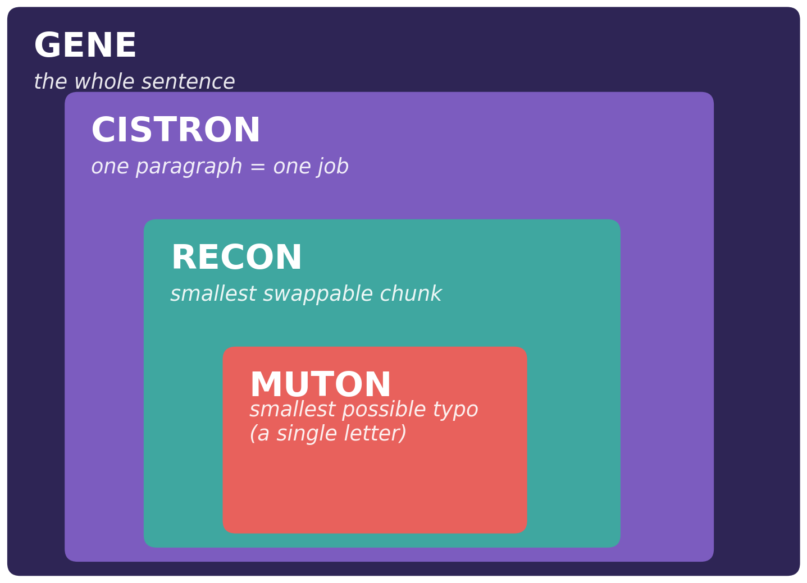
PUTTING IT TOGETHER
Gene, Cistron, Recon, Muton — Nested Like Boxes
GENE
CISTRON
RECON
MUTON
the whole functional stretch
one paragraph = one job (≈ a gene)
smallest swappable chunk
smallest possible typo, 1 letter
Size order: Muton ≤ Recon ≤ Cistron ≤ Gene
Cistron, Recon & Muton — The Molecular Gene, Made Simple
9
Notes:
Benzer's fine-structure analysis established a nested hierarchy: the cistron (functional unit, defined by complementation) is composed of many recons (recombinational units) which are in turn composed of many mutons (mutational units); in the smallest theoretical case muton = recon = a single base pair, while a cistron typically spans hundreds to thousands of base pairs. Source: Benzer, S. (1957) 'The Elementary Units of Heredity'.

Slide 11
A CHANGED PICTURE
Old vs New: How the Gene Concept Changed
CLASSICAL VIEW
MOLECULAR VIEW
Smallest unit of mutation
The whole gene
A single base pair (muton)
Smallest unit of recombination
The whole gene
As small as one base pair (recon)
Smallest unit of function
The whole gene
The cistron (still ≈ one gene)
Internal structure
None — solid and indivisible
Linear, divisible, mappable in fine detail
Cistron, Recon & Muton — The Molecular Gene, Made Simple
10
Notes:
Summary comparison of classical (Mendelian/Morgan-era) vs molecular (Benzer-era) gene concepts across the criteria of mutation, recombination, and function. The cistron remains functionally close to the classical 'gene', but muton and recon revealed that mutation and recombination act at a much finer scale than the gene itself.

Slide 12


THE BIGGER PAYOFF
Why It Mattered
Cracking the Genetic Code
Gene ↔ Protein Colinearity
Because mutons could be single letters, Crick, Brenner and colleagues (1961) used rII mutants to show the genetic code is read three letters at a time — the triplet code.
Yanofsky and colleagues (1964) showed the order of mutations along a gene matches the order of altered amino acids in its protein — confirming DNA's sequence directly spells out a protein's sequence.
Cistron, Recon & Muton — The Molecular Gene, Made Simple
11
Notes:
Crick, F.H.C., Barnett, L., Brenner, S., & Watts-Tobin, R.J. (1961) 'General Nature of the Genetic Code for Proteins', Nature 192:1227-1232 — used rII frameshift mutants to demonstrate the triplet, non-overlapping, comma-free nature of the genetic code. Yanofsky, C., et al. (1964) 'On the Colinearity of Gene Structure and Protein Structure', PNAS 51:266-272 — demonstrated colinearity between the tryptophan synthetase gene's mutational map and its protein's amino-acid sequence, directly building on Benzer's fine-structure mapping methodology.

Slide 13
SUMMARY
Key Takeaways
1
The classical gene was pictured as one solid, indivisible unit of structure, mutation, and function.
2
Seymour Benzer's rII experiments in bacteriophage T4 showed a gene actually has fine internal structure.
3
Muton = the smallest unit that can mutate — as small as a single DNA letter.
4
Recon = the smallest unit that can be swapped by recombination.
5
Cistron = a stretch of DNA that does one job, defined by the “broken flashlights” complementation test.
6
This discovery helped crack the triplet genetic code and prove gene–protein colinearity.

Slide 14
REFERENCES
References & Further Reading
Morgan, T. H. (1910). Sex limited inheritance in Drosophila. Science, 32(812), 120–122.
Garrod, A. E. (1908). Inborn errors of metabolism. The Lancet, 172(4427), 1–7.
Beadle, G. W., & Tatum, E. L. (1941). Genetic control of biochemical reactions in Neurospora. PNAS, 27(11), 499–506.
Benzer, S. (1955). Fine structure of a genetic region in bacteriophage. PNAS, 41(6), 344–354.
Benzer, S. (1957). The elementary units of heredity. In The Chemical Basis of Heredity (McElroy & Glass, eds.), Johns Hopkins Press.
Benzer, S. (1959). On the topology of the genetic fine structure. PNAS, 45(11), 1607–1620.
Benzer, S. (1961). On the topography of the genetic fine structure. PNAS, 47(3), 403–415.
Crick, F. H. C., Barnett, L., Brenner, S., & Watts-Tobin, R. J. (1961). General nature of the genetic code for proteins. Nature, 192, 1227–1232.
Yanofsky, C., et al. (1964). On the colinearity of gene structure and protein structure. PNAS, 51(2), 266–272.
Cistron, Recon & Muton — The Molecular Gene, Made Simple
12

