Slide 1

GENETICS · FINE-STRUCTURE ANALYSIS
Classical vs. Molecular
Concepts of the Gene
Cistron · Recon · Muton — Fine-Structure Analysis of the rII Locus in Bacteriophage T4
A Postgraduate Seminar in Molecular Genetics

Slide 2







OVERVIEW
What We Will Cover
Classical Gene Concept
Cracks in the Model
The “beads on a string” model of Morgan and Sturtevant
Garrod, Beadle & Tatum, and the rise of the biochemical gene
Benzer's rII System
Fine-Structure & Deletion Mapping
An ultrasensitive phage assay for detecting rare recombinants
Ordering thousands of mutations to the nucleotide
Cistron, Recon, Muton
Classical vs. Molecular Gene
Function, recombination, and mutation — redefined at the molecular level
A side-by-side synthesis of the two concepts
Legacy
The triplet code, colinearity, and today's more flexible gene concept
Classical vs. Molecular Concepts of the Gene
1

Slide 3
THE CLASSICAL VIEW · PRE-1950S
The Gene as a “Bead on a String”
Mendel (1866) treated the gene as an abstract “unit factor” controlling one trait, transmitted intact from parent to offspring.
Morgan, Sturtevant & Muller (1910s–1930s) localized genes to fixed positions (“loci”) on chromosomes, ordered like beads strung along a wire.
A gene was treated as a single, indivisible unit that simultaneously served as the unit of structure, function, mutation, AND recombination.
Three Load-Bearing Assumptions
1
Structural indivisibility
Recombination occurs between genes — never within one.
2
Mutational unity
A gene changes wholesale from one allelic state to another.
3
Functional atomicity
A gene is wholly functional or wholly non-functional; it has no “parts.”
Each “bead” = one indivisible gene locus on the chromosome (red = a mutant gene)
Classical vs. Molecular Concepts of the Gene
2
Notes:
Classical genetics (Mendel through Morgan/Sturtevant/Muller) treated the gene as the smallest unit of heredity: indivisible by recombination or mutation, and equivalent to the unit of function. Source: Morgan, T.H. (1910) Science 32:120-122; standard treatment in Griffiths et al., Introduction to Genetic Analysis; Snustad & Simmons, Principles of Genetics.

Slide 4
TOWARD A BIOCHEMICAL GENE · 1900S–1940S
From Trait to Enzyme: the Biochemical Gene
Garrod (1902–1909)
Beadle & Tatum (1941)
Later refinement
Studied “inborn errors of metabolism” such as alkaptonuria and proposed that one mutant gene blocks one specific step in a metabolic pathway.
X-ray-induced auxotrophic mutants of Neurospora crassa each lost exactly one enzyme activity — the “one gene–one enzyme” hypothesis. Awarded the Nobel Prize in 1958.
Many enzymes are built from more than one polypeptide chain, each separately encoded — sharpened to “one gene–one polypeptide” (e.g. tryptophan synthetase, haemoglobin).
Genes were now understood to act through discrete molecular products — but the internal architecture of the gene itself remained unknown. Answering that required a new experimental system: bacteriophage.
Classical vs. Molecular Concepts of the Gene
3
Notes:
Garrod's 'inborn errors of metabolism' (alkaptonuria, etc.) anticipated Beadle & Tatum's 1941 one-gene-one-enzyme hypothesis from Neurospora crassa mutants (Beadle & Tatum, 1941, PNAS 27:499-506), which won the 1958 Nobel Prize. Multi-subunit proteins later required the 'one gene-one polypeptide' refinement.

Slide 5
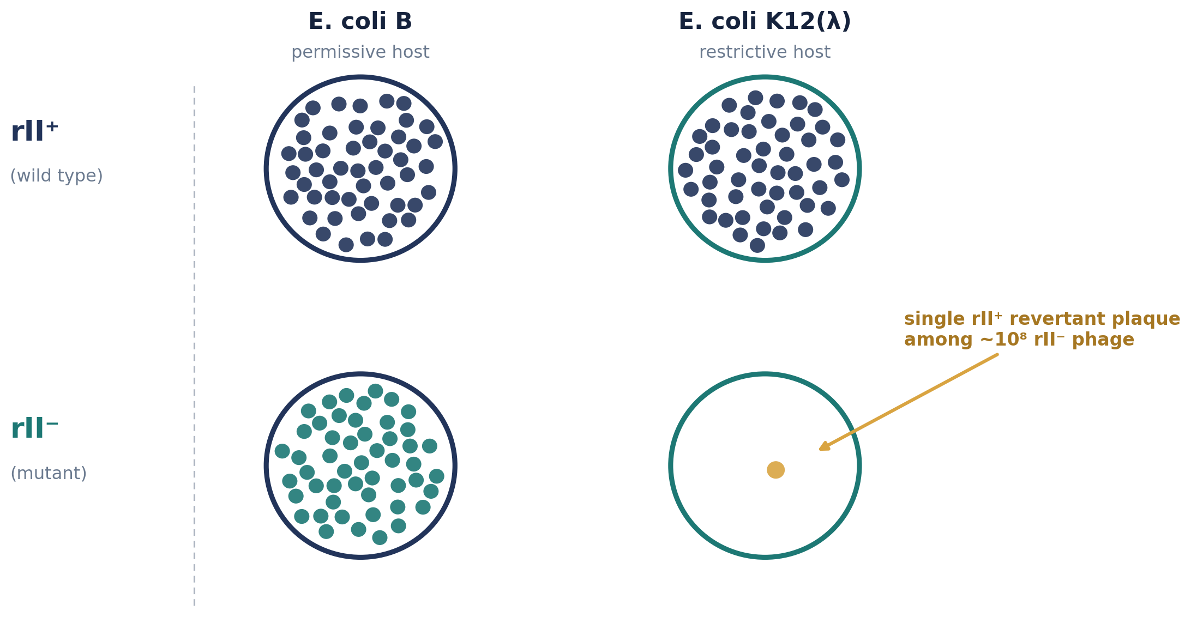
THE EXPERIMENTAL SYSTEM · SEYMOUR BENZER, 1950S–60S
A Phage System of Extraordinary Power
Seymour Benzer, trained as a physicist, joined the Cold Spring Harbor phage course and worked with André Lwoff at the Pasteur Institute.
He chose rII mutants of bacteriophage T4 — easily scored by their “rapid lysis” plaque morphology on E. coli B.
The decisive trick: rII⁻ mutants cannot form plaques on E. coli K12(λ), while rII⁺ (wild type) can — a “restrictive” host that acts as a molecular sieve.
A single rII⁺ revertant among 10⁸ mutant phage produces a visible plaque — a resolving power far beyond classical recombination mapping in eukaryotes.
Classical vs. Molecular Concepts of the Gene
4
Notes:
Benzer's system exploited the rII locus of T4: rII mutants lyse E. coli B rapidly (visible as large plaques) but cannot grow on E. coli K12 lysogenic for phage lambda [K12(λ)], while wild-type phage can grow on both. Source: Benzer, S. (1955) PNAS 41:344-354; historical account in Resonance 13:898-908 (Indian Academy of Sciences).

Slide 6
METHOD · RECOMBINATION MAPPING
Mapping Mutations to the Nucleotide
Two rII⁻ mutants co-infect E. coli B; the progeny are plated on K12(λ) — only rII⁺ recombinants can form plaques there.
Recombination frequency between two mutations is converted directly into a physical map distance between their sites.
The smallest resolvable recombination frequency was about 0.02%, corresponding to roughly one to two base pairs (Benzer, 1959).
The T4 genome spans about 1500 map units ≈ 1.5×10⁵ base pairs — so 1 map unit ≈ 100 bp.
~2,000
point mutants isolated and mapped
304
distinguishable mutable sites resolved
1–2 bp
finest resolvable map distance
Recombination frequency = (2 × wild-type plaques) / (total plaques) × 100
Classical vs. Molecular Concepts of the Gene
5
Notes:
Recombination frequency = (2 x wild-type plaque count)/(total plaque count) x 100, converted to map units; smallest observed value ~0.02% implying resolution to 1-2 base pairs. Source: Benzer, S. (1959) 'On the topology of the genetic fine structure.' PNAS 45:1607-1620; Benzer (1961) PNAS 47:403-415; Snustad & Simmons, Principles of Genetics.

Slide 7
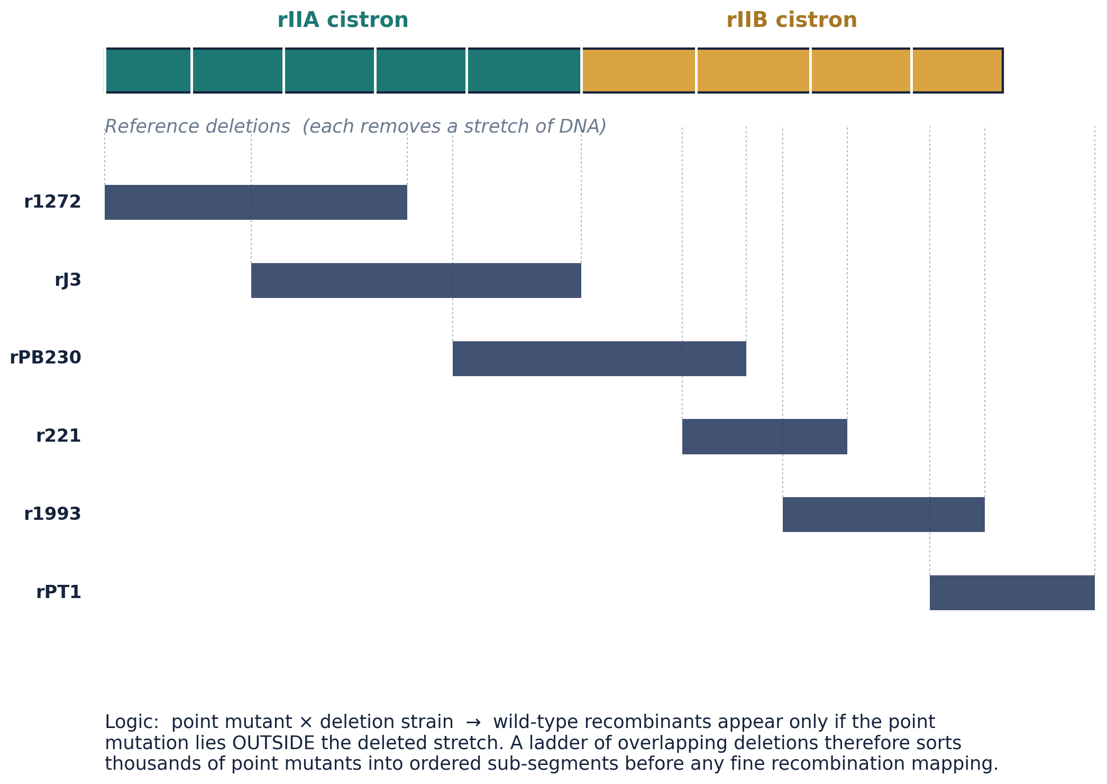
METHOD · DELETION MAPPING
Sorting Thousands of Mutants with Deletions
Classical vs. Molecular Concepts of the Gene
6
Notes:
Benzer used stable deletion mutants (which neither revert nor recombine within the deleted region) as a coarse sieve: crossing ~2000 point mutants against a small panel of overlapping deletions sorted them into ordered sub-segments before fine recombination mapping between individual point mutants. Source: Benzer, S. (1961) 'On the topography of the genetic fine structure.' PNAS 47:403-415.

Slide 8
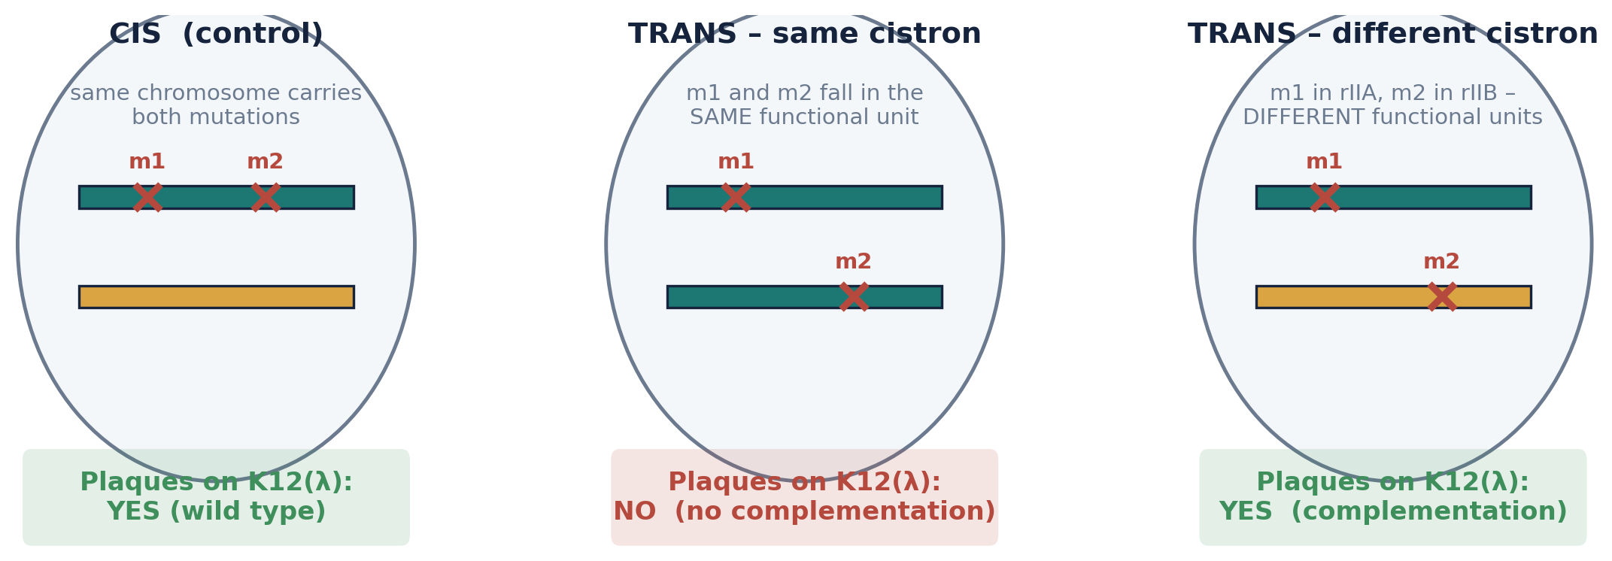
METHOD · THE COMPLEMENTATION TEST
The Cis-Trans (Complementation) Test
Two rII⁻ mutants co-infect E. coli K12(λ) — a host on which neither mutant alone can grow.
Different genes: each chromosome supplies the wild-type product the other lacks → complementation → plaques form.
Same gene: neither chromosome can supply a working product → no complementation → no plaques.
Classical vs. Molecular Concepts of the Gene
7
Notes:
The cis configuration (both mutations on one chromosome, the other wild type) is the essential control and must always give the wild-type phenotype. Source: Benzer, S. (1957) 'The elementary units of heredity.' In The Chemical Basis of Heredity, Johns Hopkins Press, pp.70-93.

Slide 9
THE MOLECULAR UNITS · I
Cistron — the Unit of Function
Benzer coined “cistron” (1957) for the functional unit revealed by the complementation test — the region within which two mutations cannot complement.
Applying the test across ~2,000 rII mutants sorted them into exactly two complementation groups: rIIA and rIIB.
rIIA and rIIB are functionally independent: a mutation in A is complemented by a wild-type B region, and vice versa.
Crucial distinction: a “cistron” is not simply a synonym for the classical “gene” — it is operationally defined by a test, not by map position alone.
rII Locus = 2 Cistrons
rIIA
rIIB
independent functional units, each complementable by a wild-type copy of the other
2 → 1957
cistrons identified; term coined by Benzer
Classical vs. Molecular Concepts of the Gene
8
Notes:
Cistron: Benzer, S. (1957) 'The elementary units of heredity,' in The Chemical Basis of Heredity (McElroy & Glass, eds.), Johns Hopkins Press, pp.70-93; complementation groups rIIA/rIIB established via the cis-trans test on E. coli K12(λ).

Slide 10
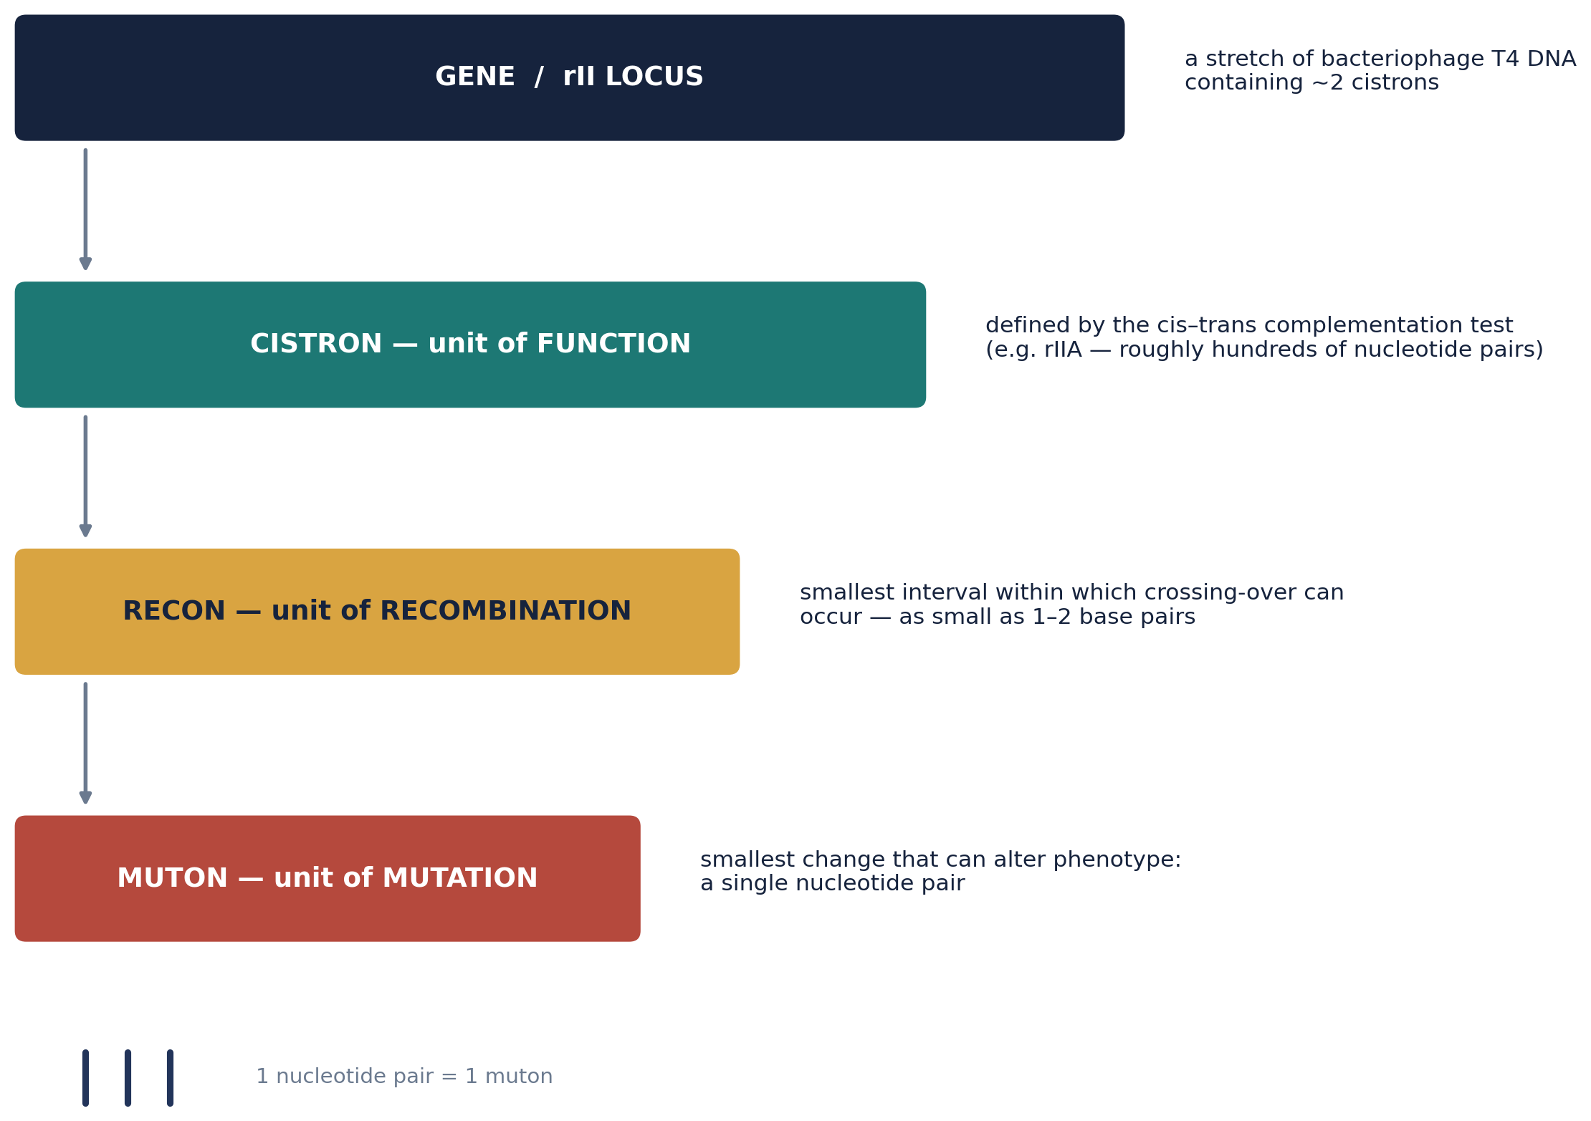
THE MOLECULAR UNITS · II
Recon and Muton — Redefining Recombination and Mutation
Classical vs. Molecular Concepts of the Gene
9
Notes:
Recon = smallest unit within which recombination can occur (Benzer's data implied intervals as small as 1-2 bp). Muton = smallest unit capable of mutation, ultimately a single nucleotide pair. Source: Benzer, S. (1957) 'The elementary units of heredity'; Benzer (1961) PNAS 47:403-415.

Slide 11
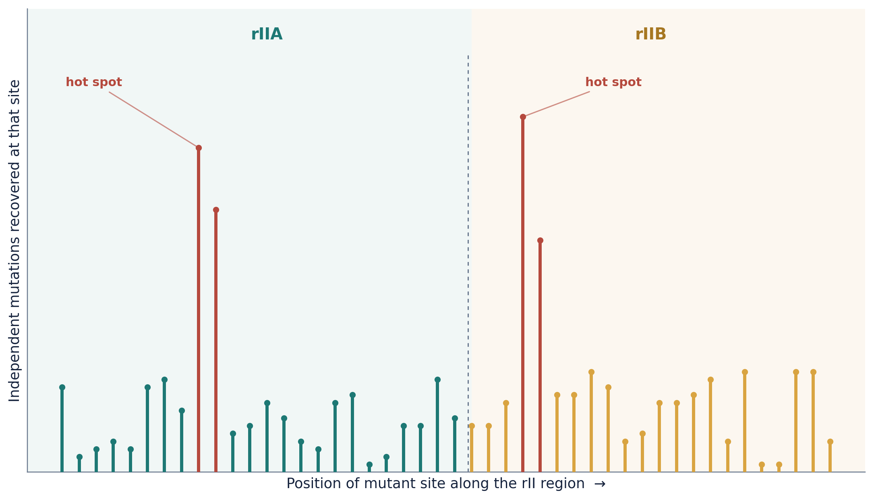
THE RESULT
The Fine-Structure Map of rII
~2,400 → 304
highly non-random
300–500
mutants collapsed onto 304 mappable sites
mutation frequency varies enormously by site
independent mutations recur at a single “hot spot”
Classical vs. Molecular Concepts of the Gene
10
Notes:
Benzer mapped ~2400 rII mutants to 304 sites separable by recombination across the two cistrons; distribution of mutations was strongly non-random, with 'hot spots' carrying 300-500 independently isolated mutations versus many singleton sites. Source: Benzer, S. (1961) PNAS 47:403-415; Snustad & Simmons, Principles of Genetics.

Slide 12
SYNTHESIS
Classical Gene vs. Molecular Gene
Feature | Classical Concept | Molecular Concept (Benzer)
Basic unit | Indivisible “bead” on the chromosome | Divisible sequence of nucleotide pairs
Unit of function | = the gene, as a whole | Cistron (defined by the complementation test)
Unit of recombination | = the gene; crossing-over only between genes | Recon — as small as 1–2 base pairs
Unit of mutation | = the gene; mutation changes the entire gene | Muton — a single nucleotide pair
How defined | By phenotype and chromosomal map position | By operational tests: recombination & complementation
Relationship of the units | Identical — one unit performs all roles | Distinct & hierarchical: gene > cistron > recon > muton
Classical vs. Molecular Concepts of the Gene
11
Notes:
Synthesis comparing the pre-molecular ('classical') and Benzer-era ('molecular') gene concepts. Sources: Benzer (1955, 1957, 1959, 1961); Snustad & Simmons, Principles of Genetics; Griffiths et al., Introduction to Genetic Analysis.

Slide 13
LEGACY · I
From rII to the Genetic Code
r1589
Benzer's mutant r1589 (a deletion spanning both cistron boundaries, fusing rIIA and rIIB) became a key tool for testing the reading-frame nature of the genetic code.
1961
Crick, Barnett, Brenner & Watts-Tobin (Nature 192:1227–1232) used rII frameshift mutations to show the code is read in non-overlapping triplets — the famous “+/−” experiment.
1964
Yanofsky et al. demonstrated colinearity: the linear order of mutable sites within a gene matches the linear order of altered amino acids in its polypeptide product.
The rII system became the proving ground for the central dogma of molecular biology.
Classical vs. Molecular Concepts of the Gene
12
Notes:
Crick, F.H.C., Barnett, L., Brenner, S., Watts-Tobin, R.J. (1961) 'General nature of the genetic code for proteins.' Nature 192:1227-1232. Yanofsky, C. et al. (1964) 'On the colinearity of gene structure and protein structure.' PNAS 51:266-272.

Slide 14
LEGACY · II
The Gene Concept Keeps Evolving
1960s–70s
Overlapping genes and “genes-within-genes” complicate the simple colinear model.
1970s
Split genes and introns are discovered in eukaryotes — a cistron is no longer a simple, uninterrupted stretch of DNA.
Today
Alternative splicing, overlapping reading frames, and regulatory RNAs further blur where one “gene” ends and another begins.
“The definition of the gene needs to remain somewhat pliable if it is to encompass all of the different structure–function relationships that occur in living organisms.”
Classical vs. Molecular Concepts of the Gene
13
Notes:
Modern complications to the simple colinear/cistron model: overlapping genes, split genes/introns (discovered late 1970s), alternative splicing, and regulatory RNAs. Framing per Snustad & Simmons, Principles of Genetics (evolution-of-the-gene-concept chapter).

Slide 15
SUMMARY
Key Takeaways
1
The classical gene was one indivisible unit of structure, function, mutation, and recombination.
2
Benzer's rII system in phage T4 gave unmatched resolving power to test that assumption directly.
3
The gene proved divisible: cistron (function), recon (recombination), and muton (mutation) are distinct, nested units.
4
The smallest recon and muton approach the single base pair — the ultimate molecular limit.
5
This work laid the operational and conceptual foundation for molecular genetics, including the triplet code and colinearity.

Slide 16
REFERENCES
References & Further Reading
Benzer, S. (1955). Fine structure of a genetic region in bacteriophage. Proceedings of the National Academy of Sciences, 41(6), 344–354.
Benzer, S. (1956). Genetic fine structure and its relation to the DNA molecule. Brookhaven Symposia in Biology, 8, 3–16.
Benzer, S. (1957). The elementary units of heredity. In W. D. McElroy & B. Glass (Eds.), The Chemical Basis of Heredity (pp. 70–93). Johns Hopkins Press.
Benzer, S. (1959). On the topology of the genetic fine structure. Proceedings of the National Academy of Sciences, 45(11), 1607–1620.
Benzer, S. (1961). On the topography of the genetic fine structure. Proceedings of the National Academy of Sciences, 47(3), 403–415.
Crick, F. H. C., Barnett, L., Brenner, S., & Watts-Tobin, R. J. (1961). General nature of the genetic code for proteins. Nature, 192, 1227–1232.
Yanofsky, C., et al. (1964). On the colinearity of gene structure and protein structure. Proceedings of the National Academy of Sciences, 51(2), 266–272.
Beadle, G. W., & Tatum, E. L. (1941). Genetic control of biochemical reactions in Neurospora. Proceedings of the National Academy of Sciences, 27(11), 499–506.
Morgan, T. H. (1910). Sex limited inheritance in Drosophila. Science, 32(812), 120–122.
Griffiths, A. J. F., Wessler, S. R., Carroll, S. B., & Doebley, J. (2020). Introduction to Genetic Analysis (12th ed.). W. H. Freeman.
Snustad, D. P., & Simmons, M. J. Principles of Genetics (7th ed.). Wiley.
Lewin, B. (2000). Genes VII. Oxford University Press.
Classical vs. Molecular Concepts of the Gene
14

