Slide 1
MOLECULAR BASIS OF GENE MUTATIONS

Slide 2
Mutation – a heritable change in genetic information
Gene mutation/Point mutation/Base mutation – a change in a particular gene
Base substitution
Frame-shift mutation
  Insertion/addition
  Deletion

Slide 4
BASE SUBSTITUTIONS
The simplest type of gene mutation is a base substitution, the alteration of a single nucleotide in the DNA. There are two types of base substitutions. In a transition, a purine is replaced by a different purine or, alternatively, a pyrimidine is replaced by a different pyrimidine. In a transversion, a purine is replaced by a pyrimidine or a pyrimidine is replaced by a purine. The number of possible transversions is twice the number of possible transitions, but transitions arise more frequently because transforming a purine into a different purine or a pyrimidine into a different pyrimidine is easier than transforming a purine into a pyrimidine, or vice versa.

Slide 5
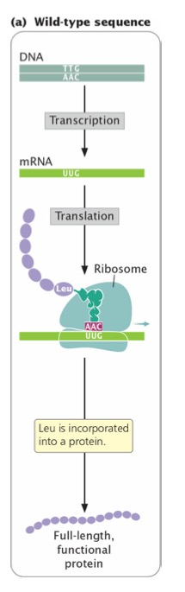
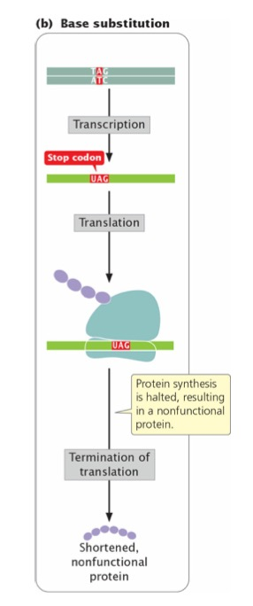
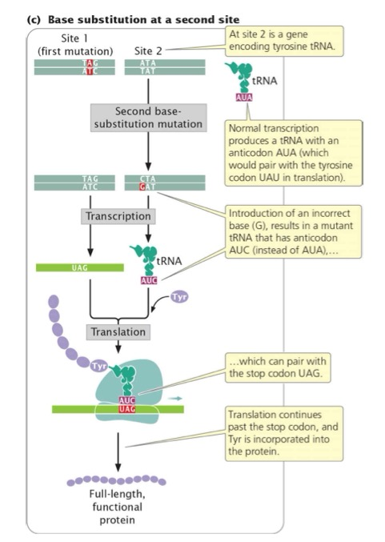

Slide 6
INSERTIONS AND DELETIONS
Insertions and deletions are collectively called indels: the addition or removal,
respectively, of one or more nucleotide pairs
Insertions and deletions are often more frequent. Insertions and deletions within sequences that encode proteins may lead to frameshift mutations: changes in the reading frame of the gene.
Frameshift mutations usually alter all amino acids encoded by the nucleotides following the mutation, so they generally have drastic effects on the phenotype. Some frameshifts also introduce premature stop codons, terminating protein synthesis early and resulting in a shortened (truncated) protein. Not all insertions and deletions lead to frameshifts, however; insertions and deletions consisting of any multiple of three nucleotides leave the reading frame intact, although the addition or removal of one or more amino acids may still affect the phenotype.
Indels that do not affect the reading frame are called in-frame insertions and in-frame deletions.

Slide 7
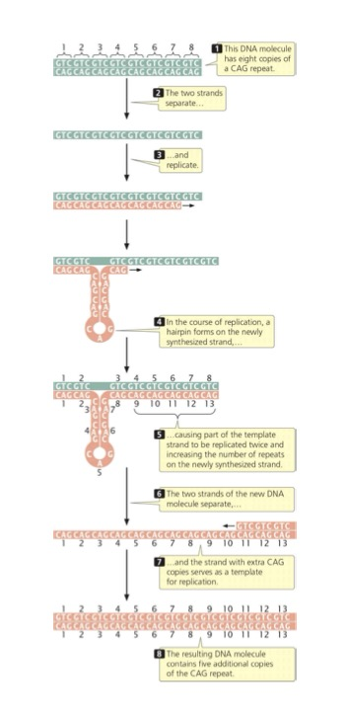

Slide 9
BASE ANALOGS
Base analogs - chemicals with structures similar to those of any of the four standard nitrogenous bases of DNA.
If base analogs are present during replication, they may be incorporated into newly synthesized DNA molecules.
5-bromouracil (5BU) is an analog of thymine; it has the same structure as thymine except that it has a bromine (Br) atom on the 5- carbon atom instead of a methyl group. Normally, 5BU pairs with adenine just as thymine does, but it occasionally mispairs with guanine, leading to a transition (T • A → 5BU • A → 5BU • G → C • G). Through mispairing, 5BU can also be incorporated into a newly synthesized DNA strand opposite guanine. In the next round of replication, 5BU pairs with adenine, leading to another transition (G • C → G • 5BU → A • 5BU → A • T).
2-aminopurine (2AP), which is a base analog of adenine. Normally, 2AP base pairs with thymine, but it may mispair with cytosine, causing a transition (T • A →T • 2AP → C • 2AP → C • G). Alternatively, 2AP may be incorporated through mispairing into the newly synthesized DNA opposite cytosine and then later pair with thymine, leading to a C • G → C • 2AP → T • 2AP → T • A transition.

