Slide 1
ROLE OF TRANSPOSON IN MUTATION

Slide 2
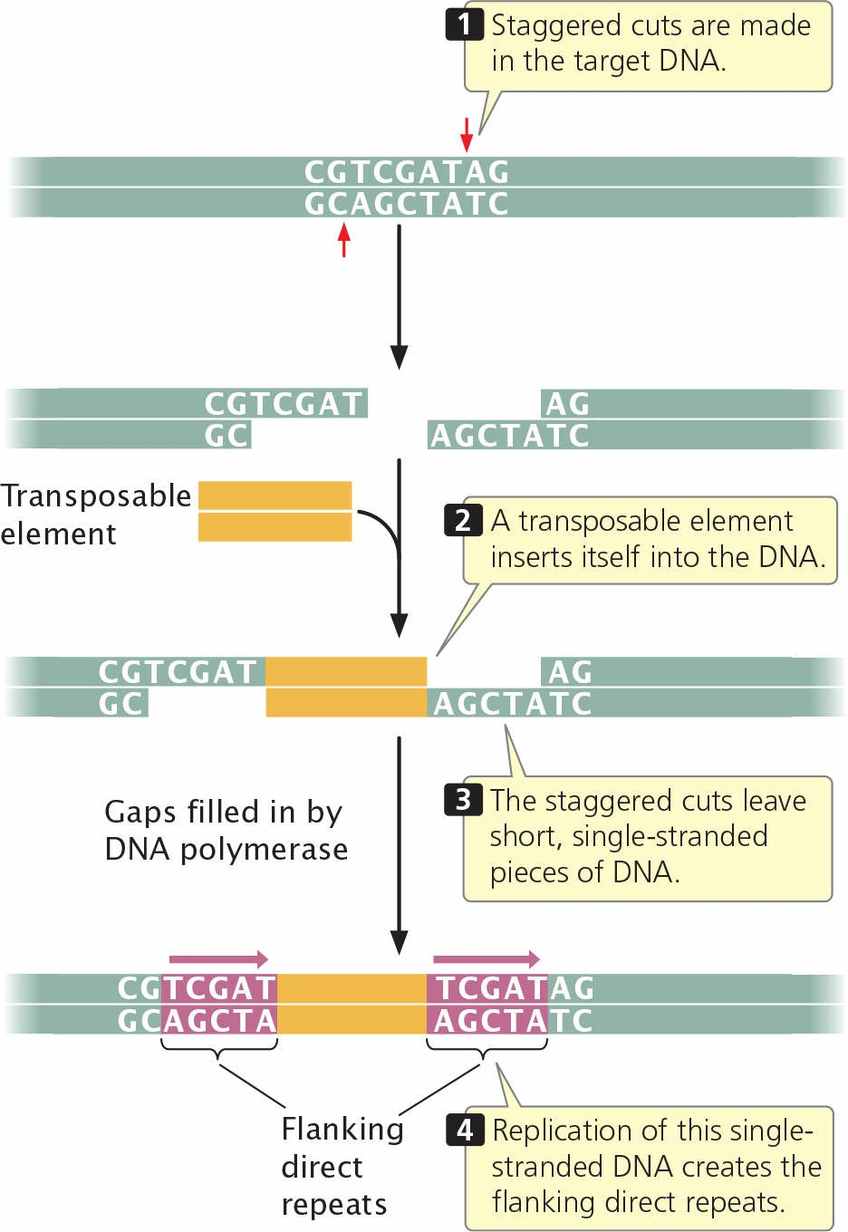
Fig. Flanking direct repeats are generated when a transposable element inserts into DNA.
Source: Genetics- A conceptual approach (by Benjamin A. Pierce; 8th edition)

Slide 3
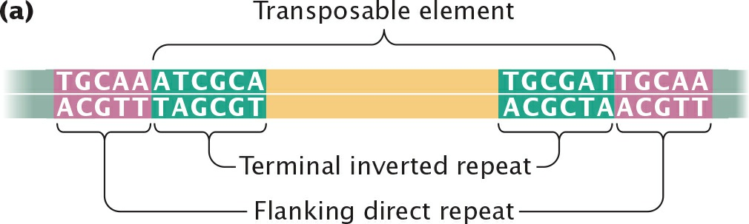
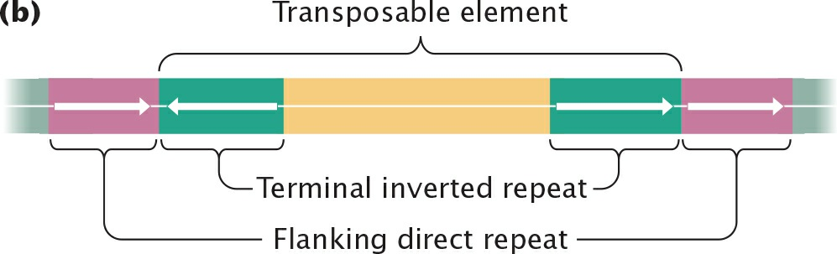
Fig. Many transposable elements have common characteristics.
Source: Genetics- A conceptual approach (by Benjamin A. Pierce; 8th edition)

Slide 4
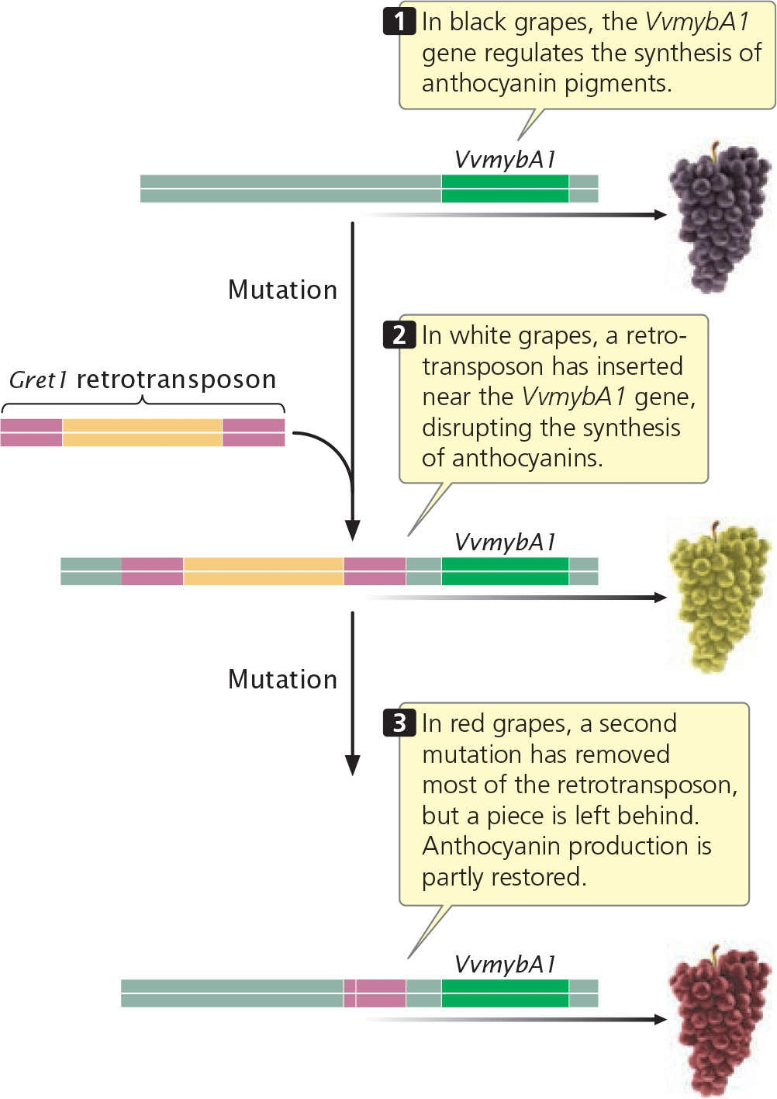
Fig. White and red color in grapes resulted from insertion and deletion of a retrotransposon, respectively.
Source: Genetics- A conceptual approach (by Benjamin A. Pierce; 8th edition)

