Slide 1
DNA REPAIR MECHANISMS

Slide 2
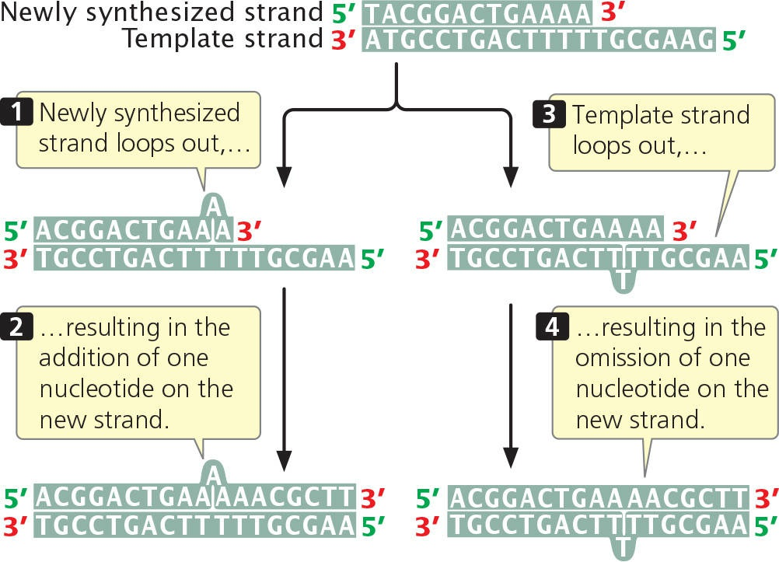
Fig. Insertion and deletion may result from strand slippage
Source: Genetics- A conceptual approach (by Benjamin A. Pierce; 8th edition)

Slide 3
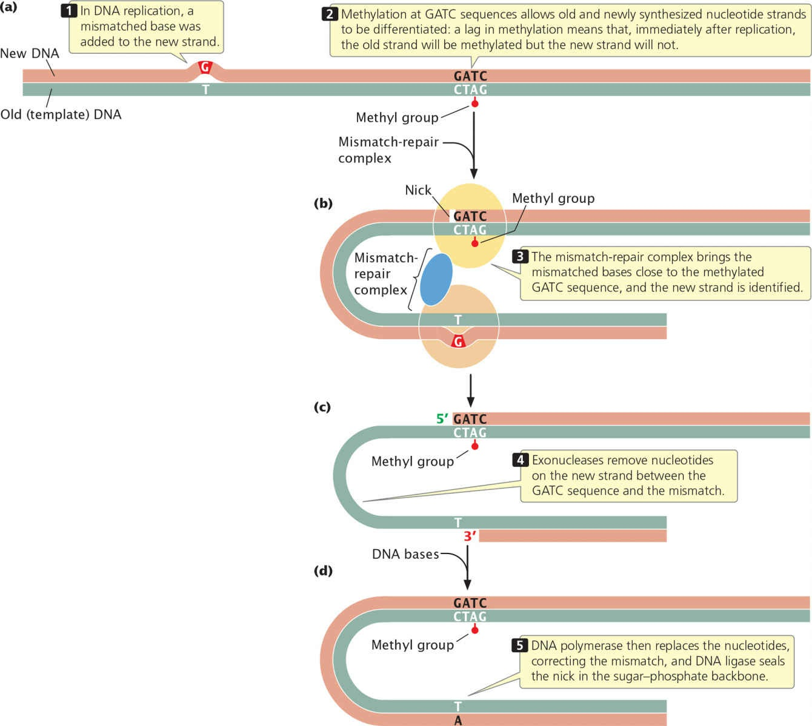
Fig. Mismatch repair
Source: Genetics- A conceptual approach (by Benjamin A. Pierce; 8th edition)

Slide 4
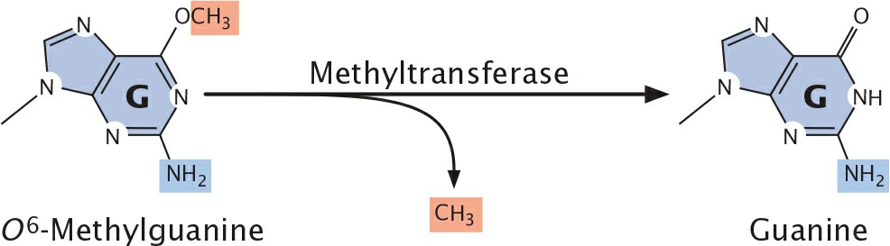
Fig. Direct repair
Source: Genetics- A conceptual approach (by Benjamin A. Pierce; 8th edition)

Slide 5
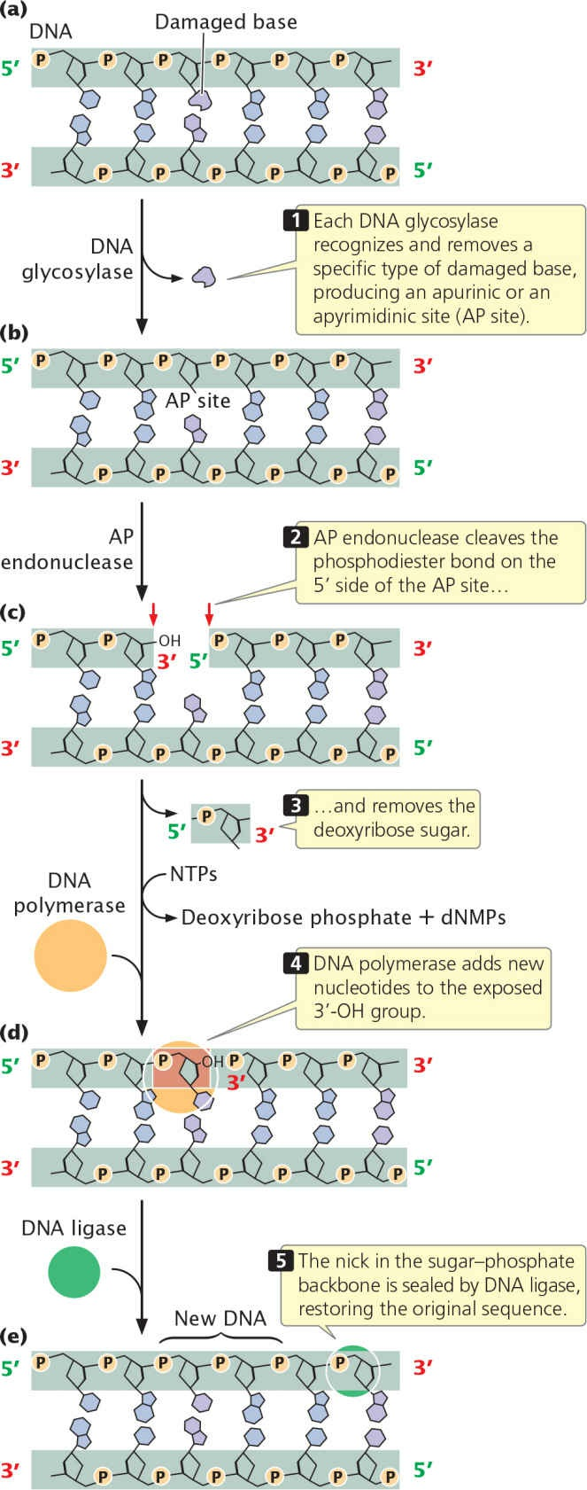
Fig. Base-excision repair
Source: Genetics- A conceptual approach (by Benjamin A. Pierce; 8th edition)

Slide 6
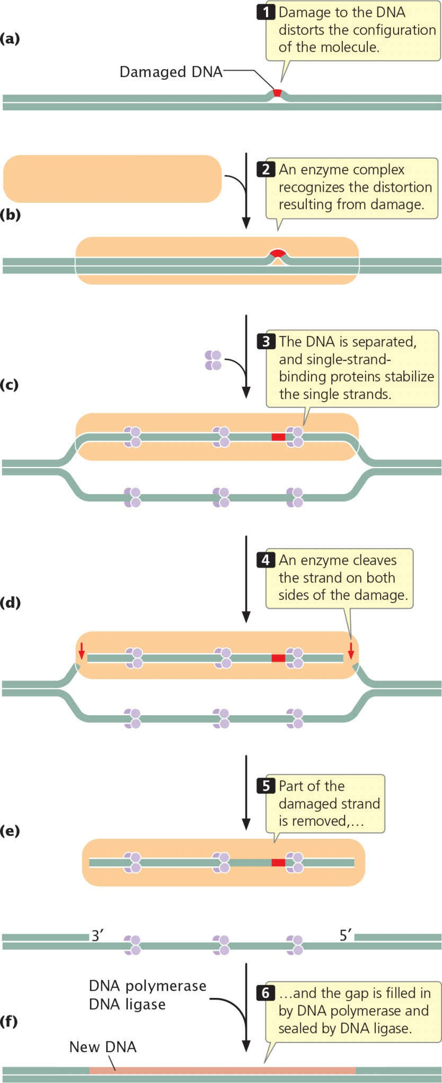
Fig. Nucleotide excision repair
Source: Genetics- A conceptual approach (by Benjamin A. Pierce; 8th edition)

