Slide 1
Bacteria

Slide 2
Introduction
Bacteria constitute a very wide group of microorganisms that exhibit a fascinating diversity in morphology, habitat, nutrition, metabolism and reproduction.
Antonie Van Leeuwenhoek first observed bacteria in the year 1676, and called them 'animalcules‘

Slide 3
General characteristics of bacteria
They are omnipresent and occur in all possible habitats (soil, water, air, food etc.,). Some bacteria can thrive under extreme environmental conditions such as extreme heat and cold, highly acidic or alkaline environments.
Most of the bacteria have heterotrophic mode of nutrition i.e., they absorb their food directly from their external environment. They maybe saprophytic, mutualistic or parasitic. Some bacteria are autotrophic; they possess bacteriochlorophyll and synthesize their own food.
Bacteria are usually single-celled and morphologically least complex of all the living organisms.
Bacterial cell wall is composed of peptidoglycan containing muranic acid or murein.
Well organised nucleus is absent
Bacterial DNA have no histone proteins and nucleosomes.
Organelles like mitochondria, endoplasmic reticulum, golgi apparatus are absent
Ribosomes occur abundantly and freely in the cytoplasm and is of 70s type.
Bacteria reproduce asexually and multiply most commonly by binary fission.
True sexual reproduction is absent. The sexuality is completed by genetic recombination methods called conjugation, transformation and transduction.
The motile bacteria possess one or more flagella.

Slide 4
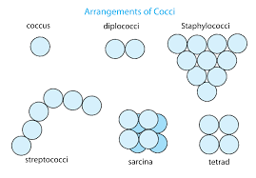
Morphology of bacteria
Unicellular bacteria
Cocus (pl. cocci): the cocci bacteria are unicellular and spherical varying from 0.5 to 1.25µ in diameter. They exist either singly(micrococcus), in pairs (diplococcus), in chains (streptococcus), in clusters (staphylococcus) or in cubical masses of 8 or more cells (sarcina)

Slide 5
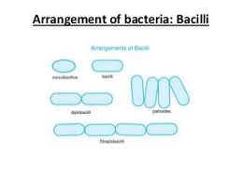
2. Bacillus (pl., bacilli)
They are unicellular and small rod-shaped ranging from about 1.5-10 µ in length. They occur either singly (microbacillus), in pairs (diplobacillus) or in chains (streptobacillus) or in palisade arrangement.
Eg., Bacillus subtilis, Lactobacillus and Clostridium.

Slide 6
3. Vibrio (pl., vibrios)
When the bacilli bacteria are so curved that they look like a comma, they are called vibrios. Their size seldom 10 µ in length and 1.5 to 1.7 µ in diameter. Eg., Vibrio comma
Spirillum (pl., spirilla)
When the bacilli bacteria are coiled, they are referred to as Spirilla. They range from 10-50 µ in length and 0.5 to 3 µ in diameter. Eg., Spirillum undulum, S. volutans
Stalked bacteria
They are unicellular bacteria having well defined stalks. Usually these bacteria have sticky, knob-like base that join each other forming a rosette-like structure. Eg., Caulobacter, Galllionella etc.
6. Budding bacteria
They are unicellular and are globose having a small, thin tube-like structure. Eg., Rhodomicrobium

Slide 7
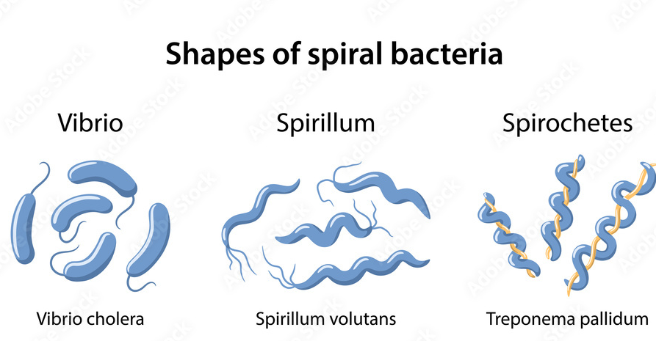
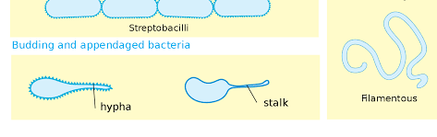

Slide 8
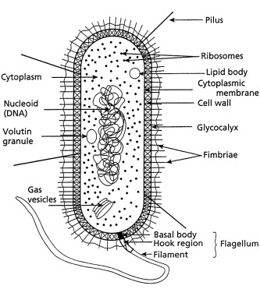

Slide 9
The bacterial cell reveals three layers (i) Capsule/Glycocalyx (ii) Cell wall and (iii) Cytoplasm
Capsule/Glycocalyx
Some bacteria are surrounded by a gelatinous substance which is composed of polysaccharides or polypeptide or both. A thick layer of glycocalyx bound tightly to the cell wall is called capsule. It protects cell from desiccation and antibiotics. The sticky nature helps them to attach to substrates like plant root surfaces, Human teeth and tissues. It helps to retain the nutrients in bacterial cell.

Slide 10
Cell wall
The bacterial cell wall is granular and is rigid. It provide protection and gives shape to the cell. The main constituent of bacterial cell wall is peptidoglycan (also known as murein, muramic acid or mucopeptide) which is biochemically unique and is absent in the cell walls of Archaebacteria or any eukaryote. The chemical composition of cell wall is rather complex and is made up of Peptidoglycan or mucopeptide ( N-acetyl glucosamine, N-acetyl muramic acid and peptide chain of 4 or 5 aminoacids).
Plasma membrane
The plasma membrane is made up of lipoprotein. It controls the entry and exit of small molecules and ions. The enzymes involved in the oxidation of metabolites (i.e., the respiratory chain) as well as the photosystems used in photosynthesis are present in the plasma membrane.
Cytoplasm
Cytoplasm is thick and semitransparent. It contains ribosomes and other cell inclusions. Cytoplasmic inclusions like glycogen, poly-β-hydroxybutyrate granules, sulphur granules and gas vesicles are present.

Slide 11
Bacterial chromosome (Nucleoid)
The bacterial chromosome is a single circular DNA molecule, tightly coiled and is not enclosed in a membrane as in Eukaryotes. This genetic material is called Nucleoid. It is to be noted that the DNA of E.coli which measures about 1mm long when uncoiled, contains all the genetic information of the organism. The DNA is not bound to histone proteins.
Plasmid
Plasmids are extra chromosomal double stranded, circular, self-replicating, autonomous elements. They contain genes for ­fertility, antibiotic resistant and heavy metals. It also help in the production of bacteriocins and toxins which are not found in bacterial chromosome. The size of a plasmid varies from 1 to 500 kb usually plasmids contribute to about 0.5 to 5.0% of the total DNA of bacteria. The number of plasmids per cell varies. Plasmids are classified into different types based on the function. Some of them are F (Fertility) factor, R (Resistance)­ plasmids, Col (Colicin) plasmids, Ri (Root ­inducing) plasmids and Ti (Tumour inducing) plasmids.

Slide 12
Mesosomes
These are localized infoldings of plasma membrane produced into the cell in the form of vesicles, tubules and lamellae. They are clumped and folded together to maximize their surface area and helps in respiration and in binary fission.
Ribosomes
The ribosomes are the site of protein synthesis. The number of ribosome per cell varies from 10,000 to 15,000. The ribosomes are 70S type and consists of two subunits (50S and 30S). The ribosomes are held together by mRNA and form polyribosomes or polysomes.
Flagella
Certain motile bacteria have numerous thin hair like processes of variable length emerge from the cell wall called flagella. It is 20–30 μm in diameter and 15 μm in length. Flagella are used for locomotion. Based on the number and position of flagella there are different types of bacteria.

