Slide 1
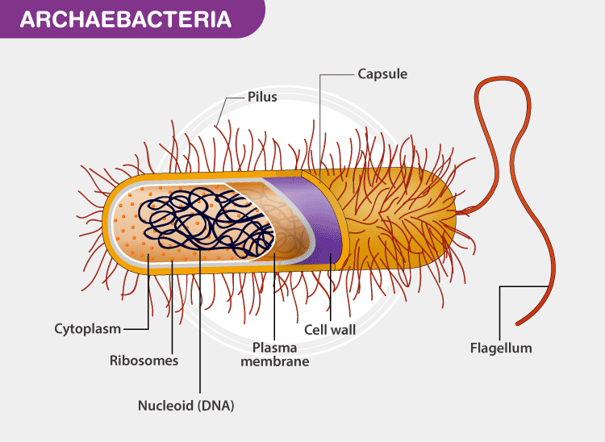
ARCHAEBACTERIA

Slide 2
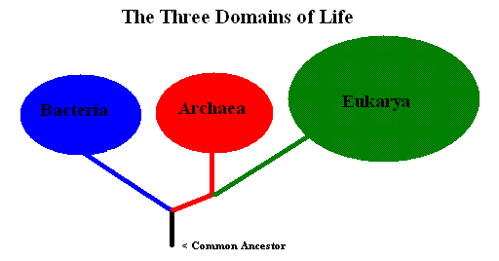
Introduction
Archaea, often referred to as archaebacteria, are a group of microorganisms that constitute one of the three domains of life, alongside Bacteria and Eukarya.
They were initially classified as bacteria due to their microscopic size and prokaryotic cell structure, but they are fundamentally different from true bacteria in terms of their genetic, biochemical, and evolutionary characteristics.

Slide 3
General characteristics
Archaebacteria are highly diverse with respect to morphology, reproduction, physiology, and ecology.
Archaebacteria can be gram-positive or gram-negative, and may be spherical, rod-shaped, spiral, and other.
They can be aerobic or anaerobic, and facultative or obligate.
Archaebacteria are usually present in extreme aquatic and terrestrial habitats, such as hypersaline or high-temperature environments.
They are very similar to eubacteria. The similarity between Archaebacteria and bacteria includes characteristics such as their cellular size, absence of nucleus, histones, circular organization of their genomes, presence of 70S ribosomes, etc.
In terms of their cell structures, Archaebacteria are indistinguishable from gram-positive bacteria. Apart from structural similarities, most of the metabolic particles are common between Archaebacteria and bacteria.
However, Archaebacteria are very different from bacteria with respect to features associated with information transfer processes such as DNA replication, transcription, and translation. Of these, DNA replication machinery appears to be most different between the two domains.

Slide 4
Archaebacteria possess unique cell membranes primarily composed of lipids. Unlike Bacteria and Eubacteria, which contain ester-linked phospholipids, the membranes of archaebacteria are characterized by ether-linked phospholipids.
The cell wall of archaebacteria is rigid, providing both shape and mechanical support. Under hypotonic conditions, it prevents the cells from bursting.
Unlike bacterial cell walls made of peptidoglycan, archaebacterial cell wall is composed of pseudomurein which renders them resistant to lysozyme, an enzyme commonly produced in host organisms as part of the immune response to degrade bacterial cell walls. Thus, pseudomurein protects archaebacteria from such enzymatic attack.
Similar to other prokaryotes, archaebacteria lack membrane-bound organelles such as mitochondria, nuclei, endoplasmic reticulum, and chloroplasts. Instead, their cytoplasm contains all the necessary molecules and enzymes required for metabolism and nutrition.

Slide 5
Major groups of Archaebacteria
Three major groups- Methanogens, extreme halophiles and thermophiles.
Methanogens- They are methane producing obligate anaerobes. They comprise the largest group of archaebacteria. For eg., Methanococcus, Methanobacterium etc.
(Extremophiles)
Extreme halophiles- They are aerobic chemoorganoheterotrophs. They thrive in very high salt concentrations. For eg., Halobacterium salinarium.
Thermophiles- They are heat loving archaebacteria found near hydrothermal vents and hot springs. The optimum growth temperature is 70-100˚C. They are gram negative and usually strict anaerobes. For eg., Thermoanaerobacalum aquaticum.

Slide 6
Components of Archaebacteria

Slide 7
Plasma Membrane: Archaebacteria possess unique cell membranes primarily composed of lipids. Unlike Bacteria and Eubacteria, which contain ester-linked phospholipids, the membranes of archaebacteria are characterized by ether-linked phospholipids.
Cell Wall: The cell wall of archaebacteria is rigid, providing both shape and mechanical support. Under hypotonic conditions, it prevents the cells from bursting. Unlike bacterial cell walls made of peptidoglycan, archaebacterial cell wall is composed of pseudomurein which renders them resistant to lysozyme, an enzyme commonly produced in host organisms as part of the immune response to degrade bacterial cell walls. Thus, pseudomurein protects archaebacteria from such enzymatic attack.
Ribosomes: In archaebacteria, ribosomes are 70S in size. Ribosomes contain three ribonucleic acids (RNA) molecules such as 16S, 23S and 5S.

Slide 8
Pilus(Pili): In archaebacteria, pilus are composed of proteins. It has a tube-like structure which is used for the attachment to the surfaces.
Flagellum(Flagella): In archaebacteria, flagellum has a long hair-like surface which is polymerized. It is used for movement. Also, this rotating structure is responsible for the insertion of proteins in the cell.
Cytoplasm: In archaebacteria, all the living functions take place in the cytoplasm. The DNA is located in the cytoplasm. The cytoplasm contains all the necessary molecules and enzymes required for metabolism and nutrition.

Slide 9
Classification
On the basis of phylogenetic relationships, Archaebacteria is divided into 5 divisions which are as follows-
Crenarchaeota
The bacteria which can survive in a wide range of habitats is known as crenarchaeota. They are composed of special proteins that help them to survive extremely high temperatures like 230 degrees Celsius. These bacteria also survive in highly acidic environments. The usual habitat of these bacteria is hot springs, deep-sea vents, and places where there is super-heated water All the hyperthermophiles, thermoacidophiles, and thermophiles are included in this category of Archaebacteria.

Slide 10
Euryarchaeota
Euryarchaeota can live under extreme alkaline conditions and also have the ability to produce methane. Methanogens and halophiles are included under euryarchaeota.
Korarchaeota
Korarchaeota possesses the genes that are familiar to the Crenarchaeota and Euryarchaeota. Moreover, it is believed that all three are descended from a common ancestor. Hyperthermophiles are included under this subcategory as they have the ability to survive extra extremely high temperatures and these bacteria are believed to be the oldest existing bacteria on the earth.
Thaumarchaeota
The bacteria which have the ability to oxidize ammonia are kept under this category.
Nanoarchaeota
Nanoarchaeota is an obligate symbiont of archaea and also belongs to the genus Ignicoccus.

Slide 11
Comparison between Bacteria and Archaebacteria
Bacteria | Archaebacteria
Present everywhere | Mostly present in extreme environmental conditions
Nucleus and unit membrane bound organelles absent | Nucleus and unit membrane bound organelles absent
Cell wall is made up of peptidoglycan | Cell wall is made of pseudomurein.
Cell membrane consists of lipids. They have ester-linked phospholipids | The main component of cell membranes is lipids. They have ether-linked phospholipids
Sensitive to antibiotics | Insensitive to antibiotics
Reproduce asexually through binary fission. | Reproduce asexually through binary fission.
Methanogenesis absent | Methanogenesis present

