Slide 1
Genetic recombination

Slide 2
Introduction
Bacteria do not reproduce sexually like reproductive organisms. Their requirements of sexuality are met through certain alternate pathways of genetic recombination which are called conjugation, transformation and transduction.
These three processes mediate transfer of genetic material (DNA) from one bacterial cell (donor) to other (recipient) cell.

Slide 3
Conjugation
Lederberg and Tatum (1946) discovered conjugation in E. coli.
Conjugation is a process by which genetic material is transferred from one bacterial cell (donor cell or male cell) to another (recipient cell or female cell) through a specialized intercellular connection called sex-pilus or conjugation tube.
The maleness and femaleness of bacterial cells are determined by the presence or absence of F-plasmid (F-factor or sex factor)
F-plasmid, an extrachromosomal genetic material is always present in the cytoplasm of donor or male cells, and the latter develop specialized cell surface appendages called F-pili or sex-pili under the control of F-plasmid.
Recipient or female cells always lack F-plasmids and, therefore, F-pili are not present on their surface. This is called as Fˉ cell.

Slide 4
In conjugation between a F⁺ (donor) cell and Fˉ (recipient) cell, it is the autonomous F-factor (F-plasmid) which is transferred, never the bacterial DNA.
When the two cells (F⁺ and Fˉ) come close to each other , the F-pilus of the F⁺ (donor) cell attaches with the Fˉ (recipient) cell and acts as a conjugation tube.
Simultaneously, the double stranded circular F-factor DNA is nicked at a specific point, and begins to replicate producing a single stranded copy of the F-factor DNA, which migrates through the tube into the cytoplasm of the Fˉ (recipient) cell.
It becomes double stranded, and circular and lies free in the cytoplasm thus rendering the recipient cell to become F⁺ donor cell. In this way, mixing a population of F⁺ (donor) cells with a population of Fˉ (recipient) cells results in the conversion of virtually all the cells in the population becoming F⁺ (donor) cells.

Slide 5
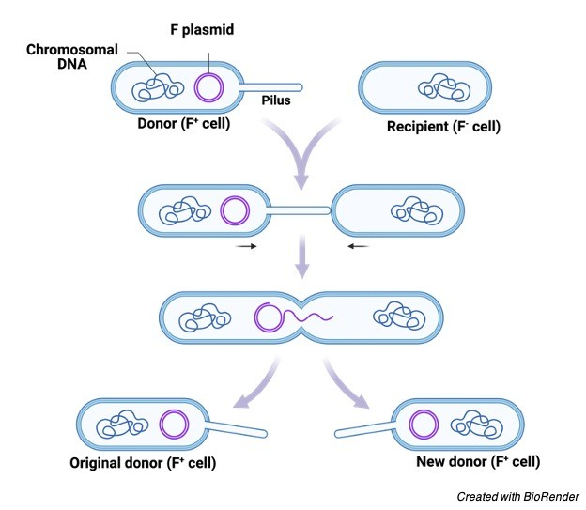

Slide 6
Transformation
This process of genetic recombination was first studied by Griffith (1928).
He took two strains of bacterium Streptococcus pneumoniae. One of the strain was virulent or pathogenic and capsulated normal; it formed smooth colonies. The other strain was avirulent or non-pathogenic and non-capsulated; it formed the rough colonies on the culture medium.
He experimented on mice as follows:
Virulent strain (capsulated)→injected into mice→mice died
Avirulent strain (non-capsulated)→injected into mice→no effect on mice
Heat-killed (dead) virulent cells→injected into mice→no effect on mice
Avirulent+heat killed virulent cells→injected into mice→mice died
Dead mice Virulent strain (capsulated)
Isolation of bacteria

Slide 7
From the Griffith’s experiment, it is obvious that the avirulent strain becomes virulent or pathogenic when mixed with heat-killed (dead) virulent strain thus causing the death of mice.
Griffith named this change of avirulent into virulent strain as transformation. He reasoned that there was a transfer of some factor from heat killed virulent strain to the avirulent strain and called it transforming principle.
In transformation, a free (naked) DNA molecule is transferred from a donor to a recipient bacterial cell.
The donor bacterium undergoes lysis to free the DNA molecule and the recipient bacterium must be competent to receive it.
When donor DNA comes into contact with the competent bacterial cell, it first binds on the cell surface and then is taken up inside the cell.
In some cases, it is observed that the double stranded dsDNA enters inside the bacterial cell as such and its one strand is degraded by endonuclease enzyme therin leaving ssDNA .
Whereas in others such as some species of Bacillus and Streptococcus only ssDNA enters the recipient bacterial cell.
An endonuclease enzyme now degrades one of the strands of the dsDNA of recipient bacterial chromosome in corresponding region and this gap is filled by the donor ssDNA with the help of ligase enzyme which joins it with the DNA of the recipient bacterial chromosome.
If the allelic forms of recipient and donor genes are not identical, the donor DNA forms a heteroduplex with the recipient bacterial DNA.
When the bacterial cell containing heteroduplex undergoes binary fission, the heteroduplex replicates forming two homoduplexes.

Slide 8
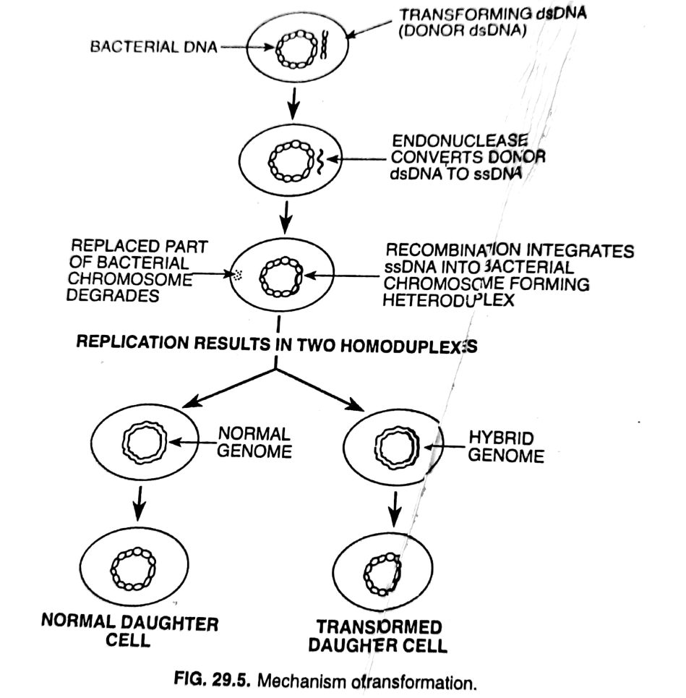
One of these is a normal duplex forming the normal bacterial cell and the other is a transformed duplex.
The daughter cell containing a transformed duplex is a transformed cell.

Slide 9
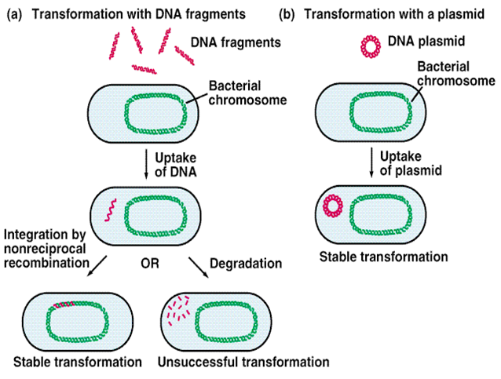

Slide 10
Transduction
This process of genetic recombination was discovered by Zinder and Lederberg (1952) in Salmonella typhimurium
During transduction, fragments of DNA are transferred from one bacterial cell to the other with the help of a viral carrier (bacteriophage)
The transduction is a phage mediated process of genetic material transfer in bacteria.
In this method, the bacteriophage acquires a portion of the bacterial DNA of the host cell in which it reproduces and then transfers this acquired DNA to another bacterial cell to which it infects.
Such bacteriophage is called ‘transducing phage’.
Transduction is of two types: generalized and specialized (restricted) transduction

Slide 11
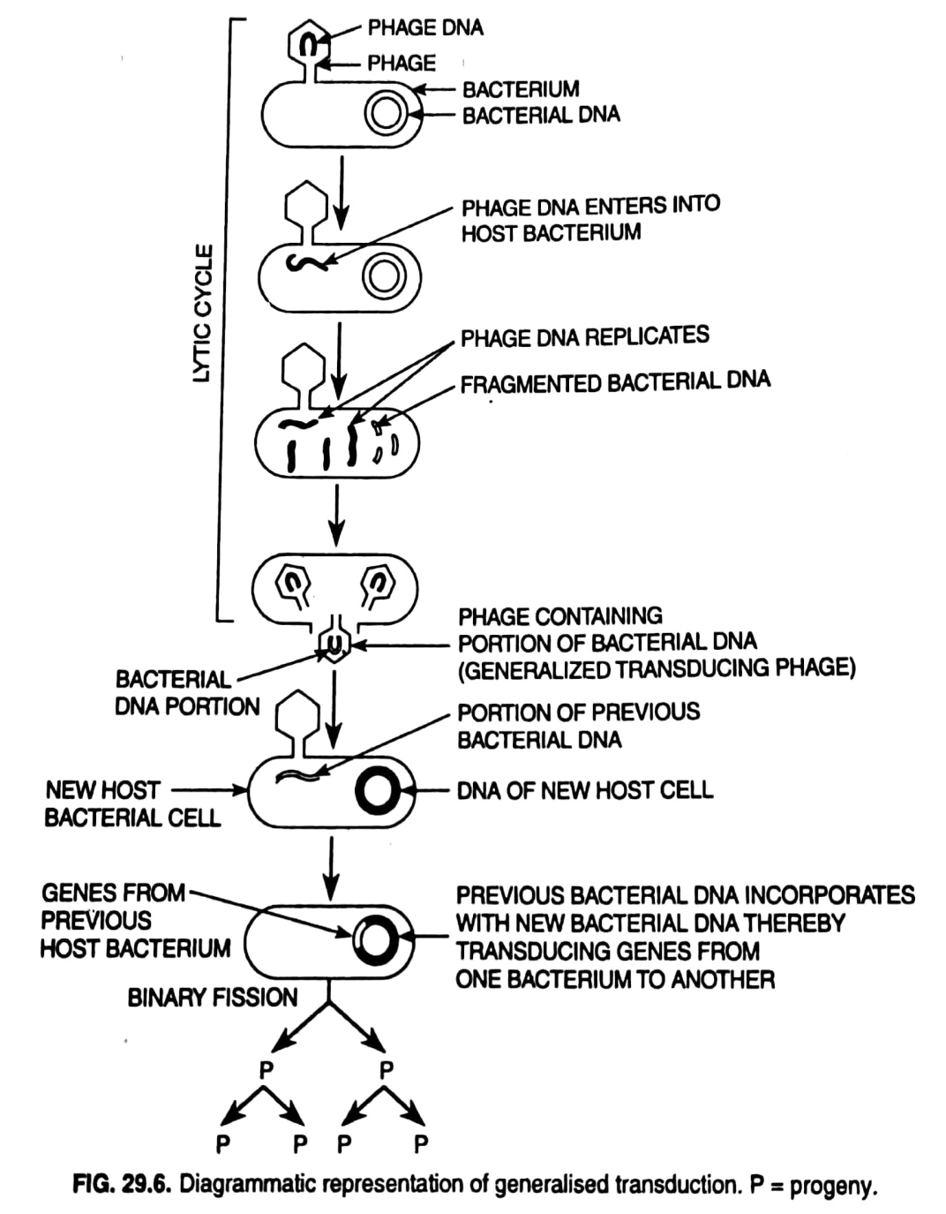
Generalized transduction
Transfer of any bacterial gene from one bacterial cell to the other is referred to as generalized or nonspecialized transduction.
In generalized transduction, some of the developing progeny phages, during their normal lytic-cycle may accidentally acquire pieces of bacterial DNA.
Such phages, after the lysis of the host bacterial cell and their release, attach to and inject their DNA into a new recipient cell but fail to re-establish lytic cycle therin.
Once inside the recipient bacterial cell, the injected DNA may be degraded by nucleases, in which case genetic exchange does not occur.
The injected DNA, however, may undergo integration resulting in homologous recombination, as a result, the transduced cell may possess new combination of genes.
The transduced bacterial cell now undergoes usual binary fission and produces progeny cells containing new combination of genes

