Slide 1
PLANT SCIENCE · MADE SIMPLE
How Plants Fight
Toxic Oxygen
ROS Detoxification & Stress Mitigation in Plants — Enzymatic and Non-Enzymatic Defenses, Explained Simply
A Beginner-Friendly Guide

Slide 2






OVERVIEW
What We'll Learn
What Is ROS?
Why Too Much ROS Is Dangerous
...and why do plants make it in the first place?
It damages the very parts a cell needs to survive
The Enzyme Squad
Helper Molecules
Fast-acting protein workers that break ROS down
Vitamins and pigments that soak up ROS directly
How It All Works Together
Helping Plants Cope
The complete, big-picture defense system
Simple ways we can boost a plant's own defenses
ROS Detoxification & Stress Mitigation in Plants
1

Slide 3
THE BASICS
What Is ROS, Really?
ROS = Reactive Oxygen Species. They're unstable oxygen molecules made naturally during photosynthesis and respiration — a bit like exhaust from a car engine.
A small amount of ROS is normal, and even useful — it acts as a signal inside the cell. It's only when ROS piles up that it becomes a problem.
O₂•⁻
H₂O₂
•OH
¹O₂
Superoxide
Hydrogen Peroxide
Hydroxyl Radical
Singlet Oxygen
The very first ROS formed — reactive but short-lived.
Longer-lived — can travel and act as a stress signal.
The most dangerous one — reacts with almost anything it touches.
Made mainly in chloroplasts when light energy is in excess.
ROS Detoxification & Stress Mitigation in Plants
2
Notes:
ROS = reactive oxygen species: superoxide (O2.-), hydrogen peroxide (H2O2), hydroxyl radical (.OH), singlet oxygen (1O2). Produced as byproducts of the photosynthetic and respiratory electron transport chains; low levels act as signaling molecules, high levels under stress cause oxidative damage. Sources: Apel & Hirt (2004) Annu Rev Plant Biol 55:373-399; MDPI Stresses 11(5):477 (2025).

Slide 4





THE PROBLEM
When Stress Hits, ROS Piles Up
Drought
Heat
Cold
Salt
Pests
↓ triggers ↓
ROS shoots up sharply — and damages key parts of the plant cell
Cell Membranes
Proteins
DNA
Chlorophyll
Get “leaky”, like a torn plastic bag
Lose their shape and stop working
Suffers mutations and breaks
Breaks down — leaves turn pale or yellow
Together, these stresses can cut crop yields by 50% or more.
ROS Detoxification & Stress Mitigation in Plants
3
Notes:
Abiotic stresses (drought, heat, cold, salinity) and biotic stress (pathogens) increase ROS production, causing lipid peroxidation of membranes, protein oxidation, DNA damage, and chlorophyll/pigment degradation. Combined abiotic stresses can reduce crop yields by ~50% or more. Source: MDPI Stresses 11(5):477 (2025).

Slide 5
THE DEFENSE SYSTEM
Plants Fight Back — Two Ways
ROS
ENZYMATIC DEFENSE
NON-ENZYMATIC DEFENSE
Protein “workers” (enzymes) that break ROS down through chemical reactions — fast, precise, reusable.
Small helper molecules (vitamins, pigments) that soak up ROS directly, like a sponge.
e.g. SOD, catalase, peroxidases
e.g. vitamin C, vitamin E, carotenoids
Both roads lead to the same safe ending: ROS → harmless water + oxygen
ROS Detoxification & Stress Mitigation in Plants
4
Notes:
Plants use two complementary antioxidant systems: enzymatic (SOD, CAT, APX, GPX, GR, MDHAR, DHAR) and non-enzymatic (ascorbate, glutathione, tocopherols, carotenoids, flavonoids, proline). Both convert ROS into harmless products (water and oxygen) or safely quench them. Source: MDPI Life 15(8):1293 (2025); MDPI Stresses 11(5):477 (2025).

Slide 6
TEAM ENZYME · STEP 1
SOD — The First Responder
SOD
Superoxide
H₂O₂ + O₂
O₂•⁻ (freshly made ROS)
hydrogen peroxide + oxygen
SOD stands for Superoxide Dismutase — usually the very first enzyme to react to ROS.
It's found almost everywhere in the cell — different versions work in different “rooms” of the cell (chloroplast, mitochondria, cytoplasm).
Think of SOD like a smoke detector — always switched on, standing guard everywhere in the cell.
ROS Detoxification & Stress Mitigation in Plants
5
Notes:
SOD (superoxide dismutase) catalyzes disproportionation of superoxide radical into H2O2 and O2; it is usually the first line of enzymatic defense. Three main isoforms based on metal cofactor and location: Cu/Zn-SOD, Mn-SOD, Fe-SOD. Source: MDPI Stresses 11(5):477 (2025).

Slide 7
TEAM ENZYME · STEP 2
CAT & APX — Cleaning Up H₂O₂
CAT / APX
H₂O₂
H₂O + O₂
hydrogen peroxide (still harmful)
water + oxygen — completely harmless
Catalase (CAT)
Ascorbate Peroxidase (APX)
Fast and simple — doesn't need any extra ingredients. Works mainly in one compartment (the peroxisome).
Needs a helping hand from vitamin C (ascorbate). Found in many parts of the cell, including chloroplasts.
ROS Detoxification & Stress Mitigation in Plants
6
Notes:
Catalase (CAT) dismutates H2O2 into water and oxygen without needing a reducing agent; located mainly in peroxisomes; very high turnover but lower affinity for H2O2. Ascorbate peroxidase (APX) reduces H2O2 to water using ascorbate as the electron donor; found in chloroplasts, cytosol, mitochondria, peroxisomes; higher affinity for H2O2 than CAT. Source: MDPI Stresses 11(5):477 (2025).

Slide 8
TEAM ENZYME · THE RECYCLING LOOP
Helper Molecules Get Recharged, Too
APX uses up vitamin C (ascorbate) to neutralize H₂O₂ — so the vitamin C gets “used up.”
But other enzymes instantly recharge that vitamin C, powered by glutathione, so it can be reused again and again.
recycling
enzymes
Vitamin C
Vitamin C
used up (after fighting H₂O₂)
fresh again — ready to fight more ROS
powered by GLUTATHIONE
Like recharging a rechargeable battery — instead of throwing the used one away.
ROS Detoxification & Stress Mitigation in Plants
7
Notes:
The ascorbate-glutathione (Halliwell-Asada) cycle: APX oxidizes ascorbate while reducing H2O2; monodehydroascorbate reductase (MDHAR) and dehydroascorbate reductase (DHAR) regenerate reduced ascorbate; DHAR uses glutathione (GSH), oxidizing it to GSSG; glutathione reductase (GR) then regenerates GSH using NADPH. This keeps the antioxidant pools 'charged' continuously. Source: Foyer & Noctor (2011) Plant Physiol 155:2-18; MDPI Stresses 11(5):477 (2025).

Slide 9

TEAM HELPER MOLECULES
Vitamin C & Vitamin E — Nature's Sponges
Vitamin C (Ascorbate)
Vitamin E (Tocopherols)
Dissolves in water. Mops up ROS directly and recharges vitamin E once it's used up. One of the most abundant antioxidants in plant cells.
Lives inside cell membranes (fat-soluble). Stops a damaging chain-reaction called “lipid peroxidation” before it spreads.
ROS Detoxification & Stress Mitigation in Plants
8
Notes:
Ascorbate (vitamin C): abundant water-soluble antioxidant, direct ROS scavenger and cofactor for APX; regenerates tocopherol. Tocopherols (vitamin E): lipid-soluble, located in membranes, break lipid peroxidation chain reactions and quench singlet oxygen. Source: MDPI Stresses 11(5):477 (2025).

Slide 10



TEAM HELPER MOLECULES
Pigments & Other Protective Molecules
Carotenoids
Flavonoids
Glutathione
Proline
Orange/yellow pigments. Absorb extra light energy before it can form ROS, and mop up singlet oxygen.
Colorful plant pigments (in leaves, fruit, flowers) that scavenge free radicals.
Recharges vitamin C and works as an antioxidant throughout the whole cell.
Does double duty — holds onto water during drought AND mops up ROS.
ROS Detoxification & Stress Mitigation in Plants
9
Notes:
Carotenoids: photoprotective pigments, quench singlet oxygen and dissipate excess excitation energy (xanthophyll cycle). Flavonoids/phenolics: free-radical scavengers, accumulate under stress (e.g., UV). Glutathione (GSH): central redox buffer, recycles ascorbate via DHAR, substrate for glutathione peroxidase/glutathione-S-transferase. Proline: compatible osmolyte with additional ROS-scavenging and membrane-stabilizing roles. Source: MDPI Stresses 11(5):477 (2025); Roles of Glycine Betaine and Proline in Improving Plant Abiotic Stress Resistance, Environ. Exp. Bot.

Slide 11
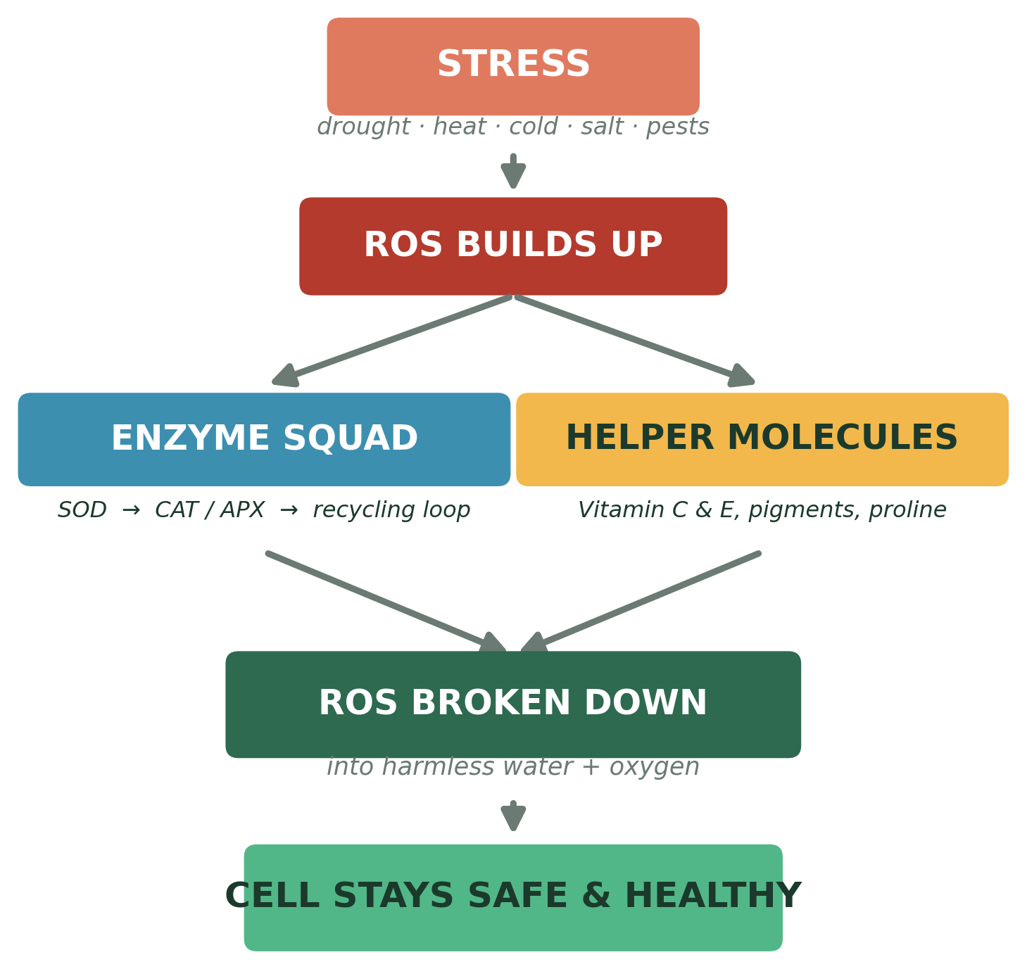
THE BIG PICTURE
The Whole System, at a Glance
ROS Detoxification & Stress Mitigation in Plants
10

Slide 12


HELPING PLANTS COPE
How We Can Help Stressed Plants
Spray Treatments
Seed Priming
Stronger Varieties
Friendly Soil Microbes
Spraying leaves with glutathione, proline, or glycine betaine gives plants a quick external antioxidant boost.
Soaking seeds in protective compounds before planting helps seedlings cope with stress from day one.
Breeding and biotechnology can give crops naturally more powerful antioxidant systems.
Certain beneficial bacteria (PGPR) around the roots help plants handle stress better.
Real examples: wheat seeds treated with melatonin germinated better under stress; chickpeas soaked in glutathione kept more chlorophyll and photosynthesis during drought.
ROS Detoxification & Stress Mitigation in Plants
11
Notes:
Exogenous priming strategies: melatonin (e.g., 100 uM improved wheat germination/stress tolerance; enhanced soybean flowering & seed yield under drought), glutathione (0.75 mM seed soaking improved chickpea chlorophyll & photosynthesis under drought), proline and glycine betaine (osmoprotection + antioxidant boost), PGPR (plant growth-promoting rhizobacteria) and breeding/transgenic approaches (overexpressing SOD/APX/CAT genes). Source: PMC9657122 (2022), 'Using Exogenous Melatonin, Glutathione, Proline, and Glycine Betaine Treatments to Combat Abiotic Stresses in Crops.'

Slide 13
SUMMARY
Key Takeaways
1
ROS are natural, reactive oxygen molecules — a few are normal, but stress makes too many.
2
Too much ROS damages membranes, proteins, DNA, and chlorophyll.
3
The Enzyme Squad (SOD, CAT, APX...) breaks ROS down step by step, fast.
4
Helper Molecules (vitamin C, vitamin E, pigments, proline) soak up ROS directly and recycle each other.
5
We can boost these natural defenses with sprays, seed priming, better breeding, and friendly soil microbes.

Slide 14
REFERENCES
References & Further Reading
Apel, K., & Hirt, H. (2004). Reactive oxygen species: metabolism, oxidative stress, and signal transduction. Annual Review of Plant Biology, 55, 373–399.
Mittler, R. (2002). Oxidative stress, antioxidants and stress tolerance. Trends in Plant Science, 7(9), 405–410.
Foyer, C. H., & Noctor, G. (2011). Ascorbate and glutathione: the heart of the redox hub. Plant Physiology, 155(1), 2–18.
Fathi, A., et al. (2025). Reactive Oxygen Species (ROS) and Antioxidant Systems in Enhancing Plant Resilience Against Abiotic Stress. International Journal of Agronomy.
Antioxidant Defense System in Plants: ROS Production, Signaling, and Scavenging During Abiotic Stress-Induced Oxidative Damage. (2025). Stresses, 11(5), 477. MDPI.
Antioxidant Defense Systems in Plants: Mechanisms, Regulation, and Biotechnological Strategies for Enhanced Oxidative Stress Tolerance. (2025). Life, 15(8), 1293. MDPI.
Rasheed, R., et al. (2022). Using Exogenous Melatonin, Glutathione, Proline, and Glycine Betaine Treatments to Combat Abiotic Stresses in Crops. Plants (Basel).
Roles of Glycine Betaine and Proline in Improving Plant Abiotic Stress Resistance. Environmental and Experimental Botany.
ROS Detoxification & Stress Mitigation in Plants
12

