Slide 1
MOLECULAR GENETICS
Sequencing Genomes
How DNA Sequences Are Determined and Analyzed
Dideoxy (Sanger) Sequencing • Automated Sequencing • Next-Generation Sequencing • Third-Generation Sequencing

Slide 2
INTRODUCTION
What Is DNA Sequencing?
DNA sequencing determines the order of bases in a DNA molecule. It allows the genetic information in DNA to be read directly, providing an enormous amount of information about gene structure and function.
1
The Dideoxy Method (Sanger)
2
The Chemical Method
(Maxam–Gilbert)
Developed in the mid-1970s by Frederick Sanger and colleagues.
Based on the elongation of DNA by DNA polymerase.
Quickly became the standard procedure for sequencing any purified DNA fragment.
Developed at about the same time by Allan Maxam and Walter Gilbert.
Based on chemical degradation of DNA rather than enzymatic synthesis.
Largely superseded by the Sanger method in routine practice.
Sequencing Genomes
2

Slide 3
DIDEOXY SEQUENCING
The Principle: Replication with Controlled Termination
The dideoxy (Sanger) method of DNA sequencing is based on replication. The fragment to be sequenced is used as a template to make a series of new DNA molecules.
1
2
3
Template & Synthesis
Sometimes, Not Always, Terminated
A Ladder of Fragments
The DNA fragment to be sequenced serves as a template for making new, complementary DNA strands.
Replication is sometimes — but not always — terminated when a specific base is encountered.
This produces DNA strands of many different lengths, each of which ends in a known base.
Because termination happens at random positions among many template copies, the reaction produces a full “ladder” of fragments of every possible length — each one ending in a nucleotide of known identity.
Sequencing Genomes
3

Slide 4
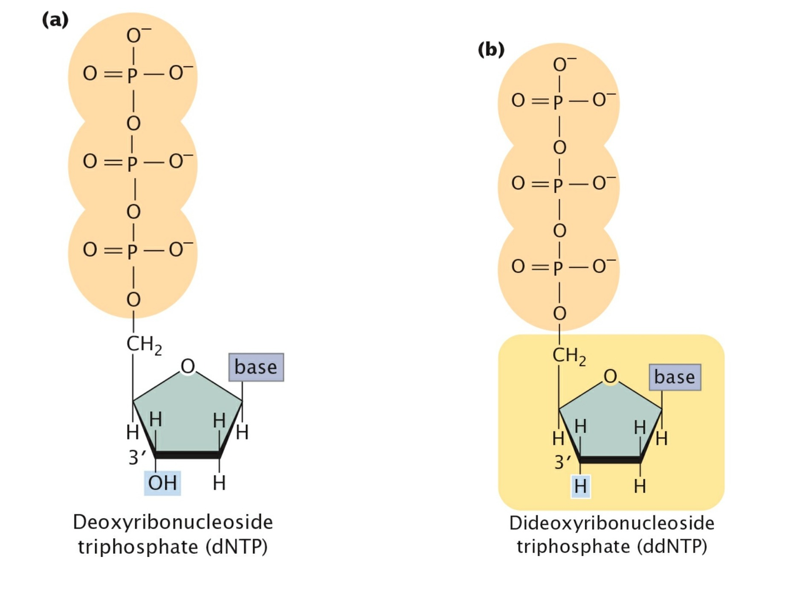
DIDEOXY SEQUENCING
The Key Substrate: Dideoxyribonucleoside Triphosphates
Normal substrate: dNTPs
DNA is normally synthesized from deoxyribonucleoside triphosphates, which carry an –OH group on the 3′-carbon atom.
Special substrate: ddNTPs
Identical to dNTPs, but lack the 3′-OH group.
Can still be incorporated into a growing DNA strand.
Once incorporated, no further nucleotide can be added — there is no 3′-OH to form a phosphodiester bond.
Result: ddNTPs terminate DNA synthesis.
Figure — Structures of dNTP (a) and ddNTP (b), the normal and chain-terminating substrates for DNA synthesis.
Sequencing Genomes
4

Slide 5
DIDEOXY SEQUENCING
Setting Up the Sequencing Reaction
Most sequencing procedures require a considerable amount of DNA, so the target fragment is first amplified by PCR or by cloning in bacteria. Copies of the target DNA are then isolated and split into four samples — one per tube.
1
2
3
4
Primer
dNTPs
One ddNTP
DNA Polymerase
Many copies of a primer complementary to one end of the target DNA strand.
All four types of deoxyribonucleoside triphosphates — the normal precursors of DNA synthesis.
A small amount of one of the four ddNTPs (ddATP, ddCTP, ddGTP, or ddTTP) — a different one in each of the four tubes.
The enzyme that elongates the new DNA strand from the primer.
Labeling: either the primer or one of the dNTPs is radioactively or chemically labeled, so that newly produced DNA can be detected after electrophoresis.
Sequencing Genomes
5

Slide 6
DIDEOXY SEQUENCING
Chain-Termination in Action: the ddATP Tube
The primer pairs with its complementary sequence at one end of each template strand, providing a 3′-OH group to initiate synthesis.
DNA polymerase elongates the new strand. Wherever it encounters a T on the template, it randomly uses either a dATP or a ddATP to add an A.
Because dATP is far more abundant than ddATP, dATP is incorporated most often, so synthesis usually continues.
Occasionally ddATP is incorporated instead, and synthesis terminates at that point.
Because termination happens randomly at different positions in different copies, the tube ends up with fragments of many different lengths, each ending in adenine.
Example fragments produced (ddATP tube)
12 nt
A
7 nt
A
2 nt
A
Each fragment ends in a ddA (green), marking where synthesis was terminated.
Sequencing Genomes
6

Slide 7
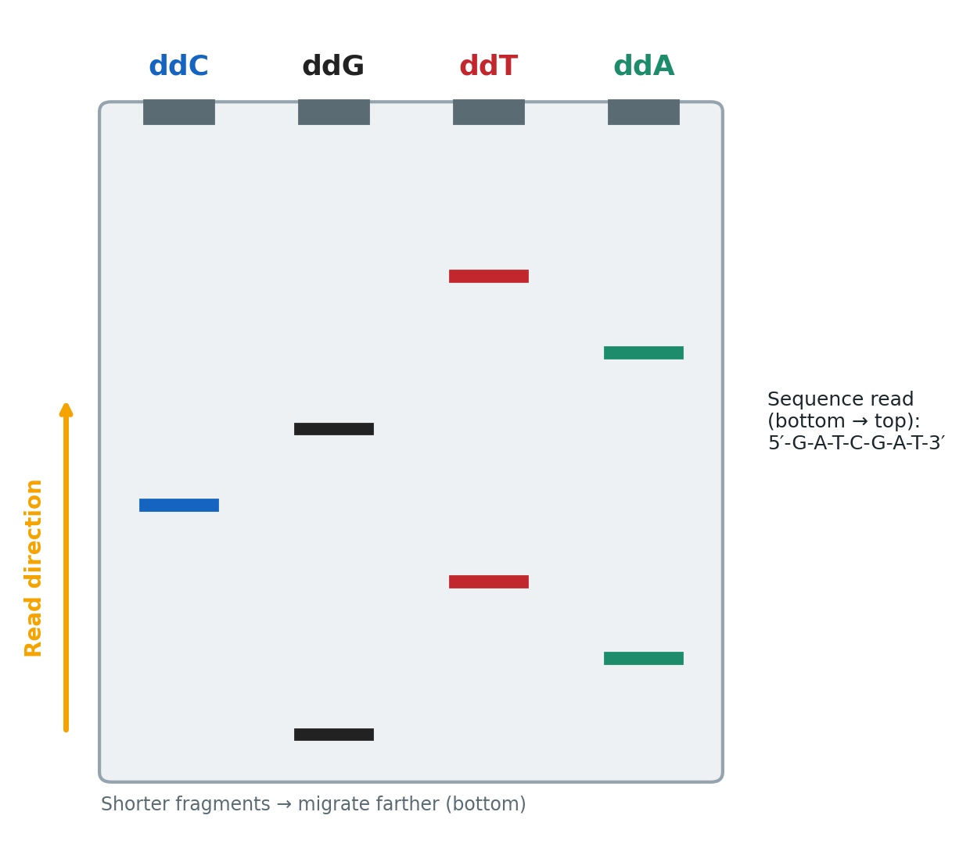
DIDEOXY SEQUENCING
Separating the Fragments: Gel Electrophoresis
Equivalent reactions take place in the other three tubes, except that synthesis is terminated at a different base in each tube.
After the polymerization reactions finish, all the DNA is denatured, and the single-stranded products are separated by gel electrophoresis.
The four tubes are run side by side on an acrylamide gel, which allows finer separation than agarose — strands differing by only a single nucleotide can be distinguished.
After electrophoresis, the locations — and therefore the sizes — of the DNA strands are revealed by the radioactive or chemical labels.
Sequencing Genomes
7

Slide 8
DIDEOXY SEQUENCING
Reading the Sequence Off the Gel
Reading the DNA sequence is the simplest and shortest part of the procedure.
Start at the bottom
The band closest to the bottom of the gel is the shortest fragment — it came from the tube whose ddNTP terminated synthesis first.
1
Move upward, one band at a time
The next band up came from the tube with the next-shortest fragment, and so on. The sequence is read from the bottom to the top of the gel.
2
Bottom → 5′ end; Top → 3′ end
Nucleotides near the bottom correspond to the 5′ end of the newly synthesized strand; nucleotides near the top correspond to the 3′ end.
3
Remember: it's the complement
The sequence obtained directly from the gel is not that of the target DNA — it is the sequence of its complement.
4
Sequencing Genomes
8

Slide 9
AUTOMATED SEQUENCING
From Manual Gels to Automated Machines
For many years, DNA sequencing was done largely by hand and was laborious and expensive. Today, sequencing is usually carried out by automated machines that use fluorescent dyes and laser scanners to sequence thousands of base pairs in a few hours.
One Tube, Four Colors
Capillary Electrophoresis
1
The dideoxy-sequencing reaction is still used, but the ddNTP for each base carries a different colored fluorescent dye — so all four reactions run in a single tube and a single well.
2
Sequencing devices carry out electrophoresis in gel-filled capillary tubes. Differently sized fragments separate within the tube and migrate past a laser and detector.
Laser Detection
High Throughput
3
As fragments pass the laser, their fluorescent dyes are activated. Each dye emits a characteristic wavelength, read by an optical scanner and fed to a computer.
4
Results are printed as a series of colored peaks. Machines with 96+ capillary tubes can read 50,000–60,000 bp of sequence in a few hours.
Sequencing Genomes
9

Slide 10
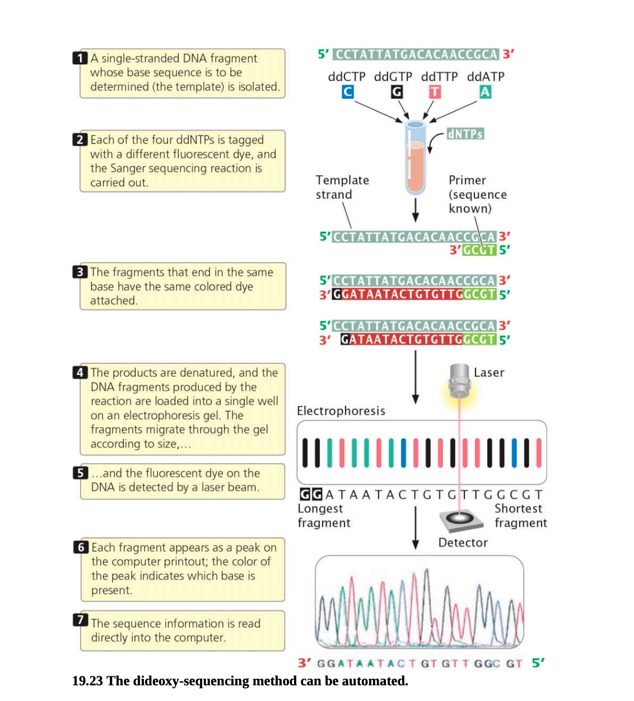
AUTOMATED SEQUENCING
Automated Dideoxy Sequencing, Step by Step
Figure — The dideoxy-sequencing method can be automated: fluorescently tagged ddNTPs, capillary electrophoresis, and laser detection combine to generate a chromatogram read directly by computer.
Sequencing Genomes
10

Slide 11
NEXT-GENERATION SEQUENCING
Sequencing at Massive Scale
Newer methods, called next-generation sequencing technologies, have made sequencing hundreds of times faster and less expensive than the traditional Sanger method.
Parallel
100,000s–Millions
Days, not Years
Most NGS platforms sequence in parallel
of DNA fragments sequenced simultaneously
to sequence a full human genome
Three major platforms are covered next: Illumina sequencing, pyrosequencing, and (third-generation) nanopore sequencing.
Sequencing Genomes
11

Slide 12
NEXT-GENERATION SEQUENCING
Illumina Sequencing
Illumina sequencing employs a technology similar in principle to dideoxy sequencing, but reads millions of fragments in parallel using reversible chain terminators.
1
Special nucleotides carry a fluorescent tag — a different color for each of the four bases — plus a chemical terminator group.
2
The terminator, once incorporated, prevents further nucleotides from being added — similar to a ddNTP, but this terminator is reversible and can be chemically removed.
3
Target DNA is cleaved into millions of short, overlapping fragments and attached to a slide.
4
Fragments are amplified, forming clusters of up to 1,000 identical copies at each spot on the slide.
5
Fragments are denatured; primers, DNA polymerase, and the special nucleotides are added, and the first nucleotide is incorporated into each new strand.
6
The solution is washed away, and the tag on the incorporated nucleotide is excited by a laser — causing it to fluoresce. Color reveals which base was just added.
7
The terminator and dye are chemically removed and the cycle repeats — hundreds of thousands of clusters are read simultaneously, one base at a time.
Sequencing Genomes
12

Slide 13
NEXT-GENERATION SEQUENCING
Pyrosequencing: Sample Preparation
Pyrosequencing is another form of next-generation sequencing based on DNA synthesis: nucleotides are added one at a time, in the order specified by the template, and each addition is detected as a flash of light.
1
Fragment & Adapt
2
Bead Capture
Target DNA is fragmented, and an adaptor — a short, known string of nucleotides — is attached to each fragment to prime PCR. Fragments are made single stranded.
Each fragment is attached to a separate bead and surrounded by a droplet of solution containing PCR reagents.
3
Emulsion PCR
4
Load the Plate
Within the droplet, the fragment is amplified by PCR, and the copies remain attached to the bead.
Beads are mixed with DNA polymerase and deposited onto a plate with more than a million microscopic wells — one bead per well.
Sequencing Genomes
13

Slide 14
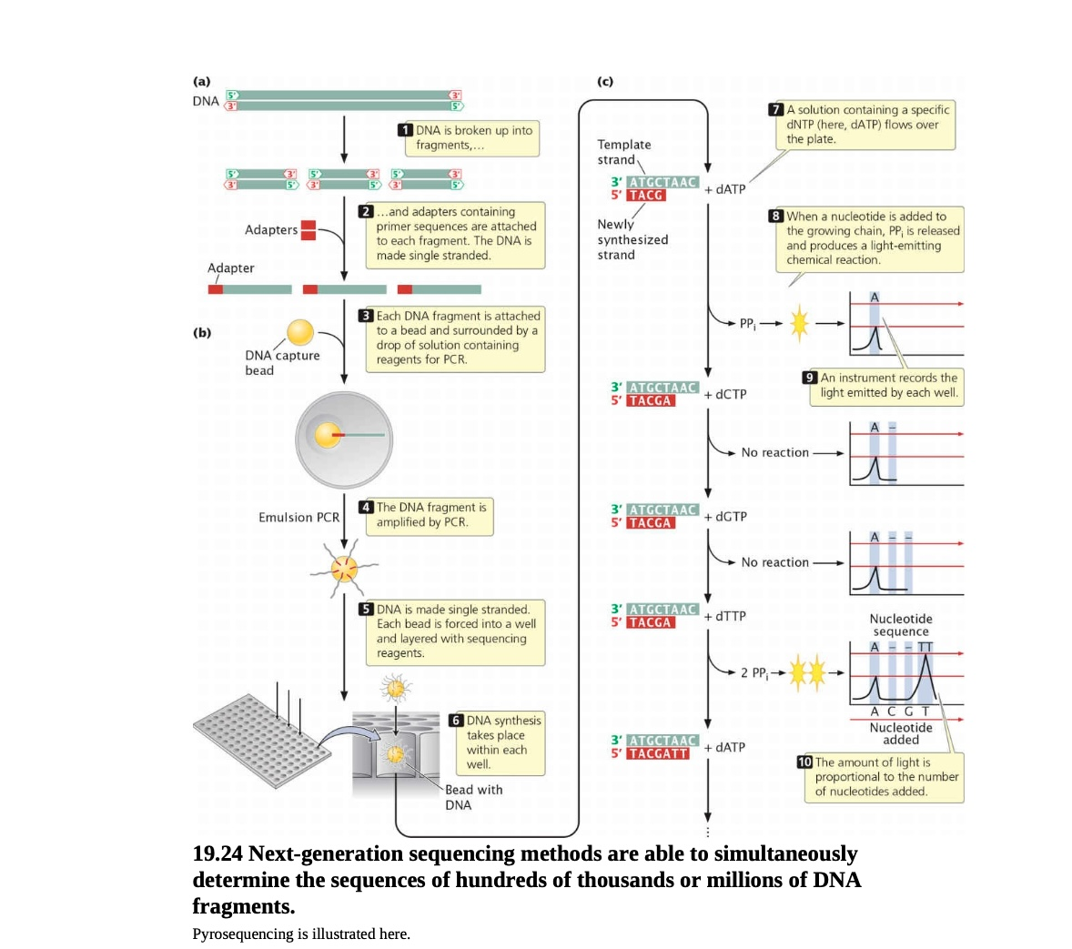
NEXT-GENERATION SEQUENCING
Pyrosequencing Workflow
Figure — Next-generation sequencing methods (pyrosequencing shown) can simultaneously determine the sequences of hundreds of thousands or millions of DNA fragments.
Sequencing Genomes
14

Slide 15
NEXT-GENERATION SEQUENCING
Pyrosequencing: The Light-Based Detection Chemistry
During DNA synthesis, two phosphate groups are cleaved from the incoming dNTP, forming pyrophosphate (PPi), and the nucleotide is attached to the 3′ end of the growing chain.
A solution containing just one type of dNTP (e.g., dATP) is passed across all the wells.
If the template in a well specifies that base next, PPi is released and a chemical reaction converts it into a flash of light, measured by an optical detector.
Light output is proportional to the number of nucleotides added: three successive A's in a row produce three times the light of a single A.
If the next position calls for a different base, no nucleotide is added, no PPi is produced, and no light is emitted.
Each dNTP type is passed across the plate in turn, and the pattern of flashes reveals the sequence of every fragment simultaneously.
Sequencing Genomes
15

Slide 16
THIRD-GENERATION SEQUENCING
Nanopore Sequencing
Even more advanced and rapid sequencing methods, typically called third-generation sequencing technologies, are currently under development. Nanopore sequencing can determine the sequence of individual molecules of DNA.
A
T
G
C
A
A single strand of DNA is passed through a nanopore — a tiny hole in a membrane.
As the molecule passes, one nucleotide at a time, it disrupts an electrical current across the membrane.
The nature of the disruption is affected by the shape of the nucleotide passing through the pore.
Each of the four bases causes a characteristic disruption, so the sequence can be read by analyzing the current as the strand passes through, one nucleotide at a time.
Hundreds of thousands of nanopores can be built into a single chip, so many DNA fragments are read simultaneously.
membrane
electrical current disrupted per base
current trace → base-calling
Sequencing Genomes
16

Slide 17
COMPARING TECHNOLOGIES
Sequencing Technologies at a Glance
Technology
Principle
Scale
Key Feature
Dideoxy (Sanger)
Chain termination with ddNTPs
One fragment / reaction
Gold-standard accuracy; industry standard for decades
Automated Sanger
Dye-labeled ddNTPs, capillary electrophoresis
One sample, 4 colors
50,000–60,000 bp read per run across 96+ capillaries
Illumina (NGS)
Reversible-terminator synthesis, imaged each cycle
Millions of fragments in parallel
Massively parallel; short reads, very high throughput
Pyrosequencing (NGS)
Light emitted via pyrophosphate release
100,000s–millions of fragments
Real-time light signal proportional to bases added
Nanopore (3rd-gen)
Electrical current disruption through a pore
Individual DNA molecules
Reads single molecules directly; no synthesis required
Note: most NGS techniques read shorter fragments than Sanger sequencing, but because so many fragments are sequenced simultaneously, they are far faster overall. On their own, these methods do not reassemble short-fragment sequences into the full original DNA sequence (see Chapter 20).
Sequencing Genomes
17

Slide 18
REVIEW
Key Takeaways
Dideoxy (Sanger) sequencing uses ddNTPs, which lack a 3′-OH group and terminate DNA synthesis when incorporated.
Four parallel reactions (one per base) generate a ladder of fragments, separated by high-resolution gel electrophoresis and read bottom-to-top.
Automated Sanger sequencing uses fluorescently labeled ddNTPs, capillary electrophoresis, and laser detection in a single reaction.
Next-generation sequencing (Illumina, pyrosequencing) sequences hundreds of thousands to millions of fragments in parallel, making it far faster and cheaper than Sanger sequencing.
Third-generation sequencing (nanopore) reads individual DNA molecules directly via disruption of an electrical current.
CONCEPT CHECK
In the dideoxy-sequencing reaction, what terminates DNA synthesis at a particular base?
A
The absence of a base on the ddNTP halts the DNA polymerase.
B
The ddNTP causes a break in the sugar–phosphate backbone.
C
DNA polymerase will not incorporate a ddNTP into the growing DNA strand.
D
The absence of a 3′-OH group on the ddNTP prevents the addition of another nucleotide.
Sequencing Genomes
18

