Slide 1
MOLECULAR GENETICS
Genomics
Structural, Functional & Comparative Genomics — and Metagenomics
A comprehensive lecture deck for BSc / MSc Genetics students
Content and figures adapted and reproduced from Pierce, B. A. Genetics: A Conceptual Approach, 6th Edition, W. H. Freeman.

Slide 2
LECTURE ROADMAP
What We Will Cover
Structural Genomics
Functional Genomics
Comparative Genomics
Genetic & physical maps, genome sequencing strategies, SNPs & haplotypes, GWAS, copy-number variation, bioinformatics, metagenomics, synthetic biology.
Predicting gene function, homology, protein domains, transcriptomics, microarrays, RNA-Seq, reporter sequences, genome-wide mutagenesis.
Prokaryotic vs eukaryotic genome architecture, horizontal gene transfer, noncoding DNA, multigene families, collinearity.
GENOMICS
1

Slide 3
20.1
Structural Genomics
Determining the DNA sequence and organization of entire genomes.
Genetic & physical maps
Genome sequencing strategies
SNPs, haplotypes & genome-wide association studies
Bioinformatics, metagenomics & synthetic biology

Slide 4
20.1 STRUCTURAL GENOMICS
What Is Structural Genomics?
Definition: Structural genomics is the study of the organization and sequence of the genetic information contained within a genome — it provides the basic DNA sequence information used in functional and evolutionary studies.
Maps first: An early step in characterizing a genome is to prepare genetic and physical maps of its chromosomes, showing the relative locations of genes, molecular markers, and chromosome segments.
Why maps matter: Maps are essential for positioning chromosome segments, aligning sequenced DNA into a whole-genome sequence, and are the foundation for positional cloning, in which genes influencing specific traits are located and sequenced.
Analogy: Just as finding a friend's house, an unfamiliar city, or a whole country each require maps of different scale, navigating a genome requires maps of different types and resolutions.
GENOMICS
2

Slide 5
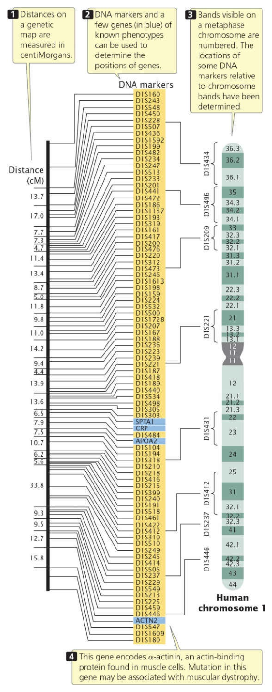
20.1 STRUCTURAL GENOMICS
Genetic Maps (Linkage Maps)
Basis: Genetic maps (linkage maps) provide a rough approximation of gene locations relative to other known genes, based on the genetic process of recombination.
Construction: Organisms of known genotype are crossed and the recombination frequency between loci is determined by examining the progeny.
Interpretation: 50% recombination → loci are on different chromosomes or far apart; less than 50% → loci are close together (same linkage group).
Units: Distances are measured in recombination frequencies — centiMorgans (cM) or map units (m.u.). Data from multiple two-point/three-point crosses are integrated into whole-chromosome linkage maps.
History: Long limited to single-locus phenotypic traits; overcome by molecular techniques — restriction-site analysis, PCR, and DNA sequencing — that supply abundant molecular markers.
Figure 20.1 — A genetic map of human chromosome 1, based on rates of recombination.
Source: Pierce, Genetics: A Conceptual Approach, 6th ed.
GENOMICS
3

Slide 6
20.1 STRUCTURAL GENOMICS
Limitations of Genetic Maps
Low resolution: The human genome has 3.2 billion bp of DNA and a total genetic length of only ~4000 cM — an average of 800,000 bp per cM. Even one marker per cM would still give very coarse physical detail.
Imperfect correspondence to physical distance: Genetic maps are based on crossover rates, which vary from one region of a chromosome to another, so cM distances are only approximations of true physical distance.
Yeast chromosome III example: Comparing the genetic map with the physical (sequence-based) map of yeast chromosome III reveals discrepancies both in distances between genes and in the order of some genes (Figure 20.2).
Still essential: Despite these limitations, genetic maps have been critical to the development of physical maps and to sequencing whole genomes.
GENOMICS
4

Slide 7
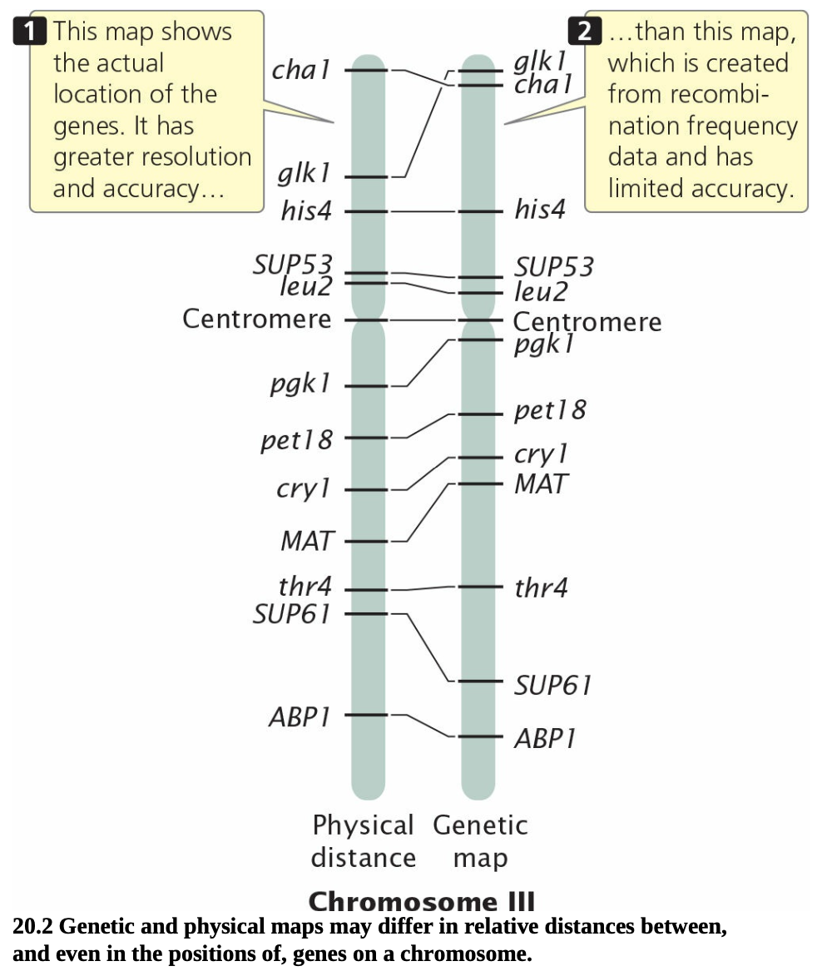
20.1 STRUCTURAL GENOMICS
Genetic Maps vs. Physical Maps
Figure 20.2 — Genetic and physical maps of yeast chromosome III may differ in relative distances between, and even the positions of, genes on a chromosome.
The physical map (left) shows actual gene locations with greater resolution and accuracy; the genetic map (right) is built from recombination-frequency data and has limited accuracy.
GENOMICS
5

Slide 8
20.1 STRUCTURAL GENOMICS
Physical Maps
Definition: Physical maps are based on the direct analysis of DNA and place genes in relation to distances measured in base pairs, kilobases, or megabases — generally higher resolution and more accurate than genetic maps.
Analogy: A physical map is like a neighborhood map showing every house on a street; a genetic map is like a highway map showing only the general locations of major towns.
Restriction mapping: DNA is cut with a restriction enzyme and fragments separated by gel electrophoresis; the number and position of bands reveal restriction-site distances. Samples cut with one enzyme, a different enzyme, and a double digest allow the sites to be positioned by comparing fragment-size overlaps.
Scale-up: For long DNA (>30 kb), computer programs determine restriction maps; mapping may be aided by radioactive end-labeling or hybridization probes.
Other techniques: Sequence-tagged sites (STSs — short unique DNA sequences), in situ hybridization (visually maps markers to chromosome locations), and direct DNA sequencing.
GENOMICS
6

Slide 9
20.1 STRUCTURAL GENOMICS
Milestones in Whole-Genome Sequencing
The ultimate goal of structural genomics is the ordered nucleotide sequence of an entire genome. Because only ~500–700 nucleotides can be sequenced at a time, a genome must be broken into thousands to millions of overlapping fragments, sequenced, and reassembled.
1982
1995
1996–2000
2003
Bacteriophage λ genome (49,000 bp) — first genome sequenced
Haemophilus influenzae (1.8 Mb) — first free-living organism (Venter, Fraser & Smith)
Yeast (1996) → E. coli (1997) → C. elegans (1998) → Drosophila & Arabidopsis (2000)
Human Genome Project sequencing completed
GENOMICS
7

Slide 10
20.1 STRUCTURAL GENOMICS
Assembling a Genome: Two Approaches
Map-Based Sequencing
Whole-Genome Shotgun Sequencing
Short sequenced fragments are assembled by first building detailed genetic and physical maps that place genetic markers at regular intervals along each chromosome.
Chromosomes are separated by pulsed-field gel electrophoresis (PFGE) or flow cytometry, then cut by partial restriction digestion into overlapping fragments cloned in YACs/BACs/cosmids.
Overlapping large-insert clones are assembled into a contig — a continuous stretch of DNA — using genetic markers or restriction “fingerprints.”
Selected clones are fractured into small-insert subclones, sequenced, and reassembled using sequence overlap; contigs are then joined and gaps filled.
Used by the International Human Genome Sequencing Consortium, with BAC clones of ~150,000 bp each.
Proposed by Craig Venter (Celera Genomics, 1998) as a faster alternative to the map-based approach.
Small-insert clones are prepared directly from genomic DNA (no prior map needed) and sequenced.
Powerful computer programs assemble the entire genome purely by examining sequence overlap among reads.
Sequencing coverage = average number of times a nucleotide is sequenced (e.g., 10× coverage). High coverage is needed because most of the genome must be sequenced many times over.
Initially used for small (bacterial) genomes; its success on the human genome was originally uncertain.
GENOMICS
8

Slide 11
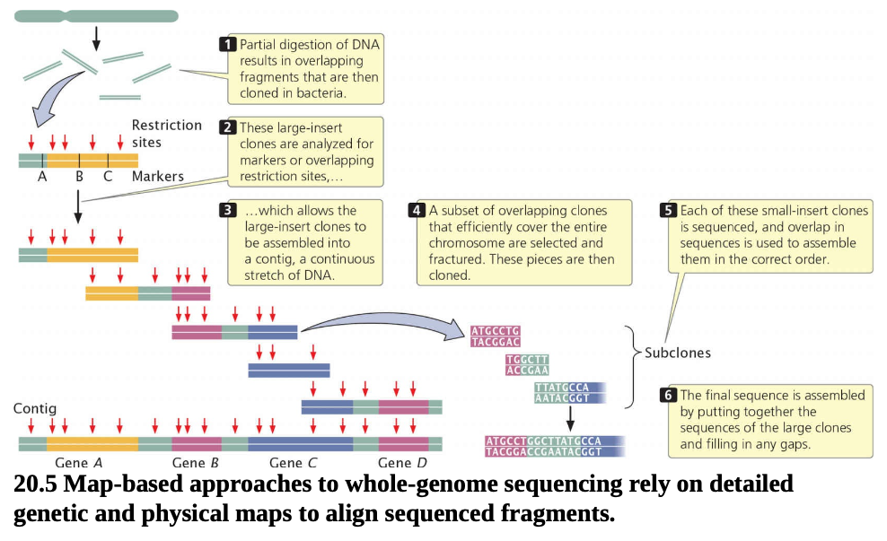
20.1 STRUCTURAL GENOMICS
Map-Based Sequencing in Practice
Figure 20.5 — Map-based approaches rely on detailed genetic and physical maps to align sequenced fragments into a whole-genome sequence.
Partial digestion → large-insert clones analyzed for markers/overlapping restriction sites → assembled into a contig → fractured into small-insert subclones → sequenced → final sequence assembled.
GENOMICS
9

Slide 12
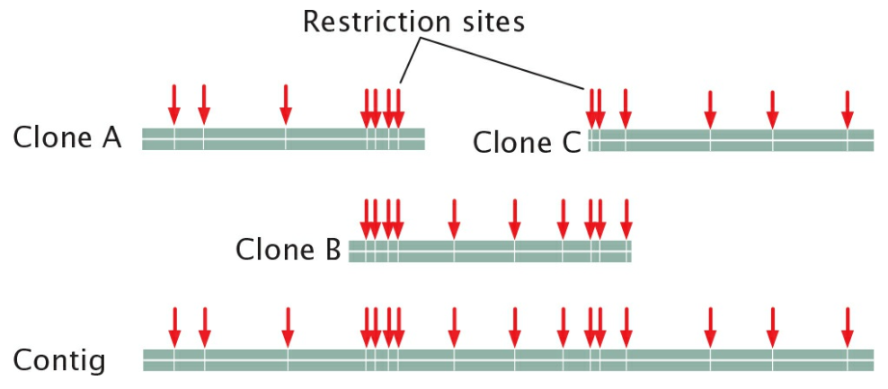
20.1 STRUCTURAL GENOMICS
Contigs, Clone Order, and Fingerprints
Contig: A set of two or more overlapping DNA fragments that together form a contiguous stretch of DNA. In 1993, a contig of 196 overlapping YAC clones was assembled for the human Y chromosome.
Marker-based ordering: A probe is made for each genetic marker and used to screen a clone library; because clones are larger than the markers, some clones carry more than one marker, revealing overlap (e.g., clone A: M1,M2; clone B: M2,M3,M4; clone C: M4,M5).
Restriction fingerprinting: Clones can also be ordered without pre-existing maps: each clone is cut with several restriction enzymes to generate a unique restriction “fingerprint,” stored in a database, and computer-compared for overlap.
Overlapping markers reveal which clones share DNA.
Source: Pierce, Genetics: A Conceptual Approach, 6th ed.
GENOMICS
10

Slide 13
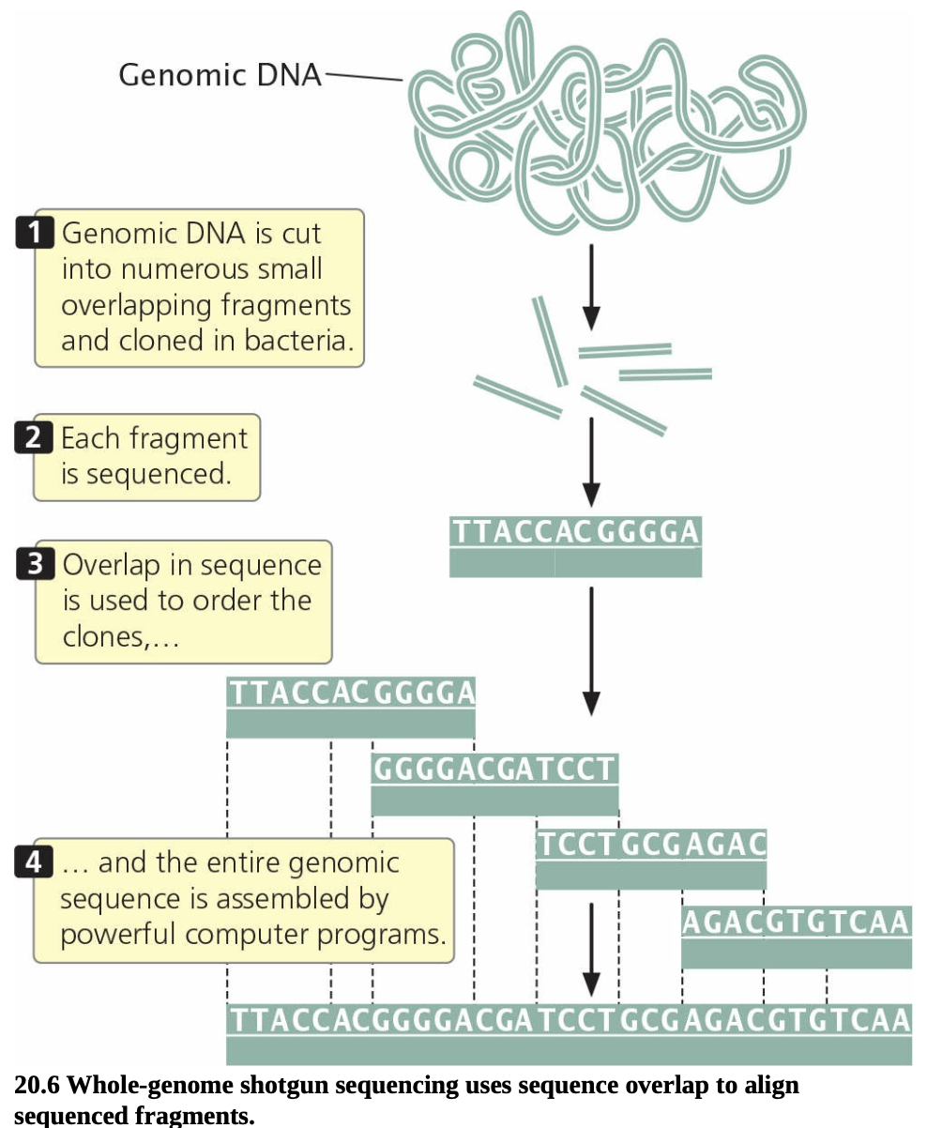
20.1 STRUCTURAL GENOMICS
Whole-Genome Shotgun Sequencing
Figure 20.6 — Genomic DNA is cut into overlapping fragments, each fragment is sequenced, and sequence overlap is used to order and assemble the entire genome computationally.
One advantage: small-insert clones can be placed in simple plasmids, easy to manipulate at scale.
GENOMICS
11

Slide 14
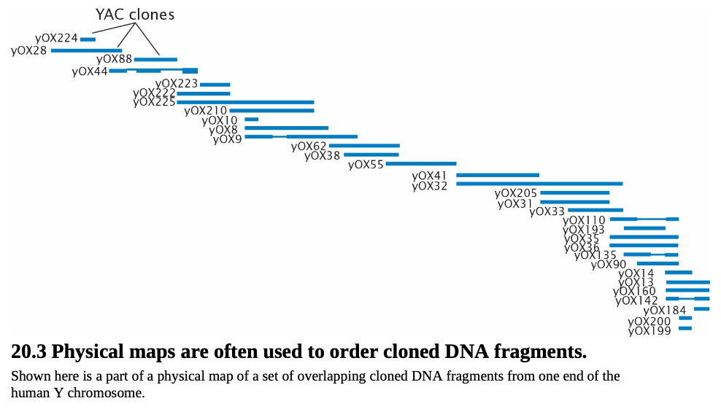
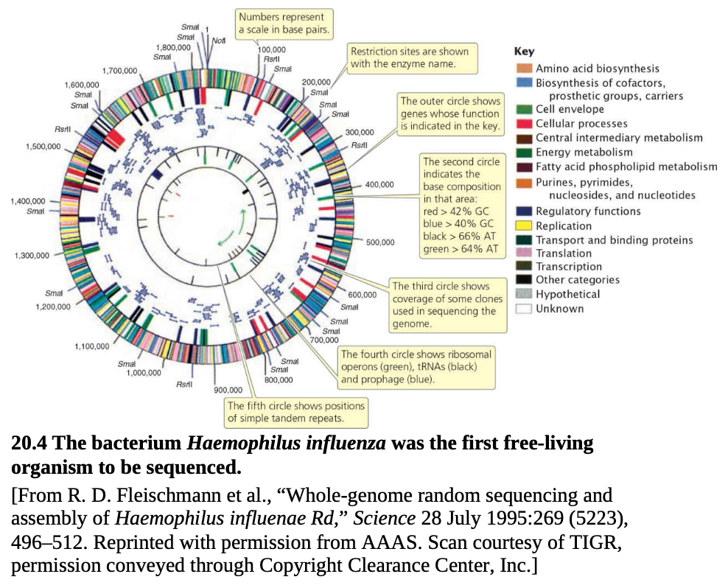
20.1 STRUCTURAL GENOMICS
Ordering Cloned DNA Fragments
Figure 20.3 (left) — a physical map of overlapping YAC clones from one end of the human Y chromosome. Figure 20.4 (right) — the first free-living organism sequenced, Haemophilus influenzae (1.8 Mb), mapped by whole-genome random sequencing.
Figure 20.4 — H. influenzae, the first free-living organism sequenced (1995).
Figure 20.3 — Physical map used to order overlapping clones.
GENOMICS
12

Slide 15
20.1 STRUCTURAL GENOMICS
The Human Genome Project
Launch: By 1980, mapping and sequencing methods were sufficiently developed that geneticists began seriously proposing sequencing of the entire human genome. Initial estimates: 15 years and $3 billion.
Start: The Human Genome Project officially began in October 1990. Early efforts focused on developing automated cloning/sequencing methods and generating detailed physical and genetic maps.
Public consortium: The International Human Genome Sequencing Consortium — 20 research groups and hundreds of researchers worldwide — used a map-based strategy.
Private effort: Craig Venter's Celera Genomics (1998) pursued whole-genome shotgun sequencing in parallel, aiming to be faster than the public map-based approach.
Completion: Sequencing of the human genome was completed in the spring of 2003.
GENOMICS
13

Slide 16
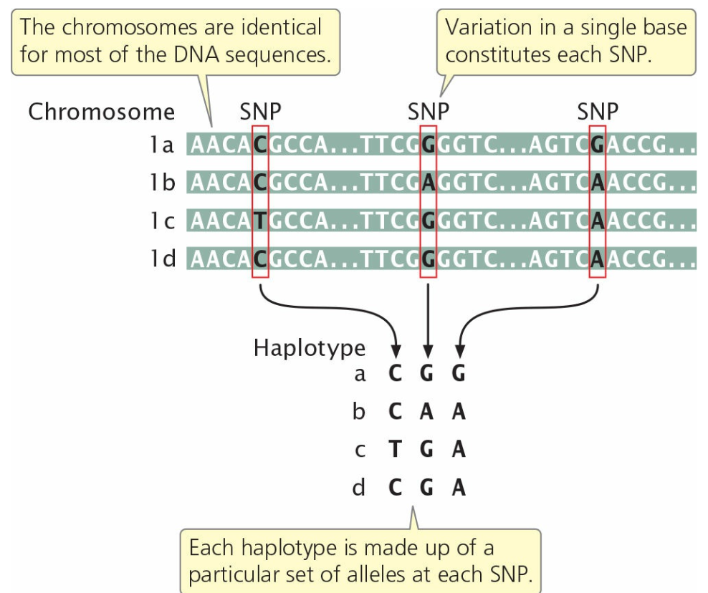
20.1 STRUCTURAL GENOMICS
Single-Nucleotide Polymorphisms (SNPs)
Definition: A SNP (“snip”) is a site in the genome where individual members of a species differ at a single base pair — inherited as allelic variants, though usually without a phenotypic effect.
How common: Two random people are identical at ~99.9% of DNA sequence, but because the genome is 3.2 billion bp, they still differ at >3 million base pairs. A SNP occurs roughly every 1000 bp between two people's chromosomes.
Haplotypes: SNPs that arose on one ancestral chromosome remain physically linked to nearby variants; the specific set of SNPs/variants on one chromosome (or part of it) is a haplotype.
Linkage disequilibrium: The nonrandom association of variants within a haplotype. Because SNPs in a haplotype are co-inherited, only a small number of tag-SNPs (perhaps 100,000 of ~10 million human SNPs) can identify most haplotypes.
Figure 20.8 — A haplotype is a specific set of SNPs and other genetic variants observed on a single chromosome or part of a chromosome.
GENOMICS
14

Slide 17
20.1 STRUCTURAL GENOMICS
The HapMap Project & Genome-Wide Association Studies
International HapMap Project: Cataloged and mapped SNPs/variants to identify common haplotypes for linkage and family studies — 4.6 million SNPs across all 23 human chromosome pairs, in four ethnic groups (African, Japanese, Chinese, European). Greatest SNP diversity found within Africans, consistent with an African origin of modern humans.
Recombination hotspots: HapMap linkage-disequilibrium data show recombination is not random across chromosomes — numerous hotspots exist where recombination occurs more often than expected by chance.
Genome-wide association studies (GWAS): Use numerous SNPs scattered across the genome to locate genes of interest by comparing haplotypes in affected vs. healthy individuals.
Examples: Age-related macular degeneration linked to a complement factor H gene on chromosome 1 (96 cases, 50 controls, >100,000 SNPs); a major Crohn disease gene; a 2007 UK study of 17,000 people and 500,000 SNPs found associations between 24 genes/segments and 7 diseases (coronary artery disease, Crohn disease, rheumatoid arthritis, bipolar disorder, hypertension, two types of diabetes).
“Missing heritability”: GWAS genes often explain only a modest fraction of genetic influence (e.g., 95 loci for blood lipids explained only 25–30% of variation) — the undetected remainder is called the “dark matter of the genome.”
GENOMICS
15

Slide 18
20.1 STRUCTURAL GENOMICS
Copy-Number Variations (CNVs)
Definition: A diploid person normally has two copies of every gene, but studies reveal differences among people in the number of copies of large DNA sequences (>1000 bp) — called copy-number variations (CNVs), including deletions and duplications.
Scale: A study of 270 people from four populations found more than 1447 genomic regions varying in copy number, encompassing 12% of the human genome — likely only a subset of all CNVs, and often spanning several hundred thousand bp.
Functional impact: Most CNVs contain multiple genes and can affect phenotype by altering gene dosage or repositioning sequences that change nearby gene regulation.
Disease associations: CNVs in UGT2B17 affect testosterone metabolism and prostate cancer risk; CNVs are also linked to Crohn disease, rheumatoid arthritis, psoriasis, schizophrenia, autism, diabetes, and intellectual disability.
GENOMICS
16

Slide 19
20.1 STRUCTURAL GENOMICS
Bioinformatics
Definition: Bioinformatics is an interdisciplinary field combining molecular biology and computer science; it centers on databases, search algorithms, gene-prediction software, and analytical tools that “mine” DNA-, RNA-, and protein-sequence data.
Databases: Primary databases contain sequence information plus its source and determination method; secondary databases contain analysis results — sequence patterns, variations, mutations, and evolutionary relationships.
Finding genes: The ab initio approach scans sequence for features typical of genes (open reading frames with start/stop codons, splice sites, promoter sequences). The comparative approach looks for similarity to sequences of known genes. Reported gene counts remain estimates because of introns, alternative splicing, and gene duplication.
Annotation: Once identified, a gene is annotated — linking its sequence to information on function, expression, protein product, and homologous genes in other species.
BLAST: The Basic Local Alignment Search Tool (BLAST) is the most widely used program for searching sequence databases for regions of high similarity to a query sequence, along with a significance score.
Other resources: Databases catalog SNP frequencies across populations, disease-causing mutations (e.g., the Human Variome Project), and gene expression patterns.
GENOMICS
17

Slide 20
20.1 STRUCTURAL GENOMICS
Metagenomics
Definition: Metagenomics is an emerging field in which the genome sequences of an entire community of organisms inhabiting a common environment are sampled and determined directly from environmental DNA — without culturing individual species.
Two key applications: (1) identifying and studying microbes that cannot be cultured in the lab, and (2) studying the community structure of microorganisms.
Acid mine drainage study: An early metagenomic study of a mine's acid drainage found the community consisted of only a few dominant bacterial species.
Global Ocean Sampling Expedition: Followed the route of Darwin's HMS Beagle voyage; cataloged sequences for more than 6 million proteins, including 1700+ new protein families, and led to discovery of proteorhodopsins — light-driven proton pumps that are a major source of energy flux in the world's oceans.
Gene-centric approach: Metagenomics also allows communities to be characterized by their component genes rather than species — asking which genes are common to, or essential within, a community.
GENOMICS
18

Slide 21
20.1 STRUCTURAL GENOMICS
The Human Microbiome
Bacteria inhabiting the human gut, skin, and other body sites are collectively termed the human microbiome.
>100 trillion
100×
2016
Microbiome cells — more than 10× the number of human cells in the body
As many genes as the human genome itself
National Microbiome Initiative unveiled to advance understanding of microbiomes
Gut microbiota & obesity: Bacteroidetes and Firmicutes dominate the human gut; obese people have relatively more Firmicutes, and this proportion falls in obese people who lose weight on a low-calorie diet — mirrored in obese vs. lean mice.
Transplant experiment: Lean mice given gut bacteria from obese mice extracted more calories from food and stored more fat — suggesting gut microflora contributes to obesity.
GENOMICS
19

Slide 22
20.1 STRUCTURAL GENOMICS
Synthetic Biology
Definition: Synthetic biology is a new field that seeks to design organisms — built entirely from scratch — that might provide useful functions, such as microbes that generate clean energy or break down toxic waste.
2002 — Poliovirus: Geneticists re-created the poliovirus by joining together laboratory-synthesized pieces of DNA.
2010 — Mycoplasma mycoides: Daniel Gibson and colleagues synthesized the complete 1.08-million-bp genome from about a thousand synthesized DNA pieces, joined into successively larger fragments; the synthetic genome even encoded, in DNA code, an email address, researcher names, and quotations. The genome was transplanted into an emptied M. capricolum cell, which then expressed the traits of the synthetic genome.
2014 — Synthetic yeast chromosome: Geneticists created a synthetic chromosome that successfully replaced a natural chromosome in yeast cells; work continues toward a fully synthetic yeast genome.
Concerns: The ability to tailor-make novel genomes raises biosafety and biosecurity concerns — accidental ecological escape or deliberate use in bioterrorism/biological warfare — prompting ongoing discussion among geneticists, ethicists, security experts, and policymakers.
GENOMICS
20

Slide 23
20.2
Functional Genomics
Determining the functions of genes by using genomic approaches.
Predicting function from sequence: homology, domains
Transcriptomics: microarrays & RNA sequencing
Reporter sequences & genome-wide mutagenesis

Slide 24
20.2 FUNCTIONAL GENOMICS
From Sequence to Function
The limitation of sequence alone: A genome sequence by itself is of limited use — like having a huge set of encyclopedias without being able to read: you recognize the letters, but the text is meaningless.
Definition: Functional genomics characterizes what sequences do — their function. Its goals include identifying the transcriptome (all RNA molecules transcribed from a genome) and the proteome (all proteins encoded by a genome).
Two toolkits: Functional genomics uses both bioinformatics and laboratory-based experimental approaches, building on gene-function methods from Chapter 19 — in situ hybridization, experimental mutagenesis, transgenic animals, and knockouts.
This section's focus: Methods that rely on knowing the sequences of other genes, and methods that can be applied to large numbers of genes simultaneously.
GENOMICS
21

Slide 25
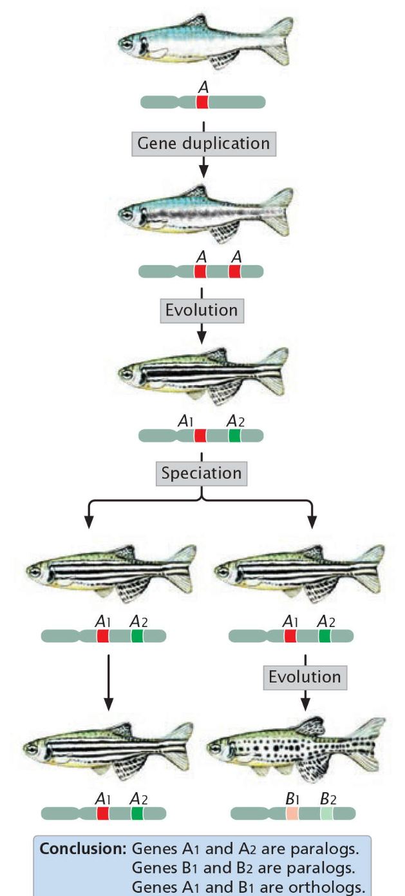
20.2 FUNCTIONAL GENOMICS
Predicting Function from Sequence
Why not just biochemistry? Predicting an encoded protein's amino-acid sequence and then studying the isolated protein is time-consuming and expensive; a major goal is to predict function computationally, from DNA sequence alone.
Homology searches: Compare DNA/protein sequences within and between species. Evolutionarily related genes (homologous genes) tend to have similar sequences.
Orthologs: Homologous genes in different species that evolved from the same ancestral gene (e.g., mouse and human α-hemoglobin genes).
Paralogs: Homologous genes within the same species that arose by duplication of a single ancestral gene (e.g., human α- and β-hemoglobin genes).
Using homology: Databases and programs such as BLAST scan for orthologous/paralogous sequences; if a function is known for one homolog, it provides clues to the function of the newly discovered gene.
Figure 20.9 — Homologous genes are evolutionarily related. Orthologs are homologous genes in different species; paralogs are homologous genes in the same species.
GENOMICS
22

Slide 26
20.2 FUNCTIONAL GENOMICS
Protein Domains
Definition: Complex proteins often contain protein domains — regions with specific shapes or functions. For example, many DNA-binding proteins share a domain that provides the DNA-binding function, such as the zinc finger — a loop of amino acids containing a zinc ion.
Conservation: Each domain has a characteristic amino-acid arrangement and has been relatively stable over evolutionary time; domains found in humans are also found in other multicellular eukaryotes.
A limited “parts list”: There is probably a limited, though large, number of protein domains, which have mixed and matched through evolutionary time to yield the protein diversity of present-day organisms.
Using domains to predict function: A newly identified gene's sequence can be scanned against a database of known domains; if it encodes one or more domains of known function, this provides important clues to the gene's possible role.
GENOMICS
23

Slide 27
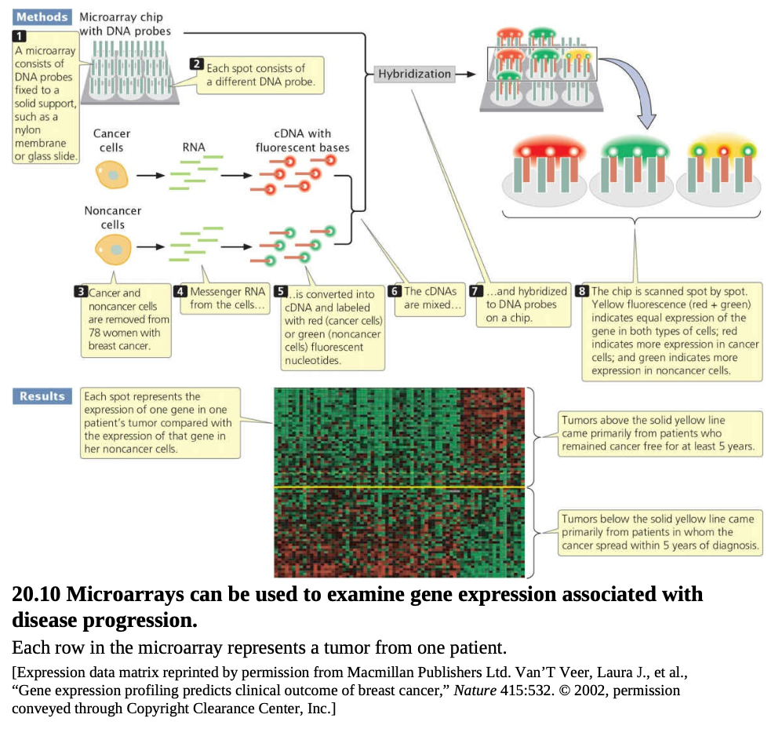
20.2 FUNCTIONAL GENOMICS
Gene Expression: Microarrays
Why go beyond single genes: In situ hybridization/probes are slow and labor-intensive for profiling many genes; transcriptomics — examining expression of thousands of genes at once — is enabled by genomic methods such as microarrays.
Method: Known DNA fragments (probes) corresponding to genes are fixed to a solid support in an ordered array; mRNA/cDNA from experimental cells is fluorescently labeled and hybridized to the array, and fluorescence is scanned automatically.
Breast cancer case study: Expression of 25,000 genes was examined in tumors from 78 young women; cancer cDNA labeled red, noncancer green — 70 genes' expression patterns predicted, far better than traditional size/appearance measures, whether cancer would spread within 5 years (34 of 78 patients relapsed).
Limitations: Requires prior knowledge of sequences; similar sequences can cross-hybridize to the same probe; limited ability to precisely quantify expression level — independent verification is desirable.
Figure 20.10 — Microarrays can be used to examine gene expression associated with disease progression (breast cancer study).
GENOMICS
24

Slide 28
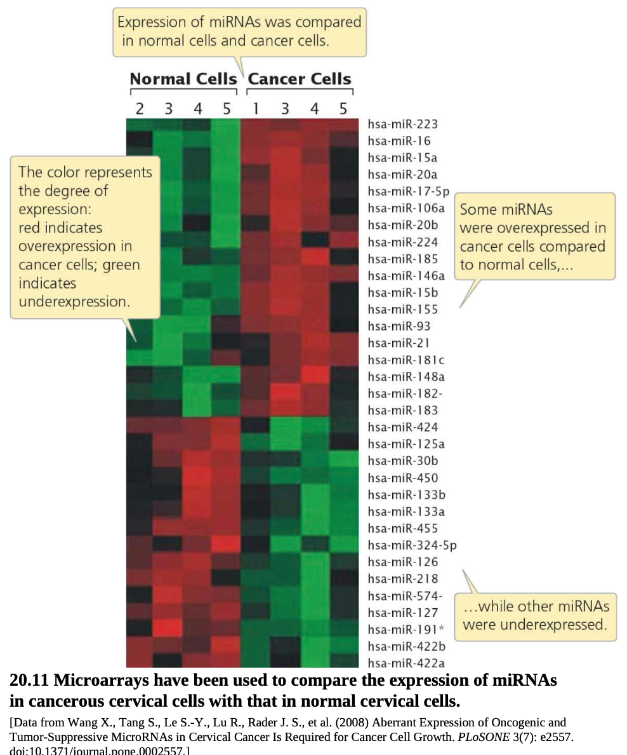
20.2 FUNCTIONAL GENOMICS
microRNA Expression in Cancer
miRNAs and cancer: Microarrays can also profile microRNA (miRNA) expression. miRNAs are frequently expressed abnormally in cancerous tissue and may contribute to cancer progression.
Cervical cancer example: A study found several miRNAs overexpressed in cancerous cervical tissue relative to normal tissue, while other miRNAs were underexpressed.
Clinical relevance: miRNA expression has been linked to tumor resistance to chemotherapy and radiation, and can help predict how tumors will respond to treatment — differentially expressed gene products are being explored as drug targets.
Figure 20.11 — Microarrays comparing miRNA expression in cancerous vs. normal cervical cells.
GENOMICS
25

Slide 29
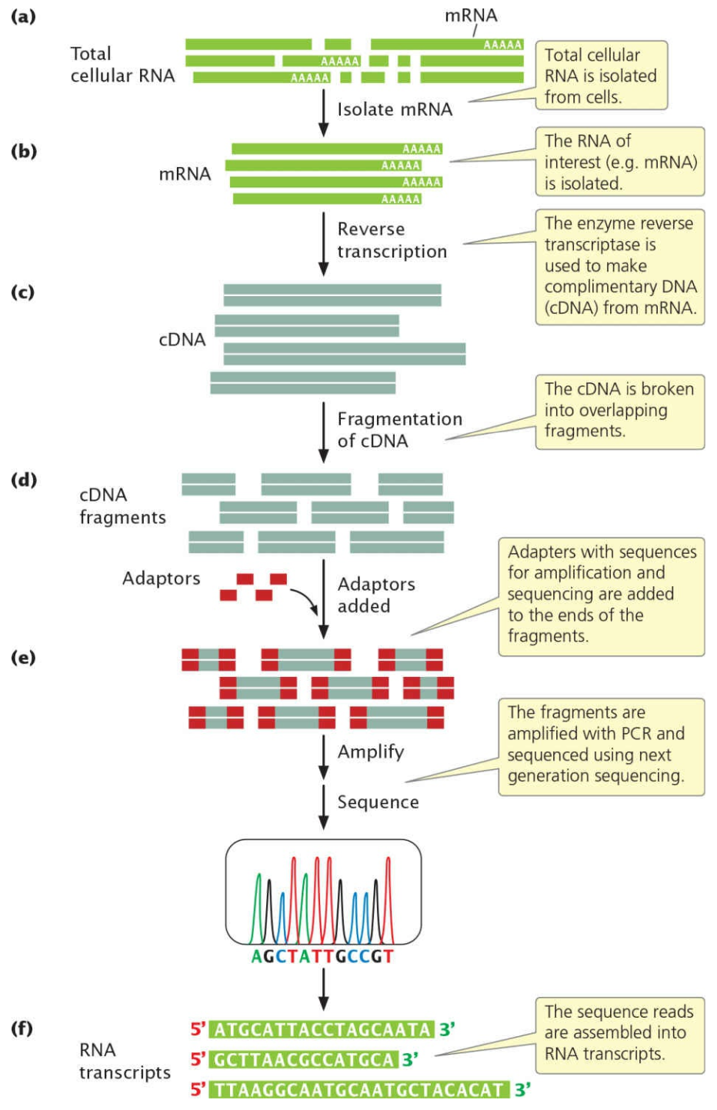
20.2 FUNCTIONAL GENOMICS
RNA Sequencing (RNA-Seq)
Figure 20.12 — RNA sequencing determines gene expression by isolating RNA, converting it to cDNA, fragmenting and sequencing it, and assembling the reads into RNA transcripts.
Five steps: (1) isolate RNA → (2) convert to cDNA (reverse transcriptase) → (3) fragment & add adaptors → (4) amplify (PCR) & sequence (next-generation platform) → (5) assemble reads into transcripts, often against a reference genome.
GENOMICS
26

Slide 30
20.2 FUNCTIONAL GENOMICS
RNA-Seq: Method & Applications
What it reveals: RNA-Seq gives detailed information on gene expression, including RNA types and numbers produced, alternatively processed RNAs, differential expression of the two alleles in a diploid individual, and RNA from bidirectional or overlapping transcription.
Removing rRNA: Total cellular RNA is mostly rRNA (often >90%); because rRNA is rarely the focus of study, the RNA of interest (e.g., mRNA) is isolated before converting to cDNA and sequencing (fragments ~200 bp).
Yeast transcriptome map: An early RNA-Seq application revealed, surprisingly, that 75% of nonrepetitive yeast genome sequences are transcribed.
Single-cell RNA-Seq: Enables study of expression differences among individual cells. In one study, RNA from 4645 individual cells from 19 melanoma patients revealed heterogeneity between malignant and nonmalignant cells, and within malignant cells, including differences associated with resistance to anticancer drugs.
GENOMICS
27

Slide 31
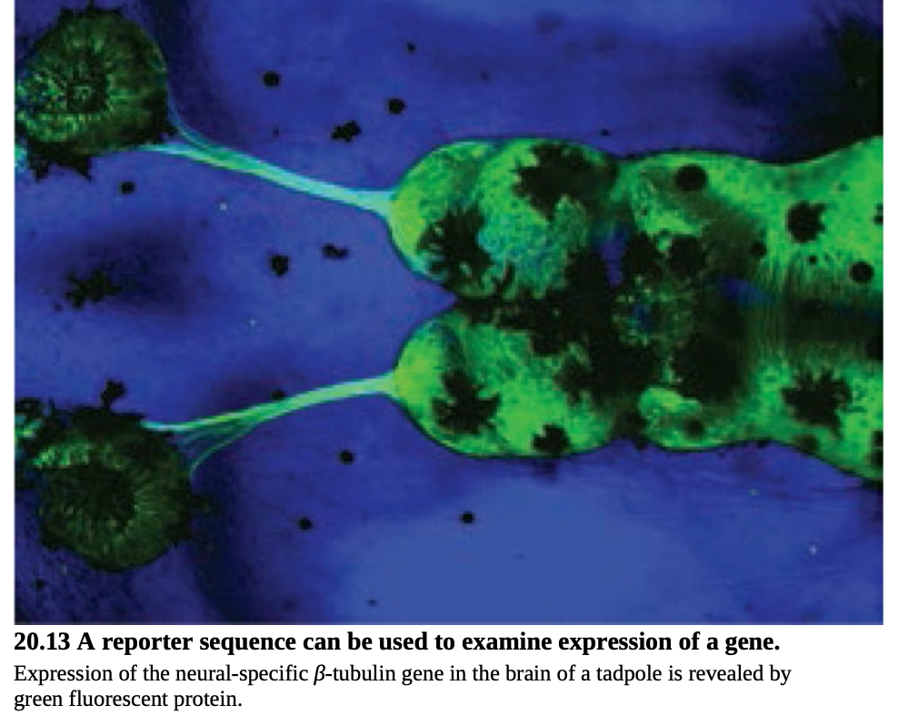
20.2 FUNCTIONAL GENOMICS
Gene Expression & Reporter Sequences
Visual approach: A genomic fragment is cloned in a BAC/vector that includes a gene's coding region plus its regulatory sequences; the coding region is replaced with a reporter sequence encoding an easily observed product.
GFP reporter: A common reporter is green fluorescent protein (GFP) from jellyfish. The cloned fragment is inserted into an embryo, creating a transgenic organism whose native regulatory sequences drive GFP expression at the right time and tissue.
GENSAT project: Systematically replaces coding regions of hundreds of genes with GFP in transgenic mice to build a comprehensive atlas of gene expression in the mouse brain, illuminating where genes linked to inherited neurological disorders act.
Allen Brain Atlas: Has compiled expression patterns for 20,000 genes in the mouse brain.
Figure 20.13 — GFP reveals expression of the neural-specific β-tubulin gene in a tadpole's brain.
GENOMICS
28

Slide 32
20.2 FUNCTIONAL GENOMICS
Genome-Wide Mutagenesis Screens
Rationale: One of the best ways to learn a gene's function is to examine phenotypes of organisms carrying mutations in that gene. Traditionally this was limited by the number of naturally occurring mutations and by mapping with few chromosomal markers.
Modern mutagenesis screen: Couples (1) random, genome-wide induction of mutations — via radiation, chemical mutagens, or transposable elements — with (2) accurate mapping using abundant molecular markers such as SNPs, all automated at scale.
Zebrafish example: Male zebrafish are treated with ethylmethylsulfonate (EMS), which induces germ-line mutations in sperm; treated males are mated to wild-type females, and F1 offspring are screened for mutant (dominant) phenotypes. Recessive mutations require further breeding to reveal.
From phenotype to gene: Variant phenotypes are verified as single-gene mutations through further crosses; the causative gene, if unknown, can then be located via positional cloning.
Application: Mutagenesis screens in mice are used to find genes affecting cardiovascular function; homology searches then test whether similar genes exist in humans, to better understand human cardiac disease.
GENOMICS
29

Slide 33
20.3
Comparative Genomics
Studying similarities and differences in gene content, function, and organization among genomes — and how genomes evolve.
Prokaryotic vs. eukaryotic genome architecture
Horizontal gene transfer
Noncoding DNA, multigene families & collinearity

Slide 34
20.3 COMPARATIVE GENOMICS
Prokaryotic Genomes
Definition: Comparative genomics studies similarities and differences in gene content, function, and organization among genomes of different organisms, revealing evolutionary relationships and the factors shaping genome evolution.
Chromosome structure: Most prokaryotic genomes consist of a single circular chromosome, though there are exceptions: Vibrio cholerae has two circular chromosomes; Borrelia burgdorferi has one large linear chromosome plus 21 smaller chromosomes.
Genome size range: From 490,885 bp in Nanoarchaeum equitans (an archaean living within another archaean) to 9,105,828 bp in Bradyrhizobium japonicum (a soil bacterium). E. coli, the classic genetic model, has a fairly typical 4.6 million bp genome.
Gene number: Typically 1000–2000 genes (range ~480 to ~8300); gene density is fairly constant across species at about one gene per 1000 bp — so, unlike eukaryotes, prokaryotes with larger genomes generally have more genes.
GENOMICS
30

Slide 35
20.3 COMPARATIVE GENOMICS
Genome Size and Environmental Complexity
Selection for rapid division: Cell-division time is often longer in organisms with larger genomes (more DNA to replicate); selection may favor smaller genomes where rapid reproduction is advantageous.
Small genomes → restricted habitats: Prokaryotes with the smallest genomes tend to occupy restricted habitats, such as living inside other organisms — a constant environment and host-supplied metabolic functions allow survival with fewer genes.
Large genomes → complex, variable environments: Bacteria with large genomes tend to occupy complex environments (e.g., soil, plant root nodules), where occasionally useful genes and abundant resources reduce pressure for rapid division.
Case study — Streptomyces coeliocolor: The “Boy Scout” bacterium (genome 8,677,507 bp) has a diverse gene set — literally “be prepared” — including genes for breaking down complex carbohydrates (letting it consume decaying plant, animal, insect, and fungal matter) and genes for antibiotic-like secondary metabolites protecting against desiccation and cold.
GENOMICS
31

Slide 36
20.3 COMPARATIVE GENOMICS
Table 20.1 — Representative Prokaryotic Genomes
Species | Genome Size (Mb) | Number of Predicted Genes
Archaeoglobus fulgidus (archaeon) | 2.18 | 2,407
Methanobacterium thermoautotrophicum | 1.75 | 1,869
Nanoarchaeum equitans | 0.49 | 536
Bacillus subtilis | 4.21 | 4,100
Bradyrhizobium japonicum | 9.11 | 8,317
Escherichia coli | 4.64 | 4,289
Haemophilus influenzae | 1.83 | 1,709
Mycobacterium tuberculosis | 4.41 | 3,918
Mycoplasma genitalium | 0.58 | 480
Staphylococcus aureus | 2.88 | 2,697
Vibrio cholerae | 4.03 | 3,828
Source: Data from the Genome Atlas, Center for Biological Sequence Analysis (cbs.dtu.dk/services/GenomeAtlas) — reproduced from Pierce, Genetics: A Conceptual Approach, 6th ed.
GENOMICS
32

Slide 37
20.3 COMPARATIVE GENOMICS
Horizontal Gene Transfer
DNA gain and loss in bacteria: Bacteria possess mechanisms to both lose DNA (simple deletion) and gain DNA (gene duplication, insertion of transposable elements).
Horizontal gene transfer: A process by which both closely and distantly related bacterial species periodically exchange genetic information over evolutionary time — through transformation (uptake of environmental DNA), exchange of plasmids, and transduction (viral vectors).
Blurring species boundaries: The widespread occurrence of horizontal gene transfer has caused some biologists to question whether distinct species even exist among bacteria.
Bacterial DNA in the human genome: Researchers have found the human genome contains as many as 145 genes derived from bacteria, archaea, viruses, fungi, and other organisms — with much higher amounts in some cancer cells, suggesting either greater susceptibility to horizontal transfer in cancer cells or a contributory role in cancer progression.
GENOMICS
33

Slide 38
20.3 COMPARATIVE GENOMICS
Eukaryotic Genomes: An Overview
Breadth of sequenced genomes: Complete sequences now exist for numerous fungi and protozoans, cucumbers, papayas, corn, rice, sorghum, grapevines, strawberries, silkworms, several fruit-fly species, aphids, mosquitoes, anemones, tunicates, ctenophores, mice, rats, dogs, pigs, sheep, cows, horses, minke whales, over 200 bird species, orangutans, gorillas, chimpanzees, humans, and many more.
Ancient DNA: Even the genomes of extinct organisms have been sequenced, including woolly mammoths and Neanderthals.
A caveat on “complete”: Even “completely sequenced” eukaryotic genomes typically contain gaps, and heterochromatic regions may not be sequenced at all — so genome-size and gene-number figures are often estimates that vary with the gene-finding software used.
GENOMICS
34

Slide 39
20.3 COMPARATIVE GENOMICS
Table 20.2 — Representative Eukaryotic Genomes
Species | Genome Size (Mb) | Number of Predicted Genes
Saccharomyces cerevisiae (yeast) | 12 | 6,144
Arabidopsis thaliana (thale-cress) | 125 | 25,706
Caenorhabditis elegans (nematode) | 103 | 20,598
Drosophila melanogaster (fruit fly) | 170 | 13,525
Anopheles gambiae (mosquito) | 278 | 14,707
Danio rerio (zebrafish) | 1,465 | 22,409
Takifugu rubripes (tiger pufferfish) | 329 | 22,089
Mus musculus (mouse) | 2,627 | 26,762
Pan troglodytes (chimpanzee) | 2,733 | 22,524
Homo sapiens (human) | 3,223 | ~20,000
Source: Data from the Ensembl website (ensembl.org) — reproduced from Pierce, Genetics: A Conceptual Approach, 6th ed. Additional rows (moss, corn, barley) also appear in the original table.
GENOMICS
35

Slide 40
20.3 COMPARATIVE GENOMICS
Genome Size, Gene Number & Complexity: No Simple Link
Bigger organisms, bigger genomes — usually: Multicellular eukaryotes generally have more DNA than simple, single-celled eukaryotes such as yeast, and more genes than prokaryotes.
But size ≠ complexity: Among multicellular eukaryotes there is no close relationship between genome size and complexity — the mosquito Anopheles gambiae has 60% more DNA than the structurally similar fruit fly Drosophila melanogaster.
Gene number ≠ complexity either: Humans have more genes than invertebrates, but only about twice as many as fruit flies, and fewer than the plant Arabidopsis thaliana. C. elegans has more genes than Drosophila but is less complex. The pufferfish has ~1/10 the DNA of humans/mice but about as many genes.
Introns and noncoding DNA: Most DNA in multicellular eukaryotes is noncoding, and many genes are interrupted by introns; in more complex eukaryotes, both the number and length of introns tend to be greater.
GENOMICS
36

Slide 41
20.3 COMPARATIVE GENOMICS
Segmental Duplications & Multigene Families
Segmental duplications: Duplicated regions greater than 1000 bp that are almost identical in sequence; about 4% of the human genome consists of segmental duplications, averaging 15,000 bp. They can be intrachromosomal (same chromosome) or interchromosomal (different chromosomes).
How they arise and matter: Segmental duplications arise from processes like unequal crossing over, and once present, they promote further duplication by causing misalignment. The original copy can continue its function while the new copy mutates freely — potentially gaining a new function. This process is a major driver of gene-family expansion.
Multigene family: A group of evolutionarily related genes that arose through repeated duplication and divergence of an ancestral gene.
Examples: The human globin gene family has 13 genes encoding globin-like, largely oxygen-carrying proteins. The human olfactory multigene family is even larger — about 1000 genes encoding olfactory receptor molecules used in our sense of smell.
GENOMICS
37

Slide 42
20.3 COMPARATIVE GENOMICS
Noncoding DNA and Gene Deserts
How much of the genome codes for protein? Only about 1.5% of the human genome directly specifies the amino acids of proteins; the function of the remaining noncoding DNA has long been debated.
“Gene deserts” appear dispensable… Marcelo Nóbrega and colleagues engineered mice missing large chromosomal regions (gene deserts) with no protein-coding genes — a 1,500,000-bp deletion from chromosome 3 and an 845,000-bp deletion from chromosome 19 — and the mice were healthy and indistinguishable from controls.
…yet some noncoding DNA is clearly functional: GWAS showed DNA sequences within a gene desert on human chromosome 9 are associated with coronary artery disease, and subsequent work found 33 enhancers within that same desert.
ENCODE project (2002–2012): Over 400 scientists cataloged all functional nucleotides in the genome (protein/RNA-coding sequences and gene-expression control sites). In 2012, ENCODE concluded that at least 80% of the human genome is involved in some type of gene function — a conclusion that remains scientifically debated and controversial.
GENOMICS
38

Slide 43
20.3 COMPARATIVE GENOMICS
Table 20.3 — Transposable-Element-Derived Repeats
Organism | % of Genome from Transposable Elements
Arabidopsis thaliana (thale-cress) | 10.5%
Zea mays (corn) | 85.0%
Caenorhabditis elegans (nematode) | 6.5%
Drosophila melanogaster (fruit fly) | 3.1%
Takifugu rubripes (tiger pufferfish) | 2.7%
Homo sapiens (human) | 44.4%
In the human genome, 45% of DNA derives from transposable elements (many now defective and immobile). Most repetitive sequences across eukaryotes arose through transposition. Source: Pierce, Genetics: A Conceptual Approach, 6th ed.
GENOMICS
39

Slide 44
20.3 COMPARATIVE GENOMICS
Table 20.4 — Estimated Protein Domains
Species | Predicted Protein Domains
Saccharomyces cerevisiae (yeast) | 851
Arabidopsis thaliana (thale-cress) | 1,012
Caenorhabditis elegans (nematode) | 1,014
Drosophila melanogaster (fruit fly) | 1,035
Homo sapiens (human) | 1,262
Despite only a modest increase in the number of domains, vertebrates show considerably more protein diversity than invertebrates because existing domains in humans are assembled into more combinations. Source: International Human Genome Sequencing Consortium, Nature 409:860–921 (2001).
GENOMICS
40

Slide 45
20.3 COMPARATIVE GENOMICS
Homologous Genes & Collinearity Across Species
Widespread homology: An obvious and remarkable trend in eukaryotic genomes is the degree of homology among genes found even in distantly related species: mice and humans share about 99% of their genes; ~50% of fruit-fly genes are homologous to human genes; even in plants, about 18% of genes are homologous to those in humans.
Collinearity: Many genes are present in the same order in related genomes — a phenomenon called collinearity — because related genomes descend from a common ancestral genome and evolutionary forces have preserved gene order in descendants.
Grass genomes as a case study: Grasses (family Poaceae) include over 10,000 species and economically vital crops (rice, wheat, barley, corn, millet, oats, sorghum), together providing about 60% of world food production.
Big size differences, conserved order: Chromosome number in grasses ranges from 4 to 266; rice has only ~460 million bp while wheat has 17 billion bp. Despite this, the position and order of many genes are remarkably conserved — intergenic regions have changed extensively, but the genes themselves have stayed relatively constant in order and content (e.g., rice, sorghum, and Brachypodium).
GENOMICS
41

Slide 46
CHAPTER RECAP
Key Concepts — Structural Genomics
Genetic maps are based on rates of recombination (measured in cM); physical maps are based on direct physical distance (measured in bp) and generally have higher resolution and accuracy.
Whole genomes are assembled by map-based sequencing (using detailed prior maps) or whole-genome shotgun sequencing (relying purely on sequence overlap); both were used in the Human Genome Project.
SNPs, haplotypes, linkage disequilibrium, and genome-wide association studies together allow genes influencing complex diseases and traits to be localized; copy-number variation adds a further layer of structural variability.
Bioinformatics, metagenomics, and synthetic biology are transforming how genomes are analyzed, sampled from whole communities, and even redesigned from scratch.
GENOMICS
42

Slide 47
CHAPTER RECAP
Key Concepts — Functional Genomics
Gene function can often be predicted from sequence alone, through homology searches (orthologs and paralogs) and the identification of conserved protein domains.
Transcriptomics — microarrays and RNA sequencing (RNA-Seq) — allows the expression of thousands of genes to be examined simultaneously, with applications from cancer prognosis to single-cell heterogeneity.
Reporter sequences such as GFP allow gene expression to be visualized directly in transgenic organisms; genome-wide mutagenesis screens couple random mutagenesis with molecular-marker mapping to find genes controlling a trait at scale.
GENOMICS
43

Slide 48
CHAPTER RECAP
Key Concepts — Comparative Genomics
Prokaryotic genome size correlates with gene number and with the complexity of the organism's environment; horizontal gene transfer is a major force in bacterial genome evolution and even contributes DNA to the human genome.
Eukaryotic genome size and gene number show no consistent relationship with organismal complexity; multicellular eukaryotic genomes are dominated by noncoding DNA and transposable-element-derived repeats.
Segmental duplications give rise to multigene families (e.g., globin, olfactory receptor genes); homologous genes and gene order (collinearity) are widely conserved across related, and even distantly related, genomes.
GENOMICS
44

Slide 49
REFERENCE
Key Terms Glossary
Structural genomics
Study of the organization and sequence of genetic information within a genome.
GWAS
Genome-wide association study — links SNPs across the genome to a trait or disease.
Functional genomics
Characterizes what genome sequences do — their function.
CNV
Copy-number variation in the number of copies of a DNA segment.
Comparative genomics
Studies similarities/differences in content & organization among genomes.
Ortholog / Paralog
Homologous genes in different species / within the same species, respectively.
Contig
Two or more overlapping DNA fragments forming a continuous stretch of sequence.
Transcriptome / Proteome
All RNAs transcribed / all proteins encoded by a genome.
SNP
Single-nucleotide polymorphism — a single base-pair site that varies among individuals.
Metagenomics
Sequencing genomes of entire communities of organisms directly from the environment.
Haplotype
A specific set of SNPs/variants observed together on one chromosome region.
Multigene family
Evolutionarily related genes arising by repeated duplication of an ancestral gene.
GENOMICS
45

Slide 50
Thank You
Questions & Discussion
All textual content and figures in this lecture are adapted and reproduced from:
Pierce, Benjamin A. Genetics: A Conceptual Approach, 6th Edition. W. H. Freeman & Company.
Figure/table numbers (20.1–20.15, Tables 20.1–20.4) refer to the source textbook's Chapter 20, “Genomics.”

