Slide 1
GENOME ORGANIZATION

Slide 2
Supercoiling
One type of DNA tertiary structure is supercoiling, which takes place when the DNA helix is subjected to strain by being overwound or underwound. B- DNA is in its lowest-energy state when it has approximately 10 bp per turn of its helix.
In this relaxed state, a stretch of 100 bp of DNA would assume about 10 complete turns.
If energy is used to add or remove any turns, strain is placed on the molecule, causing the helix to supercoil, or twist on itself.
Molecules that are overrotated exhibit positive supercoiling.
Underrotated molecules exhibit negative supercoiling.
Supercoiling is a partial solution to the cell’s DNA packing problem because supercoiled DNA occupies less space than relaxed DNA.
Supercoiling relies on topoisomerases, enzymes that add or remove rotations from the DNA helix
Most DNA found in cells is negatively supercoiled

Slide 3
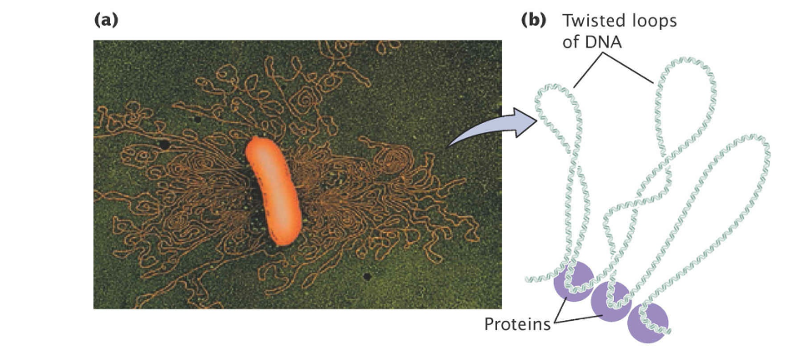
The Bacterial Chromosome
Most bacterial genomes consist of a single circular DNA molecule.
In circular bacterial chromosomes, the DNA does not exist in an open, relaxed circle; the 3 million to 4 million base pairs of DNA found in a typical bacterial genome would be much too large in this state to fit into a bacterial cell.
Unlike eukaryotic DNA, bacterial DNA is not attached to histone proteins, but bacterial DNA is associated with a number of proteins that help to compact it.
When a bacterial cell is viewed with an electron microscope, its DNA frequently appears as a distinct clump, called the nucleoid, which is confined to a definite region of the cytoplasm.
Many bacteria contain additional DNA in the form of small circular molecules called plasmids, which replicate independently of the chromosome.

Slide 4
Eukaryotic Chromosomes
Each eukaryotic chromosome consists of a single, extremely long linear molecule of DNA.
The chromosomes are in an elongated, relatively uncondensed state during interphase.
The packing of eukaryotic DNA is not static, but changes regularly in response to cellular processes.
CHROMATIN
Eukaryotic DNA in the cell is closely associated with proteins.
This complex of DNA and proteins is called chromatin.
The two basic types of chromatin are euchromatin, which undergoes the normal process of condensation and decondensation in the cell cycle, and heterochromatin, which remains in a highly condensed state throughout the cell cycle, even during interphase.
Euchromatin constitutes the majority of the chromosomal material and is where most transcription takes place.
All chromosomes have permanent heterochromatin (called constitutive heterochromatin) at the centromeres and telomeres; the Y chromosome also consists largely of constitutive heterochromatin.
Heterochromatin may also occur during certain developmental stages; this material is referred to as facultative heterochromatin.
Heterochromatin is characterized by a general lack of transcription, the absence of crossing over, and replication late in the S phase.

Slide 5
The most abundant proteins in chromatin are the histones, which are small, positively charged proteins of five major types: H1, H2A, H2B, H3, and H4.
All histones have a high percentage of arginine and lysine, positively charged amino acids that give the histones a net positive charge. These positive charges attract the negative charges on the phosphates of DNA; this attraction holds the DNA in contact with the histones.

Slide 6
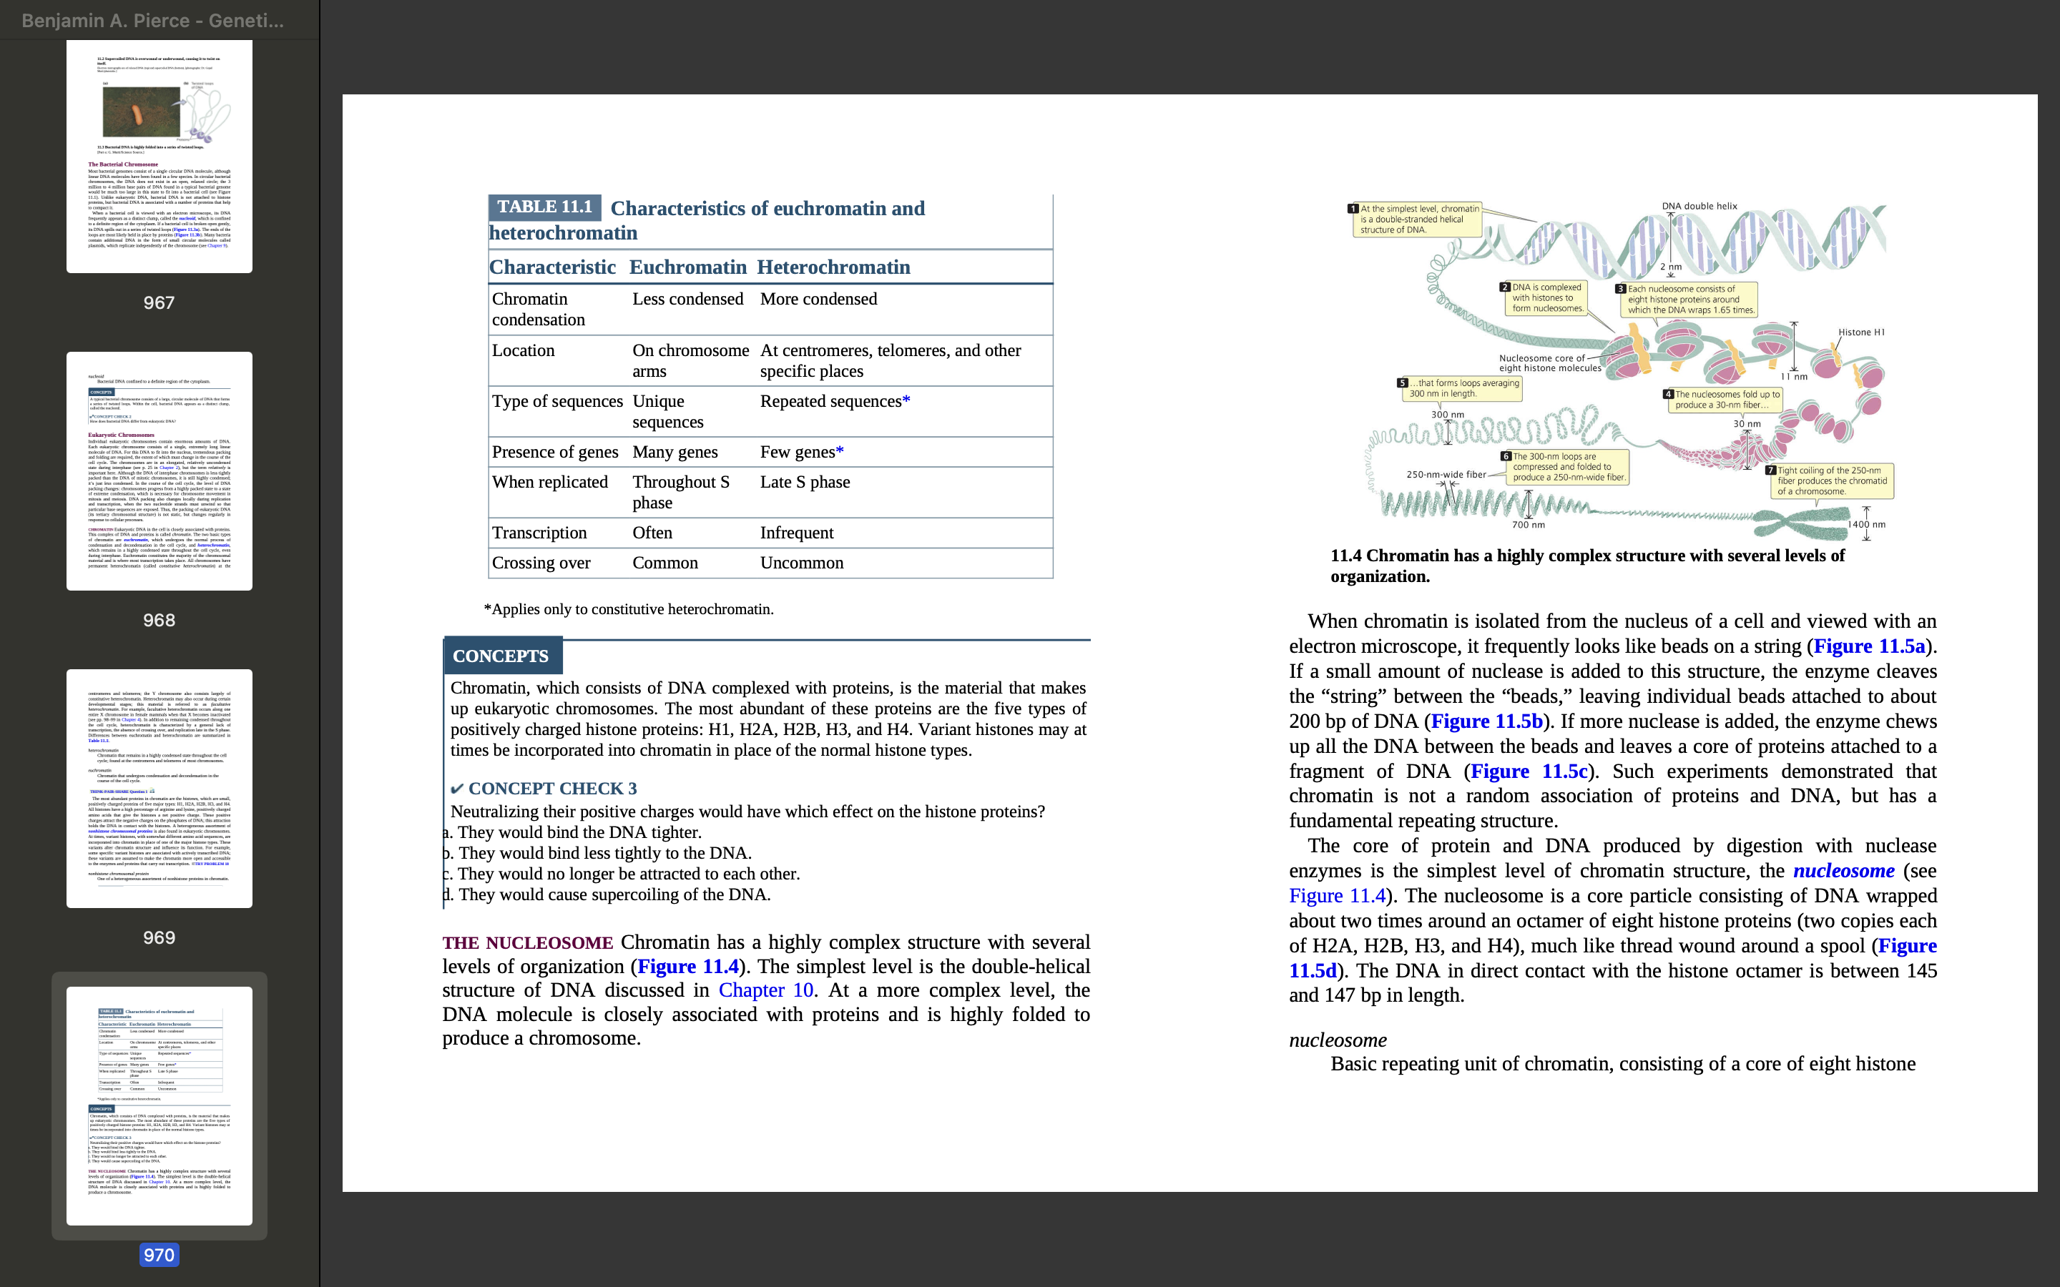
THE NUCLEOSOME
Chromatin has a highly complex structure with several levels of organization.
At a more complex level, the DNA molecule is closely associated with proteins and is highly folded to produce a chromosome.
When chromatin is isolated from the nucleus of a cell and viewed with an electron microscope, it frequently looks like beads on a string
The core of protein and DNA produced by digestion with nuclease enzymes is the simplest level of chromatin structure, the nucleosome.
The nucleosome is a core particle consisting of DNA wrapped about two times around an octamer of eight histone proteins (two copies each of H2A, H2B, H3, and H4), much like thread wound around a spool.
The DNA in direct contact with the histone octamer is between 145 and 147 bp in length.

Slide 7
The fifth type of histone, H1, is not a part of the nucleosome core particle, but plays an important role in nucleosome structure.
H1 binds to 20–22 bp of DNA where the DNA joins and leaves the histone octamer and helps to lock the DNA into place, acting as a clamp around the nucleosome.
Nucleosomes are located at regular intervals along the DNA molecule and are separated from one another by linker DNA, which varies in size among cell types; in most cells, linker DNA comprises from about 30 to 40 bp.
Although histone proteins are not present in bacteria, archaea have two types of histones that are similar to the H3 and H4 histones found in eukaryotes.

Slide 8
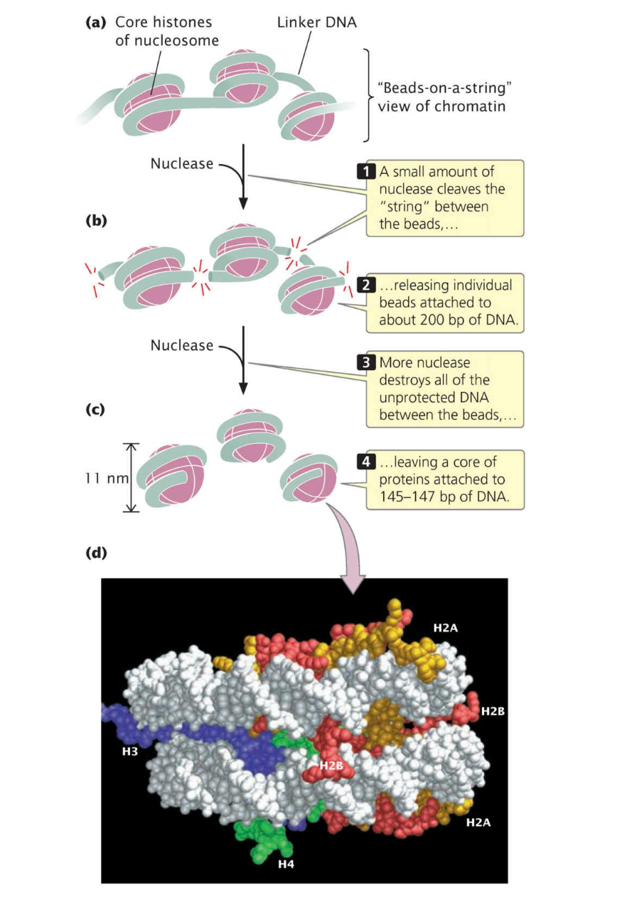

Slide 9
Eukaryotic Chromosomes Possess Centromeres
and Telomeres
Centromere Structure
The centromere, a constricted region of the chromosome, is the attachment site for the kinetochore and for spindle microtubules; this chromosome structure is necessary for proper chromosome movement in mitosis and meiosis
Telomere Structure
Telomeres are the natural ends of a chromosome
These telomeric sequences usually consist of repeated units of a series of adenine or thymine nucleotides followed by several guanine nucleotides
Repeating unit in human telomeres is 5′–TTAGGG–3′, which may be repeated from hundreds to thousands of times.
Special proteins bind to this G-rich single- stranded sequence, protecting the telomere from degradation and preventing the ends of chromosomes from sticking together.

Slide 10
The Denaturation and Renaturation of DNA
When double-stranded DNA in solution is heated, the hydrogen bonds that hold the two nucleotide strands together are weakened, and with enough heat, the two strands separate completely, a process called denaturation or melting.
The temperature at which DNA denatures, called the melting temperature (Tm), depends on the base sequence of the particular sample of DNA: G–C base pairs have three hydrogen bonds, whereas A–T base pairs have only two, so the separation of G–C pairs requires more heat (energy) than does the separation of A–T pairs.
The denaturation of DNA by heating is reversible: if single-stranded DNA is slowly cooled, single strands will collide and hydrogen bonds will form again between complementary base pairs, producing double-stranded DNA. This reaction is called renaturation or reannealing.
Two single-stranded molecules of DNA from different sources, such as different organisms, will anneal if they are complementary; this process is termed hybridization. For hybridization to take place, the two strands from the different sources do not have to be complementary at all their bases—just at enough bases to hold the two strands together.

Slide 11
The Mitochondrial Genome
In most animals and fungi, the entire mitochondrial genome exists on a single, double-stranded, highly coiled, circular DNA molecule, although there may be many copies of this genome in each cell. This circular mitochondrial DNA molecule is similar in structure to a bacterial chromosome.
Plant mitochondrial genomes often exist as a complex collection of multiple circular DNA molecules. Each mitochondrion contains multiple copies of the mitochondrial genome, and a cell may contain many mitochondria.
Like bacterial chromosomes, mtDNA lacks the histone proteins normally associated with eukaryotic nuclear DNA, although it is complexed with other proteins that have some histone-like properties. The guanine–cytosine (G–C) content of mtDNA is often sufficiently different from that of nuclear DNA that mtDNA can be separated from nuclear DNA by density-gradient centrifugation.
The sizes of mitochondrial genomes of most species range from 15,000 bp to 65,000 bp, but those of a few species are much smaller (e.g., the genome of Plasmodium falciparum, the parasite that causes malaria, is only 6000 bp), while those of some plants are several million base pairs.
The number of genes is more constant than genome size: most species have only 40–50 genes. These genes encode five basic functions: respiration and oxidative phosphorylation, translation, transcription, RNA processing, and the import of proteins into the cell. Most of the variation in the size of mitochondrial genomes is due to differences in noncoding DNA sequences.

Slide 12
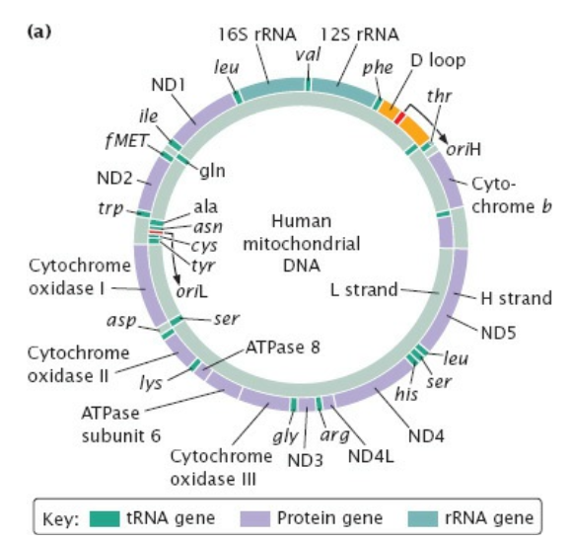
HUMAN mtDNA
Human mtDNA is a circular molecule encompassing 16,569 bp that encode 2 rRNAs, 22 tRNAs, and 13 proteins. The two nucleotide strands of the molecule differ in their base composition: the heavy (H) strand has more guanine nucleotides, whereas the light (L) strand has more cytosine nucleotides. The H strand is the template for both rRNAs, 14 of the 22 tRNAs, and 12 of the 13 proteins, whereas the L strand serves as the template for only 8 of the tRNAs and 1 protein. Human mtDNA is highly economical in its organization: there are few noncoding nucleotides between the genes, and almost all the mRNA transcribed from it encodes proteins. Human mtDNA also contains very little repetitive DNA. The one region of human mtDNA that does contain some noncoding nucleotides is the D loop.

Slide 13
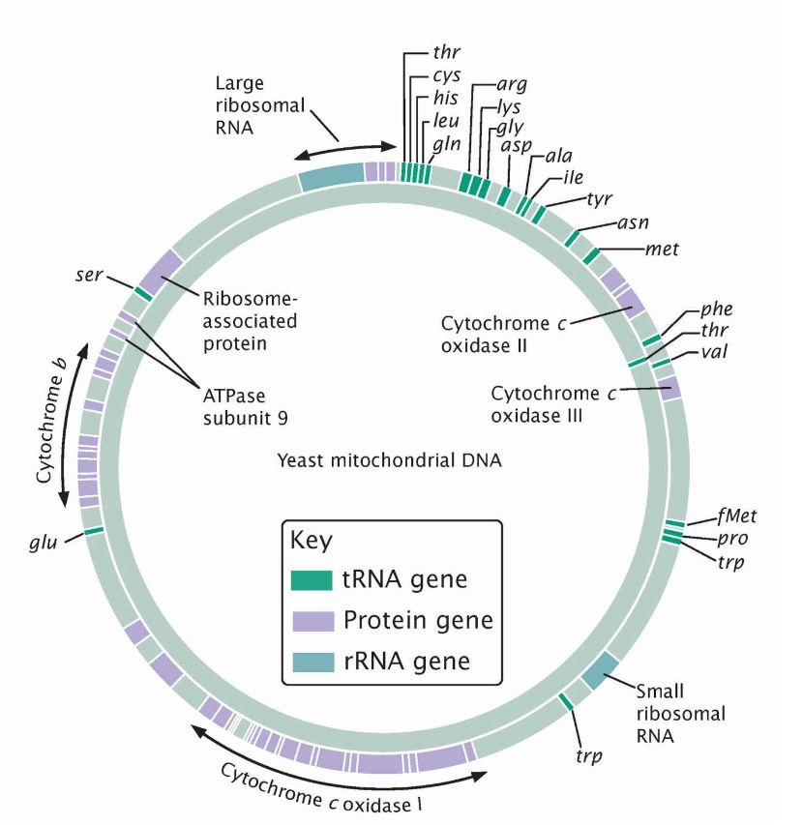
YEAST mtDNA
The organization of yeast (Saccharomyces cerevisiae) mtDNA is quite different from that of human mtDNA. Although the yeast mitochondrial genome, with its 78,000 bp, is nearly five times as large, it encodes only six additional genes, for a total of 2 rRNAs, 25 tRNAs, and 16 proteins. Most of the extra DNA in the yeast mitochondrial genome consists of noncoding sequences found within and between genes.

Slide 14
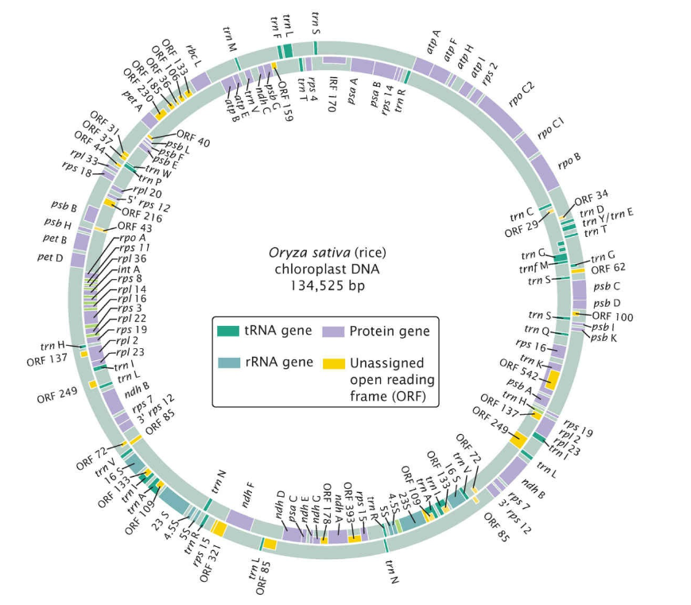
The Chloroplast Genome
Among plants, the chloroplast genome ranges in size from 80,000 to 600,000 bp, but most chloroplast genomes range from 120,000 to 160,000 bp. Chloroplast DNA is usually a single, double-stranded DNA molecule that is circular, highly coiled, and lacks associated histone proteins. As in mtDNA, multiple copies of the chloroplast genome are found in each chloroplast, and there are multiple organelles per cell, so there are several hundred to several thousand copies of cpDNA in a typical plant cell.

