Slide 1

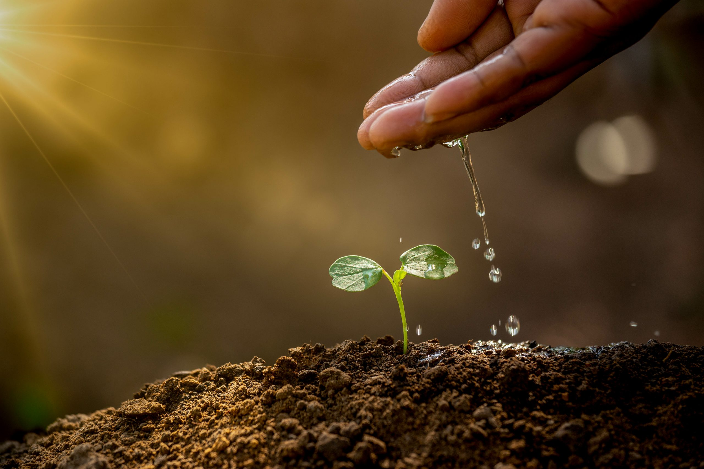
NATURAL RESOURCE MANAGEMENT
AND
SUSTAINABLE DEVELOPMENT
(VAC)

Slide 2
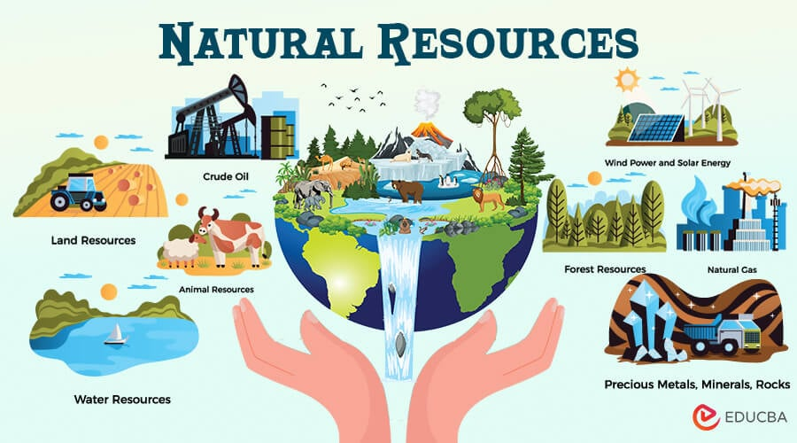
Natural Resources
Natural resources are materials and substances provided by nature, such as air, water, soil, plants, animals, sunlight, minerals, and fossil fuels, that are used by living things to survive and meet their needs.

Slide 3
Resource
A resource is anything that is naturally occurring or human-made and is used to satisfy human needs or wants. Resources can include things like water, minerals, forests, air, land, energy, and technology.
According to James.S. Fisher,resources are anything that can be used to satisfy a need or desire.”
According to Encyclopedia of Social Sciences, Vol 11,” resources are those aspects of man’s environment which facilitates the satisfaction of human wants and the attainment of social objectives.

Slide 4
Characteristics
Utility (Usefulness for human needs)
Scarcity (Limited availability relative to demand)
Renewability (Whether they replenish over time)
Accessibility (Ease of obtaining them)
Economic value (Monetary worth)

Slide 5
Types of resources
Resources
Natural resource
Human resource
Capital resource
Technological resource

Slide 6
Reserve
A reserve also known as potential resource refers to the portion of a natural resource that has been identified, surveyed, and is available for use with existing technology, but is deliberately left unused or underused.
These reserves are often preserved to ensure the sustainable use of resources for future generations, to protect the environment, or due to economic, legal, or strategic reasons.

Slide 7
Characteristics
Identified and Known:
Reserve resources are already discovered and their quantity and location are known through surveys and studies.
Technologically Usable:
These resources can be extracted or utilized with the existing technology.
Not in Immediate Use:
Although available, they are not currently being used due to economic, legal, environmental, or strategic reasons.

Slide 8
Environmentally or Legally Protected:
Some reserves are not used due to legal restrictions or environmental conservation efforts (e.G., Forest reserves, protected wildlife areas).
Supports Sustainable Development:
Helps in planning and managing resources sustainably by avoiding overuse and depletion.
Preserved for future use:
These are kept aside to ensure availability for future generations or in times of scarcity.

Slide 9
Factors influencing resource availability
Geographical distribution
-Resources are unevenly distributed across the earth due to natural processes.
-Eg: oil is abundant in the middle east, while some countries have rich coal deposits
Climate and Environmental Conditions
-Climate affects the availability of resources like water, forests, and agriculture.
-Eg: arid regions may lack freshwater or fertile soil.
Technological Development
-Advanced technology makes it easier to discover, extract, and utilize resources.
-Eg: deep-sea drilling technology has increased oil resource availability.
Economic Factors
-If extraction is too costly, a resource may be left unused even if it is available. Market demand and investment also influence availability.

Slide 10
Sustainable Management Practices
-Conservation, recycling, and responsible usage can improve long-term resource availability.
Natural Disasters and Environmental Degradation
-Events like earthquakes, floods, or deforestation can damage or destroy resources. Pollution can make resources like water or soil unusable.
Population Pressure
-High population leads to increased consumption and faster depletion of resources. It can also strain resource distribution.
Human Skills and Labor
-The availability of trained workers and human capital influences how effectively resources are used.

Slide 11
Resource Distribution in India and North-Eastern (NE) States
India is a country rich in a variety of natural resources, but their distribution is highly uneven due to its vast geographical diversity. The north-eastern (NE) states of india, though relatively small in area, are resource-rich, especially in terms of biodiversity, forests, and water resources.

Slide 12
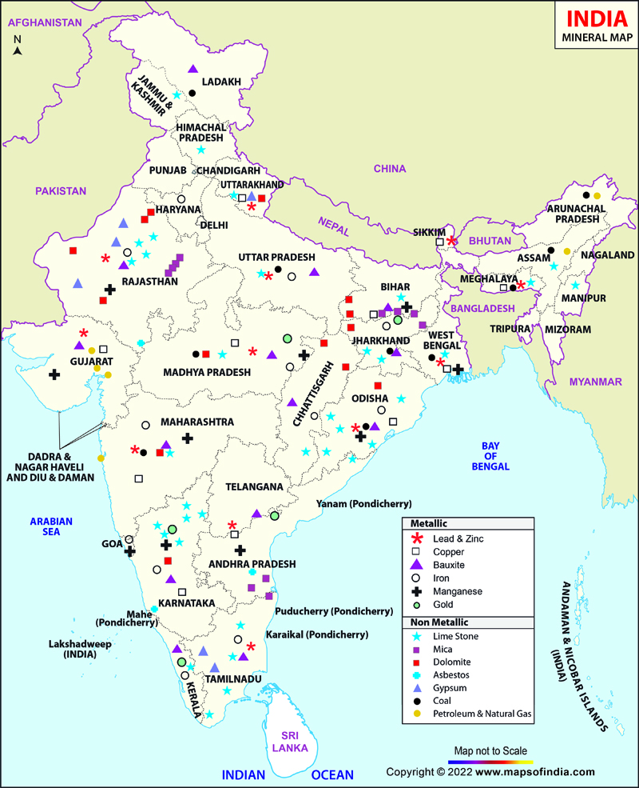

Slide 13
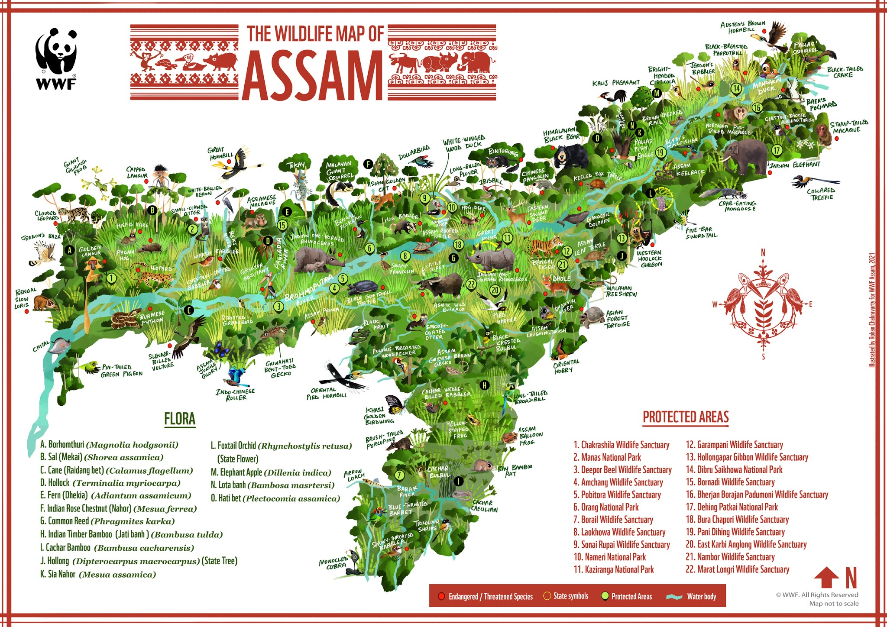

Slide 14
Resource Distribution in India
Jharkhand,odisha,Chhattisgarh-Rich in coal,iron ore,bauxite and uranium
Rajasthan-Limestone,copper,zinc,gypsum
Goa and Karnataka-Iron Ore
Maharashtra & Gujarat-Manganese,oil,natural gas
Minerals
Coal-Jharkhand,West Bengal,odisha,chattisgarh
Petroleum & Natural gas-Assam,Gujarat,Mumbai,Andhra Pradesh
Renewable Energy-Solar (Rajasthan,Gujarat),Wind (Tamil nadu,Maharashtra),Hydro (Himachal Pradesh,Uttarakhand,NE states)
Energy Resources

Slide 15
Forest resources
Water resources
Agricultural resources
Dense forests in Madhya Pradesh,Chhattisgarh,Odisha and NE states
Provide timber,medicinal plants and biodiversity
Indo-Gangetic plains-Fertile soil for wheat,rice,sugarcane
Southern India-Rice,millets,cotton,groundnut
NE states-Rice,tea,horticulture,spices
Northern rivers (Ganga,Yamuna) and peninsular rivers (Godavari,Krishna) used for irrigation and hydropower
North-eastern rivers (Brahmaputra and tributaries) have vast hydro potential.

Slide 16
Resource Distribution in North-Eastern States (NE India)
The NE region includes 8 states: Assam, Arunachal Pradesh, Meghalaya, Manipur, Mizoram, Nagaland, Tripura, And Sikkim.
Mineral Resources:
  Assam: Oil and natural gas (digboi, duliajan), coal, limestone.
  Meghalaya: Limestone, coal, uranium (exploration stage).
  Nagaland & Arunachal Pradesh: Small deposits of coal, petroleum, and minerals.

Slide 17
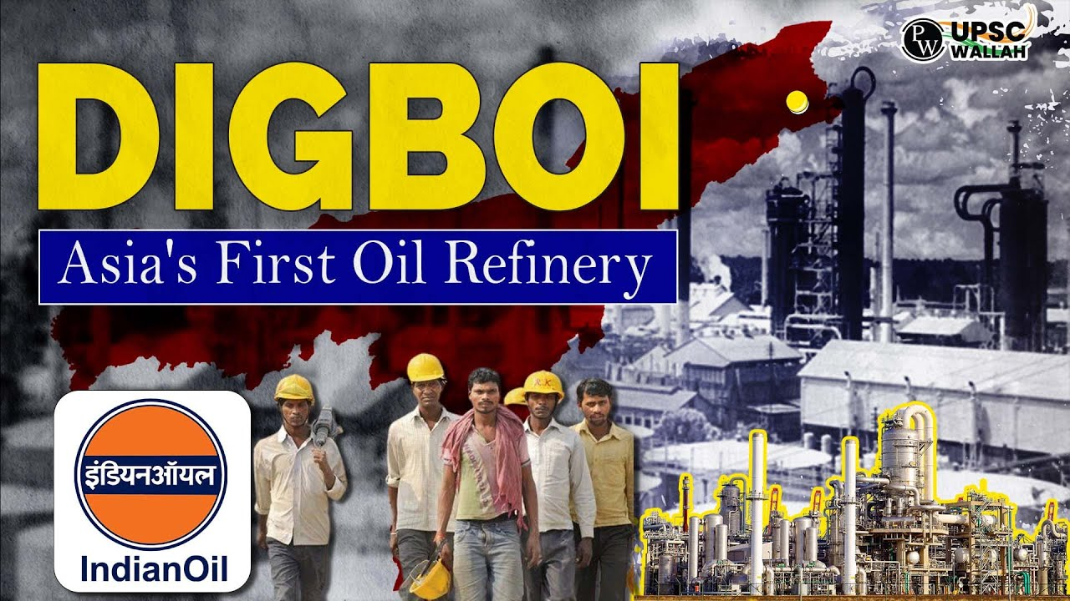
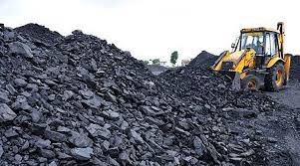

Slide 18
Forest Resources:
Around 60–80% of land area is under forest cover in most NE states.
Rich in timber, bamboo, medicinal plants, and biodiversity.
Important for the local economy and traditional practices.
Water Resources:
The Brahmaputra River and its tributaries provide vast hydropower potential (e.g., Subansiri and Dibang projects).
Used for irrigation, drinking water, and navigation.

Slide 19
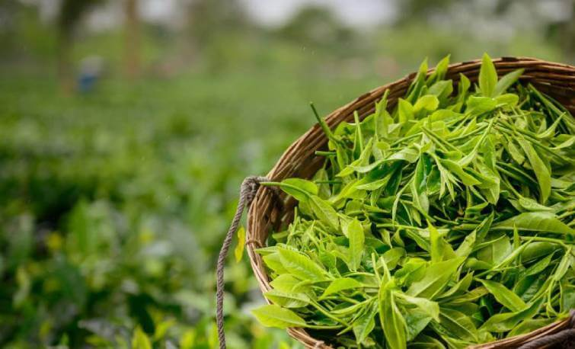
Agricultural Resources:
  Assam: Tea, Rice, Jute, Sugarcane.
  Other states: Horticulture (Pineapple, Oranges, Banana), Spices, And Traditional Crops Using Shifting Cultivation (Jhum).
Energy Resources:
  Hydropower potential is high due to hilly terrain and rainfall.
  Oil and Gas in Assam and Arunachal Pradesh.
  Growing focus on small hydel and solar projects.

Slide 20
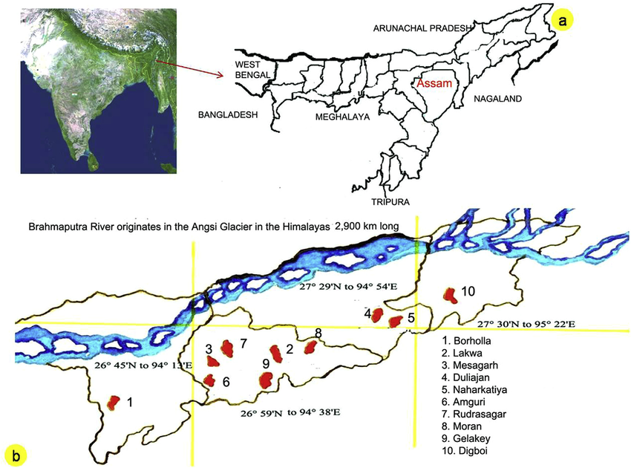

Slide 21
