Slide 1

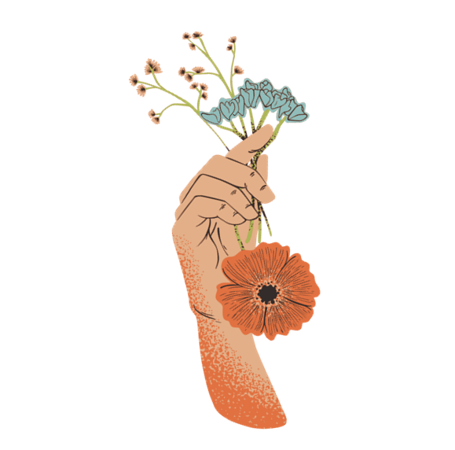

PERSONALITY,
SELF
&
FASHION

Slide 2
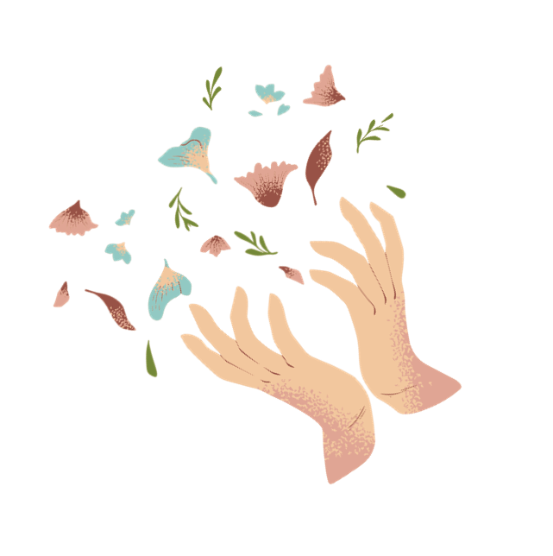
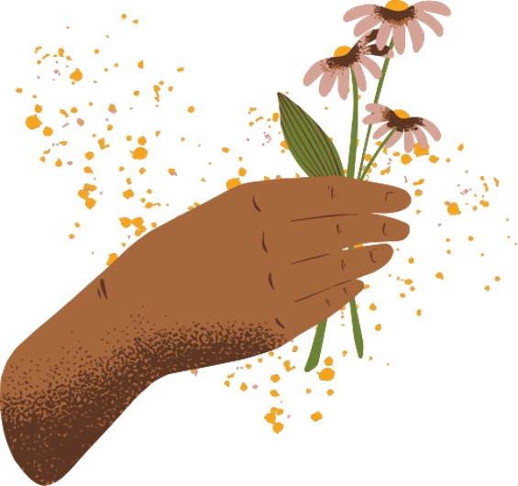
Choosing your outfit isn’t picking a costume, it’s closer to selecting your operating system for the day. The clothing you put on actively shapes how you think, not just how others perceive you.

Slide 3

Personality
A characteristic way of thinking, feeling, and behaving. Personality embraces moods, attitudes, and opinions and is most clearly expressed in interactions with other people.
It includes behavioural characteristics, both inherent and acquired, that distinguish one person from another and that can be observed in people’s relations to the environment and to the social group.
It is relatively stable over time and influences preferences, decisions, and lifestyle choices. Example traits: confident, shy, creative, practical, stylish, bold.

Slide 4
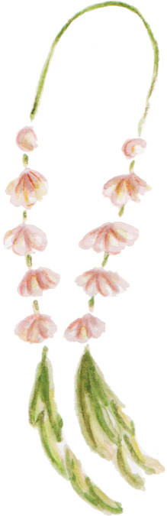
How Personality Affects Clothing Choices??
Expression of Traits
  Confident people often wear bright colors or trendy clothes.
  Shy people may prefer simple, plain, or comfortable outfits.
  Creative people experiment with new styles, patterns, or accessories.
  Practical people choose clothes that are useful, durable, and easy to wear.
Identity & Image
  Clothes show who we are and how we want others to see us.
  Example: A teacher may wear formal clothes to look professional, while a student may wear casual clothes to look relaxed.
Mood & Feelings
  Personality influences how emotions are shown through clothing.
  Happy or energetic people may wear colorful outfits, while serious personalities may prefer darker shades.
Consistency in Style
  Personality makes people stick to certain styles.
  A minimalist person always chooses simple designs, while a flamboyant person loves bold fashion.
“Clothes are a mirror of personality. They help us express traits, identity, mood, and style without speaking.”

Slide 5

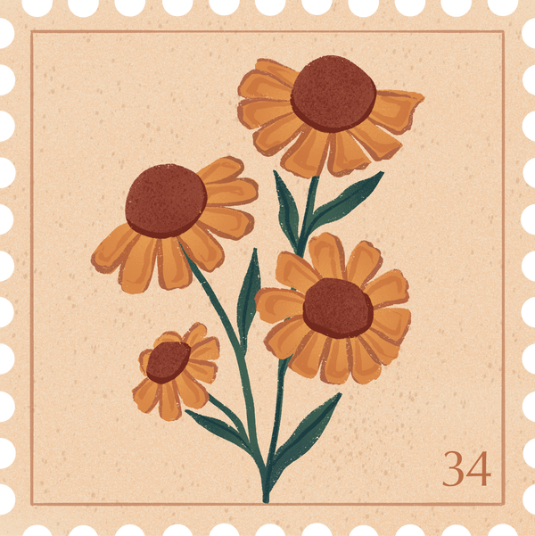

Self-concept
Self-concept is the perception and understanding a person has of themselves—their identity, values, and social roles.
Connection to Clothing:
  People dress in ways that reinforce their identity (e.g., a teacher choosing formal attire to project authority).
  Fashion choices help individuals align with their desired image—professional, casual, rebellious, or elegant.
Example: A student who sees themselves as modern and tech-savvy may prefer smart casual or branded clothing to reflect that identity.

Slide 6
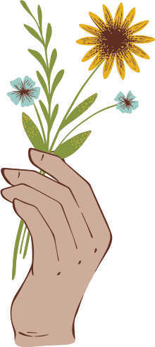
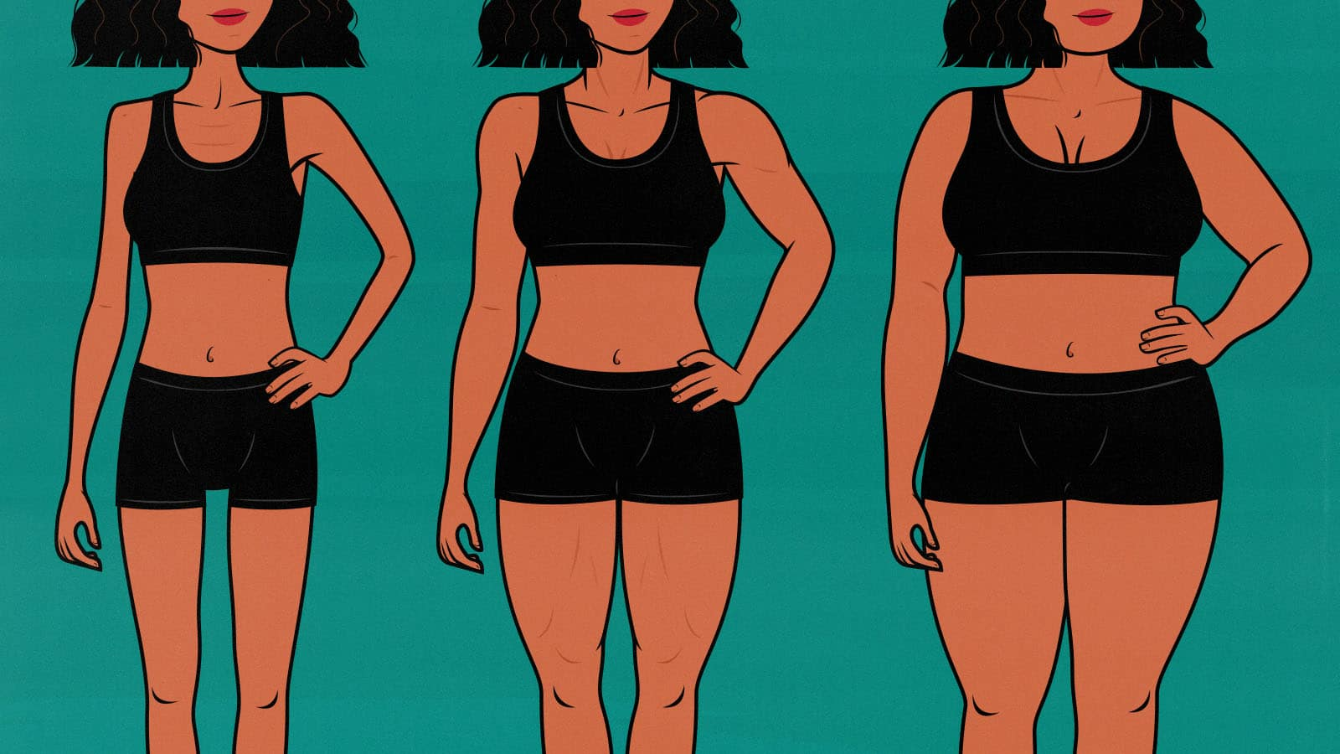
Body Image
Body image is how a person sees, feels, and thinks about their own body.
It includes confidence, satisfaction, and comfort with appearance.
Example: Two people of the same size may feel differently—one proud, one insecure.

Slide 7
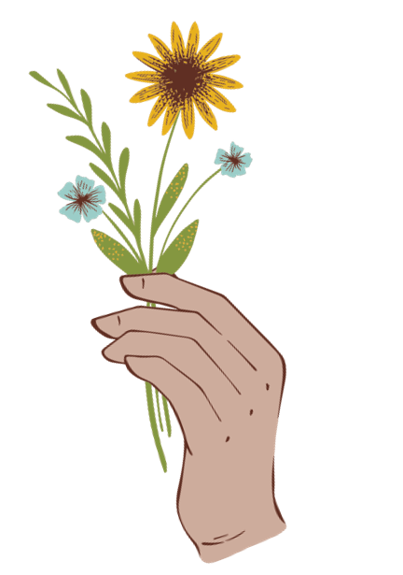
Role of Fashion & Clothing
Positive Body Image
  People feel confident and happy with their looks.
  They choose clothes freely, experiment with styles, and enjoy fashion.
  Example: Wearing fitted or colorful outfits without hesitation.
Negative Body Image
  People feel dissatisfied or insecure about their body.
  They avoid certain styles, prefer loose clothes, or use fashion to hide features.
  Example: Choosing oversized clothes to cover shape.
Clothing as a Tool
  Fashion can enhance body image by highlighting strengths and balancing proportions.
  Example: Vertical stripes make a person look taller; darker shades can make someone feel slimmer.
  Clothes also provide comfort and psychological security.

Slide 8
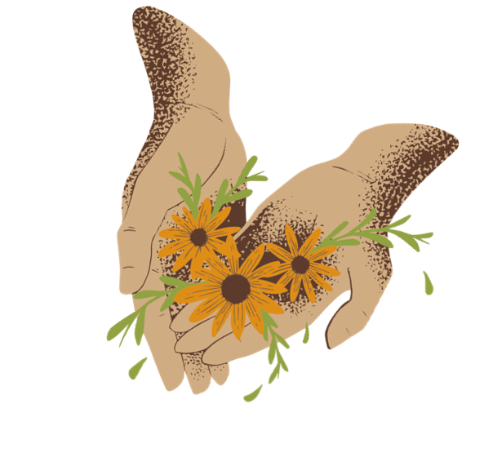

Boosting Confidence
  Clothes can make people feel good about themselves.
  Example: A well‑fitted outfit can highlight strengths and increase self‑esteem.
Hiding Insecurities
  People with negative body image may use clothing to cover or conceal.
  Example: Loose or oversized clothes to hide shape.
Enhancing Features
  Fashion helps balance body proportions.
  Example: Vertical stripes make a person look taller; darker shades can make someone feel slimmer.
Expressing Comfort & Identity
  Clothing allows individuals to feel secure and show who they are.
  Example: Choosing styles that match personality while also making them feel comfortable in their body.

Slide 9
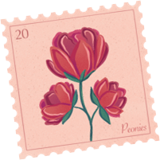

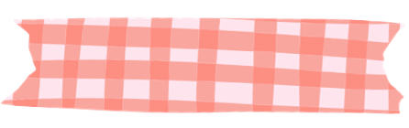
Big Five Theory of Personality
The Big Five theory of personality is a major psychological model that explains human personality using five broad traits. The Big Five theory shows that fashion is a reflection of personality traits, shaping how people dress, express themselves, and interact socially. It is often remembered by the acronym OCEAN:
Openness → Fashion as creativity.
Conscientiousness → Fashion as discipline.
Extraversion → Fashion as confidence.
Agreeableness → Fashion as harmony.
Neuroticism → Fashion as comfort/security.

Slide 10
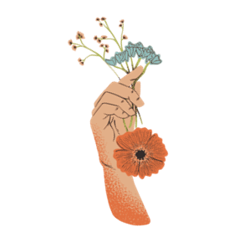


Openness to Experience
People high in openness are imaginative, curious, and creative. In fashion, they often experiment with bold styles, unusual cuts, and artistic designs. Clothing becomes a way to express originality and explore new trends. For example, they may mix traditional wear with modern accessories or try eco‑friendly fashion to reflect their values.
Conscientiousness
Conscientious individuals are organized, disciplined, and responsible. Their clothing choices reflect neatness and professionalism. They prefer well‑structured outfits, classic styles, and polished looks that signal reliability. For instance, a conscientious person may consistently choose formal wear or clean, simple designs that show order and self‑control.

Slide 11



Extraversion
Extroverts are sociable, energetic, and outgoing. They use fashion to attract attention and project confidence. Their wardrobes often include bright colours, trendy outfits, and statement accessories. For example, an extrovert may wear bold prints or fashionable brands to stand out in social gatherings and express their lively personality.
Agreeableness
Agreeable people are warm, cooperative, and empathetic. Their clothing choices are modest, comfortable, and socially harmonious. They avoid extremes and prefer styles that make others feel at ease. For example, soft fabrics, pastel colours, and approachable casual wear reflect their friendly and caring nature.

Slide 12
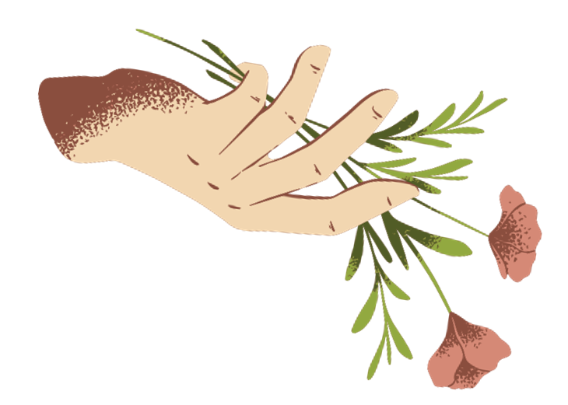



Neuroticism
Individuals high in neuroticism may feel anxious, insecure, or emotionally unstable. Their fashion choices often lean toward safe, neutral, or comfort‑oriented clothing. They may avoid bold styles and prefer outfits that provide psychological security. For instance, loose fits, darker shades, or understated designs help them feel more comfortable and less exposed.

